Slide 1
The Gaia Portal brought to you by the GENIUS Project
WP7 REVIEW
GENIUS final advisory board meeting, March 27th

Slide 2
Outline
Gaiaverse Roadmap
The Gaiaverse Portal
1.1. Website evolution
1.2. Top 10 most visited pages
1.3. Traffic channels
1.4. Country and Language
Gaiaverse Twitter Profile
2.2. Twitter Analytics

Slide 3
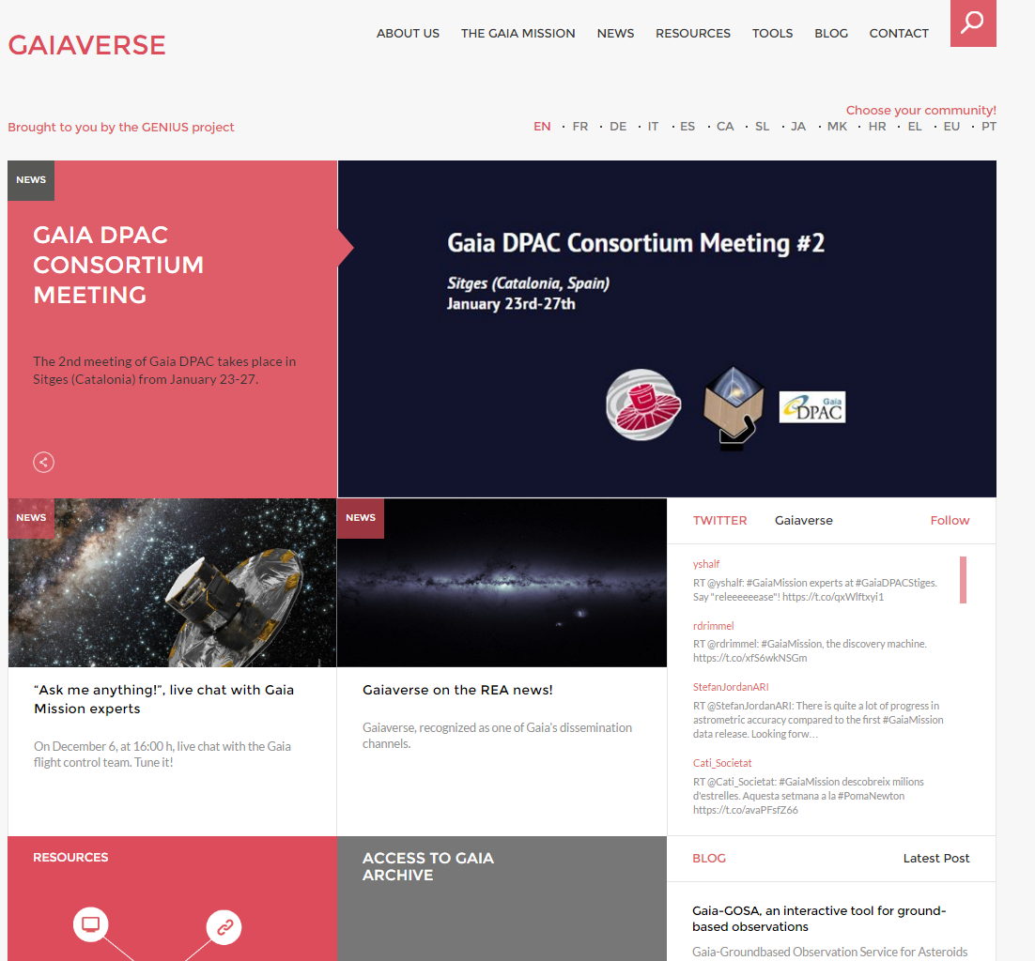
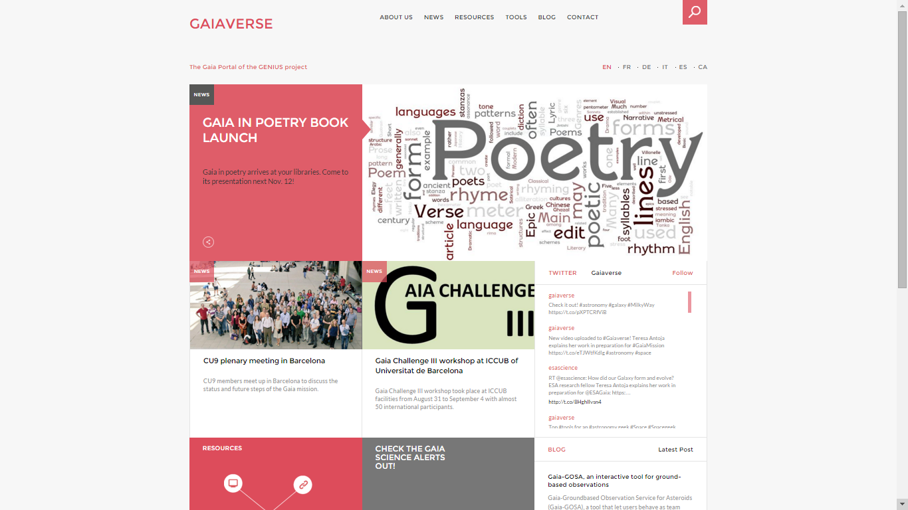
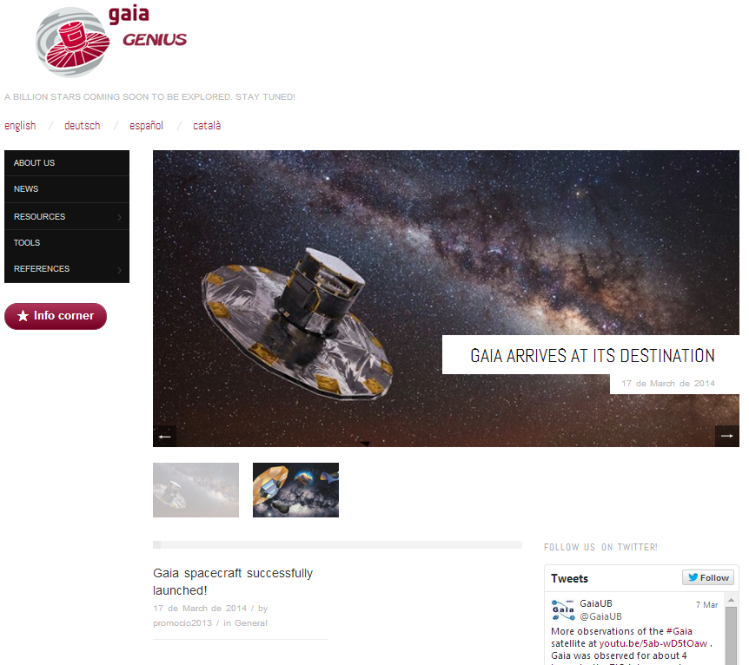
Roadmap
Roadmap
31/03/17
Handover to the Gaia community
14/9/16
DR1
EU PT and DR1 new pages
1/1/16
More languages
SL JA MK HR EL
8/7/15
Gaiaverse launch
EN FR DE IT ES CA
1/9/14
New portal development
1/6/14
Editorial Board
28/3/14
1st portal version
11/2/14
Survey
1/2/14
1st platform
awindowtotheuniverse.csuc.cat
genius-project.csuc.cat
4/12/13
KOM
10/11/13
Tech. note

Slide 4
1. The Gaiaverse Portal
Homepage Menu:
About Us
The Gaia Mission
News
Resources
Tools
Blog
Contact
Homepage Boxes:
Highligthed News Article (+2 additional articles)
Twitter Timeline
Resources
Link to the Gaia Catalogue
Link to the Official Gaia Mission Website
Link to the Gaia Science Alerts
Blog

Slide 5
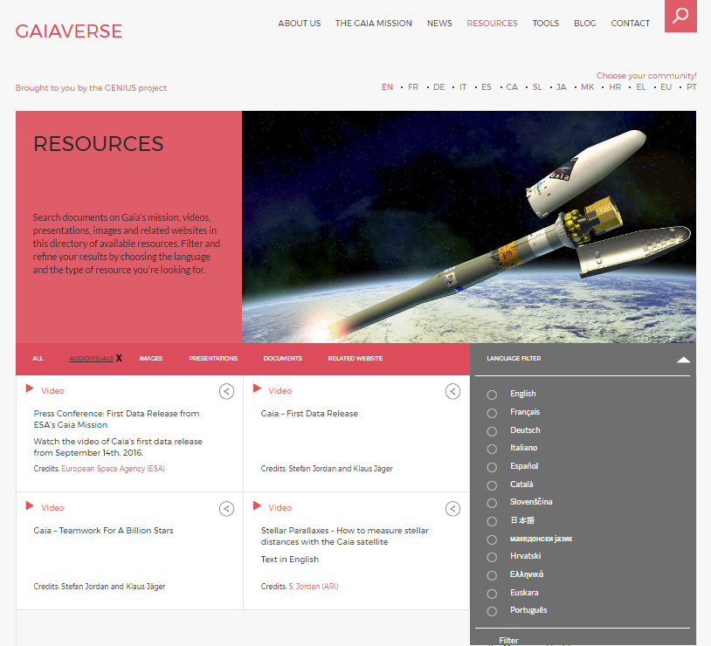

Slide 7
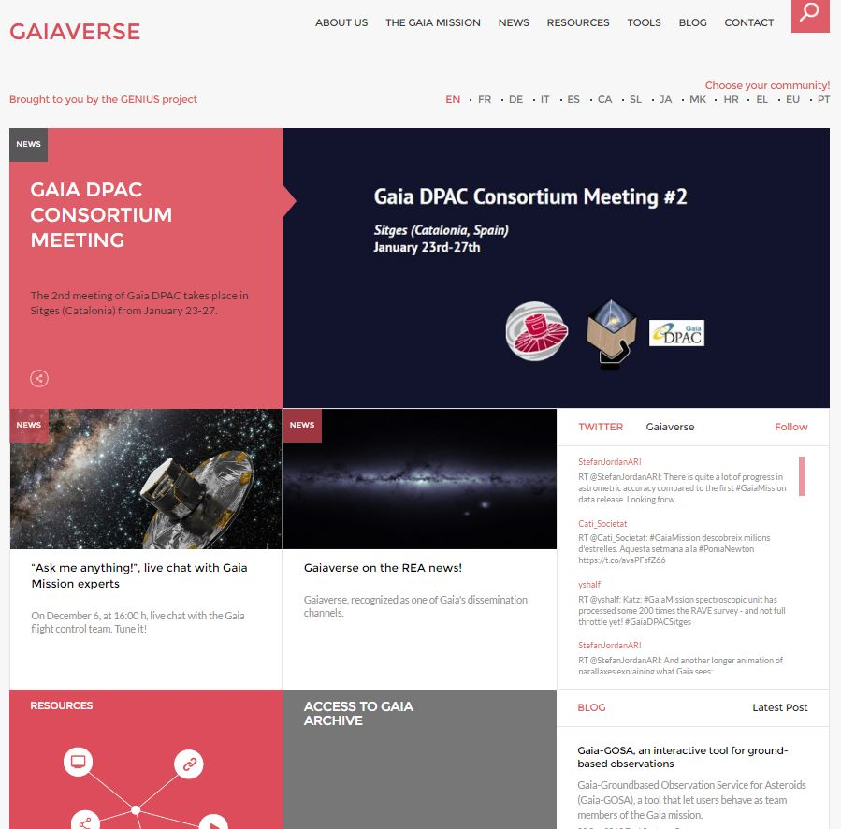
1. The Gaiaverse Portal
Released on July 8, 2015
13 Languages (6+5+2)
20 Collaborators
>9,000 Sessions
>6,200 Users
69% New Visitors
31% Returning Visitors
>22,771 Page Views
2.51 Pages/Session
00:02:40 Avg. Session Duration
Notes:
Languages (13):
July 2015: English, Spanish, Catalan, German, Italian and French.
January 2016: Slovene, Japanese, Croatian, Macedonian, Greek.
September 2016: Portuguese, Euskera.
Period: July 8, 2015 – January 23, 2017

Slide 8
1.1. Website evolution
1st Gaia Data Release
DR1 page + Direct access to Gaia Archive
>1,000 Visited Pages
2.55 Pages/Session
Gaia’s 1st year of scientific observations
Notes:
First peak (Sept./Oct. 2015) coincides with Gaia’s first year of scientific observations: we published a news post. On the blog part, Toni Santana wrote a post talking about Gaia-GOSA, which got great feedback (many visitors went to Gaiaverse to read this post).
Second peak is on Sept. 14 and following days, coinciding with the first Gaia Data Release, with new pages available dedicated to such release and direct access to the catalogue.

Slide 9
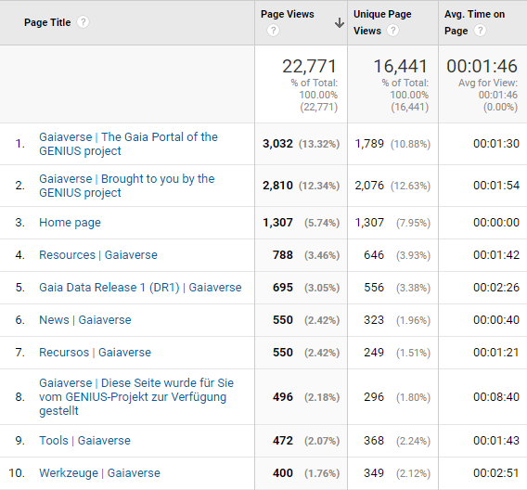
1.2. Top 10 most visited pages

Slide 10
1.3. Traffic Channels
85.44%
9.29%
3.70%
Others
1.57%

Slide 11
1.4. Country and Language

Slide 12
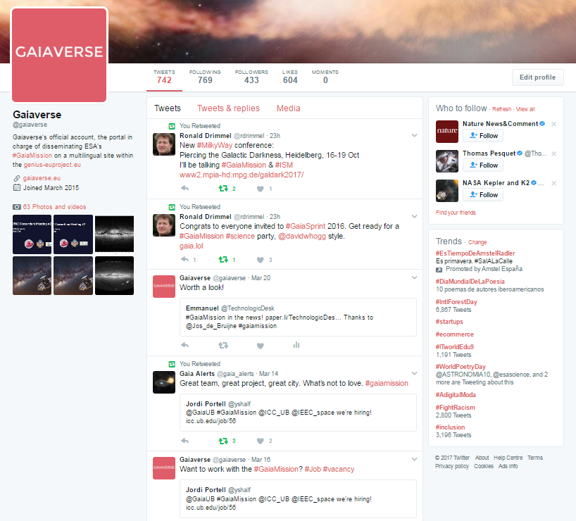
2. Gaiaverse Twitter Profile
+430 Followers

Slide 13
2.1. Twitter Analytics

Slide 14
2.2. Twitter Analytics

Slide 15
2.3. Twitter Analytics
Gender
+5%
Age
Notes:
Organic audience includes the set of users who have interacted with organic content (= naturally shown in people’s feeds) belonging to Gaiaverse.

Slide 16
2.4. Twitter Analytics
Country
Language

Slide 17
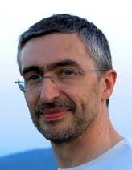
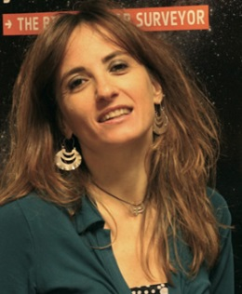
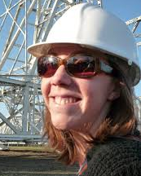
Editorial Board
Frédéric Arenou
Eduard Masana
Gráinne Costigan
Mariateresa Crosta
Heather Campbell
Notes:
After the plenary meeting in Vienna, an editorial team was created
Editorial Team: high-level supervision of the portal contents
Anthony Brown suggested this group to be a subset of the outreach team within DPAC
Members: Frederic Arenou -Paris-, Anthony Brown -Leiden- (Gráinne Costigan), Mariateresa Crosta -Itàlia-, Heather Campbell -Cambridge- and Eduard Masana)

Slide 18
List of collaborators
André Moitinho (PT)
Márcia Barros (PT)
Sónia Antón (PT)
Angela Kochoska (MK)
Antonios Karampelas (EL)
Catherine Turon (FR)
Danijela Birko (HR)
Frédéric Arenou (FR)
George Seabroke (EN)
Gráinne Costigan (FR)
Heather Campbell (EN)
Josep M. Carrasco (blog)
Maider Insausti (EU)
Maria Teresa Crosta (IT)
Marusa Zerjal (SL)
Ryoichi Nishi (JP)
Stefan Jordan (DE)
Tomaz Zwitter (SL)
Toni Santana-Ros (blog)
Yoshiyuki Yamada (JP)

Slide 19
THANK YOU!
Comments? Questions?

