Slide 1


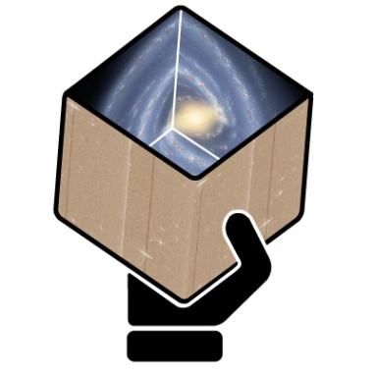
GENIUS
Final Report
for WP3:
aspects of archive system design
Nigel Hambly
Institute for Astronomy, Edinburgh University

Slide 2
WP3 Description
  From the GENIUS proposal:
“The objective of this work package is to design, prototype and develop aspects of the archive infrastructure needed for the scientific exploitation of Gaia data. The design and technology choices made will be motivated by the real user requirements identified by WP2 – in particular, the massive, complex queries defined by the Grand Challenges – and by other initiatives, such as the GREAT project, and will be made with full recognition of the constraints imposed by the ESAC archive system, with which it must interface effectively. Prototypes will be prepared and tested in cooperation with the end user community and with the ESAC science archive team through the DPAC CU9. A core principle will be the adoption of Virtual Observatory standards and the development of VO infrastructure to enable ready interoperation with the other external datasets needed to release the full scientific potential of Gaia.”

Slide 3
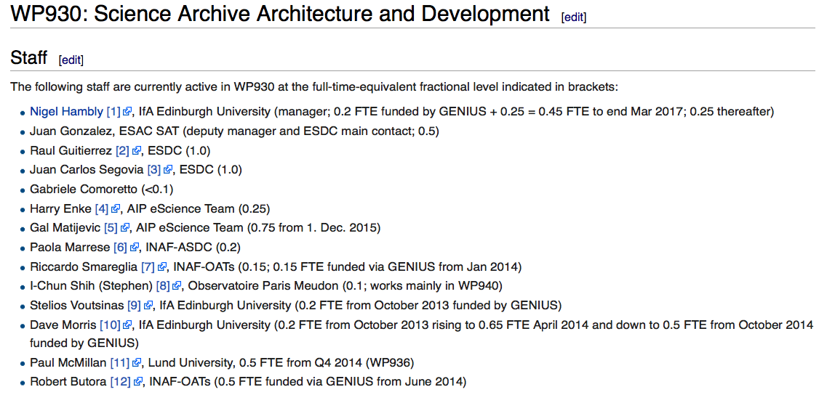
GENIUS WP3 in DPAC CU9 WP930
=> 1.8 (out of total of 6.1) FTE to end of March 2017

Slide 4
Work Breakdown Structure
  T3.1: Technical Co-ordination
    System Requirements Specification
    Systems Interface Control: ICDs
  T3.2: Aspects of Archive (end-user) Interface Design
    Subsystems interface infrastructure (affecting end-user experience)
    Enhanced features for User Interfaces
  T3.3: VO Infrastructure
    Client-side “Table Access Protocol” (TAP) tool
    International Virtual Observatory Alliance (IVOA) work
  T3.4: Data Centre Collaboration
    Distributed Query Processing (DQP) infrastructure
  T3.5: Cloud-based Research and Data Mining Environments
    Virtual Machines and containerisation

Slide 5
T3.1: Technical Co-ordination
  Good communication channels
    On-line collaborative tools (Wiki, SVN, teleconferencing)
  Requirements Specification
    SRS documented (Milestone MS6)
  Formal interface control established
    e.g. DQP ICD (Deliverable D3.1)
and ensures good coordination between the 20 individuals involved in DPAC CU9 WP930 (presently a total of 6.1 FTE with 2.5 FTE at ESDC, 1.8 FTE national funding agencies and 1.8 FTE currently resourced via GENIUS in WP3)

Slide 6
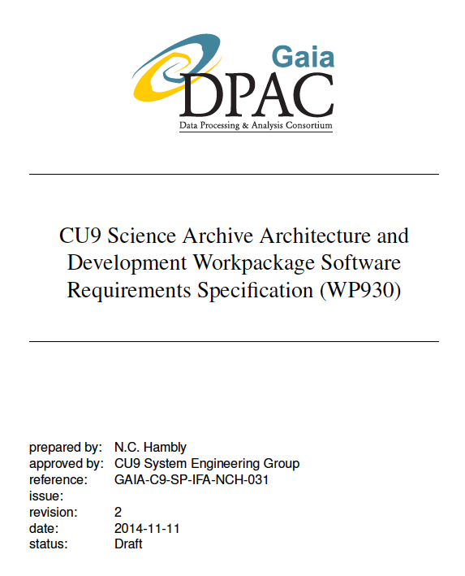
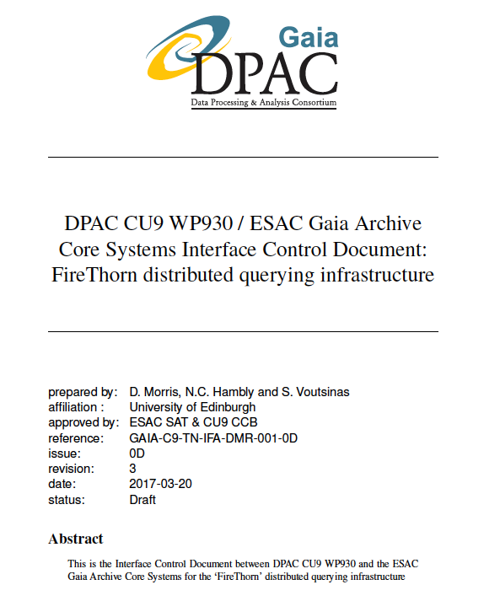
T3.1 (cont.): Integration with DPAC
GENIUS
Deliverable D3.1

Slide 7
T3.2: Aspects of Archive Interface Design
  End-user experience depends on propagation of relevant information through the system
  Primary mechanism for interface specification within DPAC is a data model “Dictionary Tool”
  Some key infrastructural features missing from the GENIUS/CU9 perspective
    Concentrated on these before proceeding any contributions to the User Interface itself
  Gaia archive UI enhancements

Slide 8
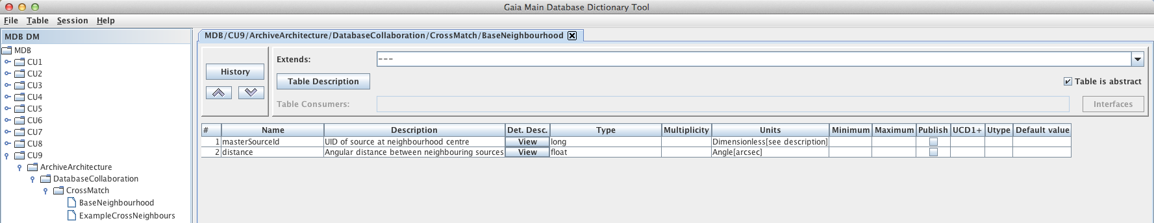
T3.2 (cont.): Dictionary Tool enhancements
  New metadata fields
  Additional propagation features
    Ensure UIs contain all necessary information
  New version of tool released Q2 2016
    In good time for DR1 developments

Slide 9
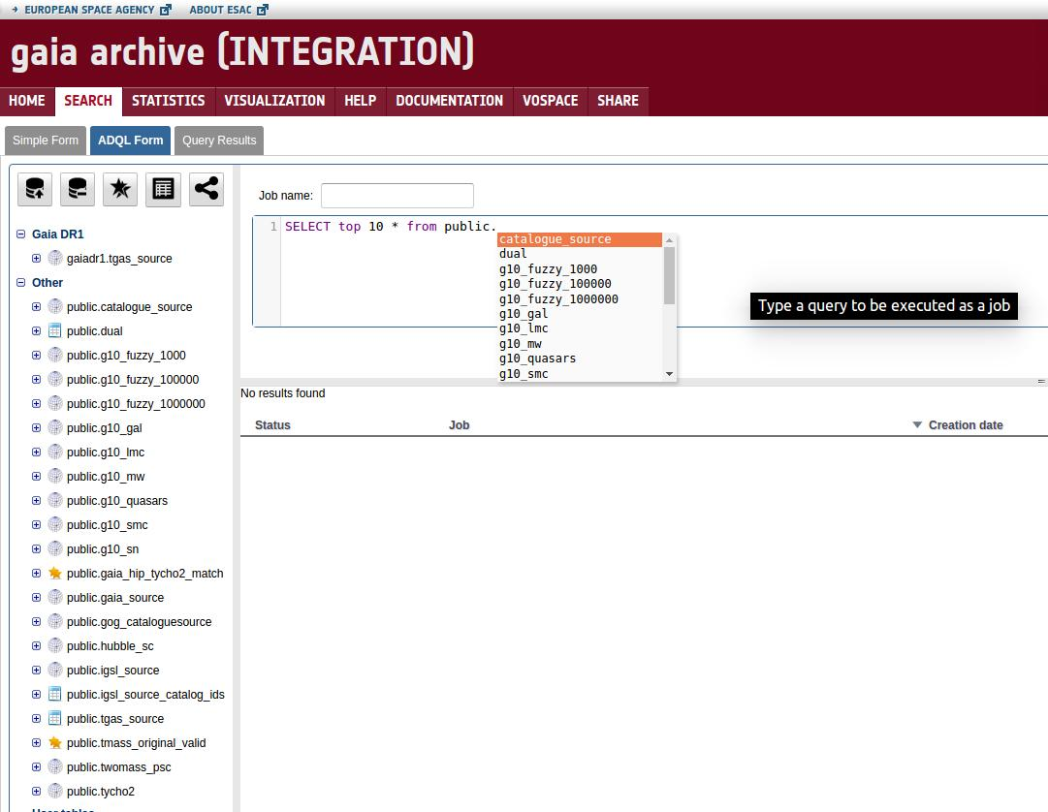
T3.2 (cont.): Gaia archive UI enhancements
  Auto-complete identified under beta-testing as a “nice-to-have” feature
GENIUS
Deliverable D3.4
Will appear in next
release of GACS

Slide 10
T3.3: VO Infrastructure
  VO-Dance, a client-side integration tool
    Allowing the end-user to publish to the VO
  IVOA activities
    ADQL standards
    ADQL parser enhancements
  VO support
    Coordination of content descriptors (UCD1+)
    ADQL Cookbook in support of GDR1
    VO Compliance Document

Slide 11
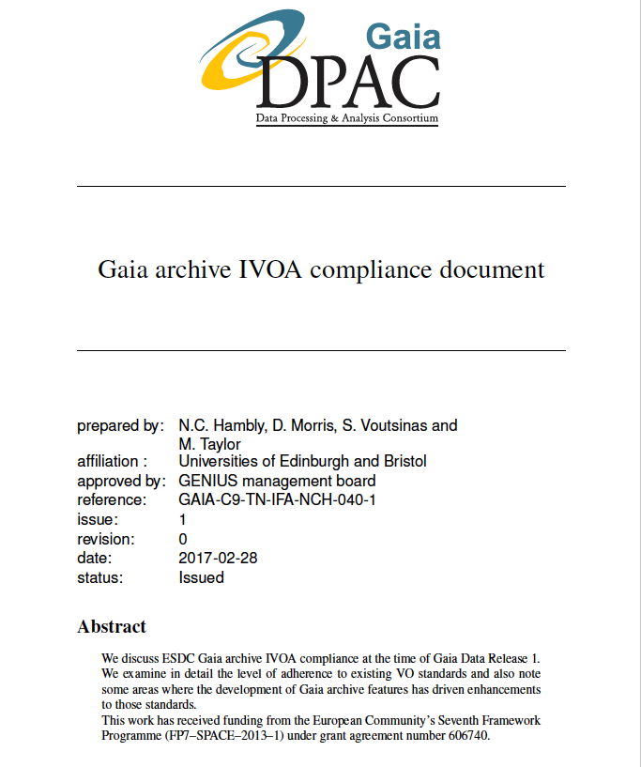
GENIUS
Deliverable D3.3

Slide 12
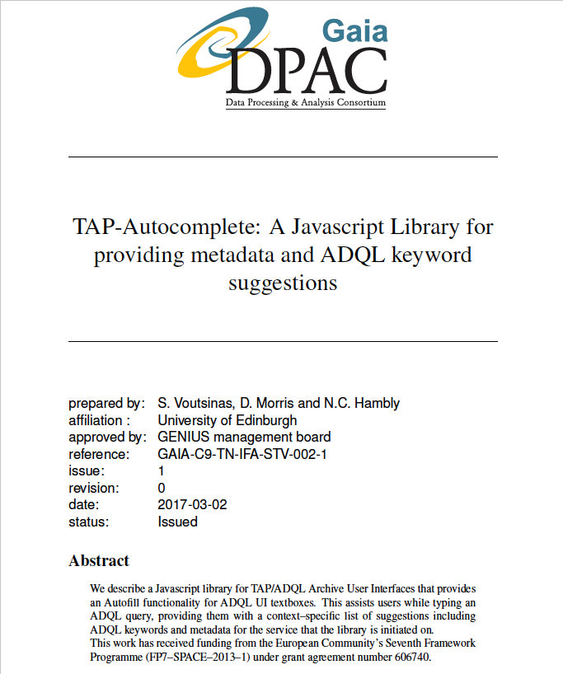
GENIUS
Deliverable D3.4

Slide 13
T3.3 (cont.): VO Infrastructure
✔ ✔ ✔
http://ia2.inaf.it/index.php/14-projects/39-eu-genius
GENIUS
Deliverable D3.4

Slide 14
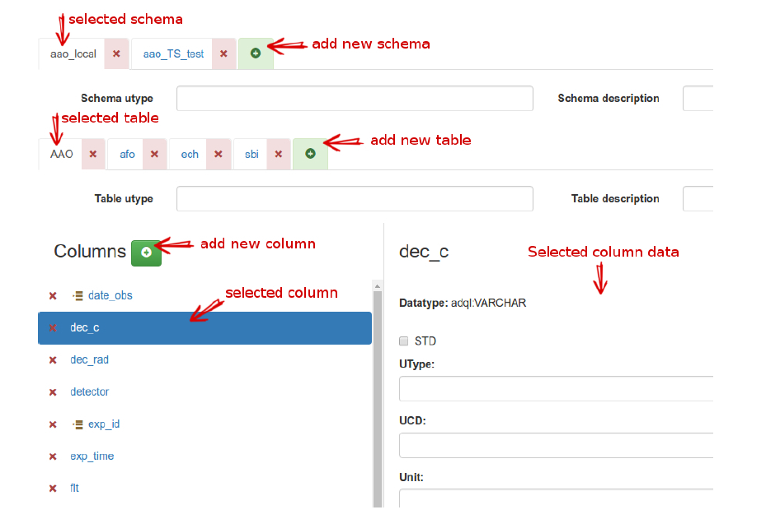
e.g. TAP Schema editing via IA2TAP GUI application

Slide 15
T3.4: Data Centre Collaboration
  Archive test suite
  Recurring theme in requirements analysis is one of use of Gaia data in conjunction with other surveys:
    Multiple wavelengths
    Multiple epochs
    Combination of primarily astrometric data with other surveys/missions
  Distributed Query Processing is required

Slide 16
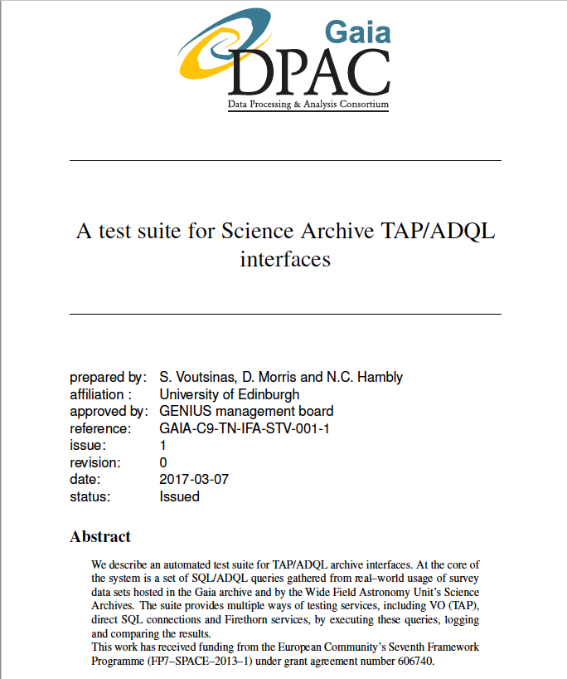
T3.4 (cont.): archive test suite
β-testing
Stress-testing
GENIUS:
Deliverable D3.5, but also covers in part
  Milestone MS9
  Deliverables D3.4 and 3.6

Slide 17
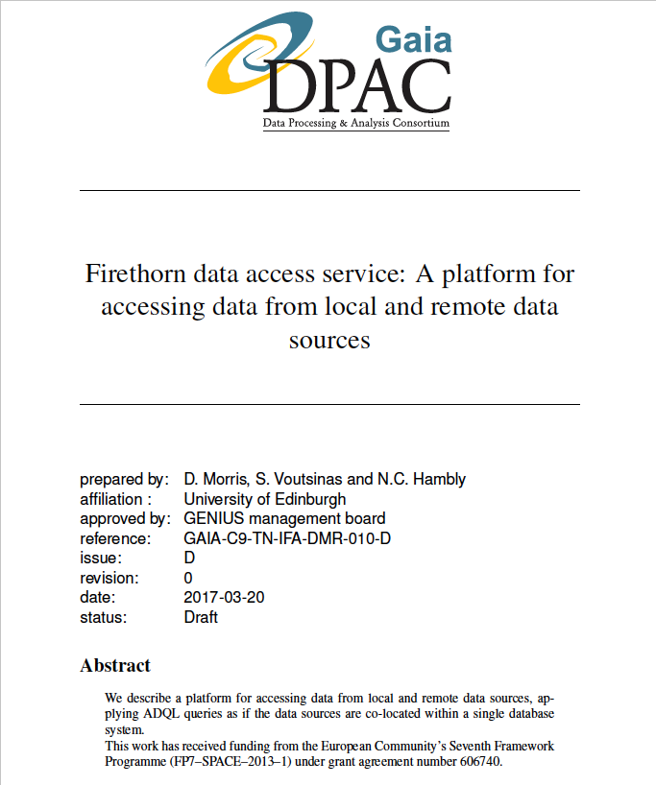
T3.4 (cont.): Distributed Query Processing
GENIUS:
Deliverable D3.6

Slide 18
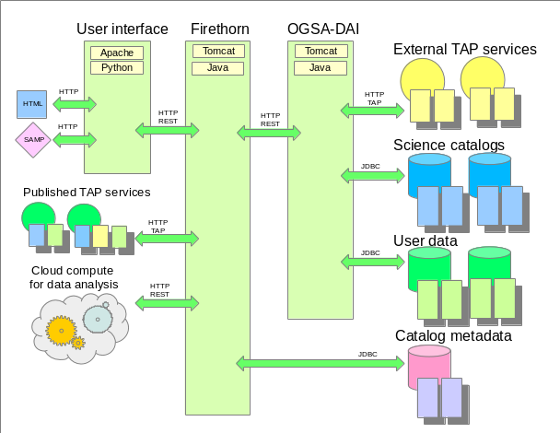
T3.4 (cont.): DQP under the hood

Slide 19
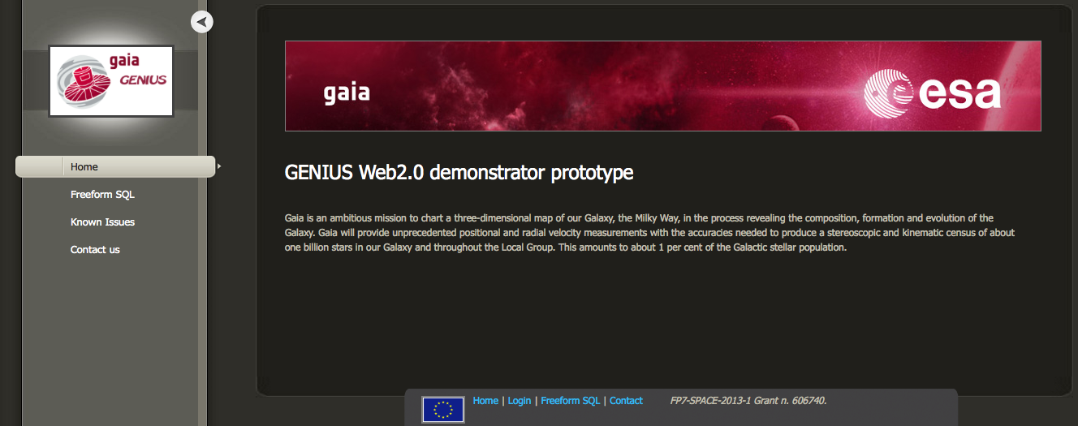
T3.4 (cont.): infrastructure demonstrator
see http://genius.roe.ac.uk
  DQP prototype
GENIUS
Deliverable D3.2

Slide 20
T3.5: Data mining environments
  Docker
    Light-weight Virtual Machine
    DQP has been containerised using Docker for deployment at ESAC
    Demonstrates flexible and secure deployment of third-party code at a Data Centre
    Has potential as a mechanism for containerisation of user code uploads

Slide 21
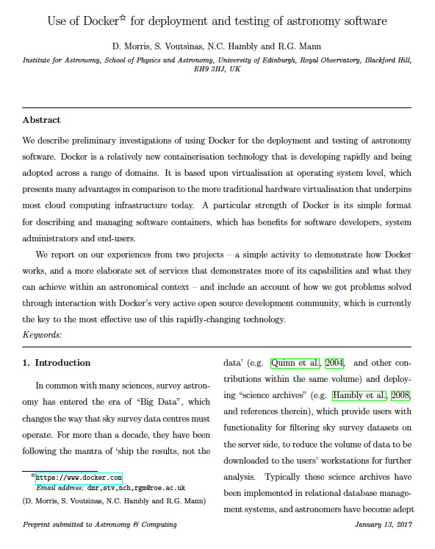
GENIUS
Deliverable D3.7

Slide 22
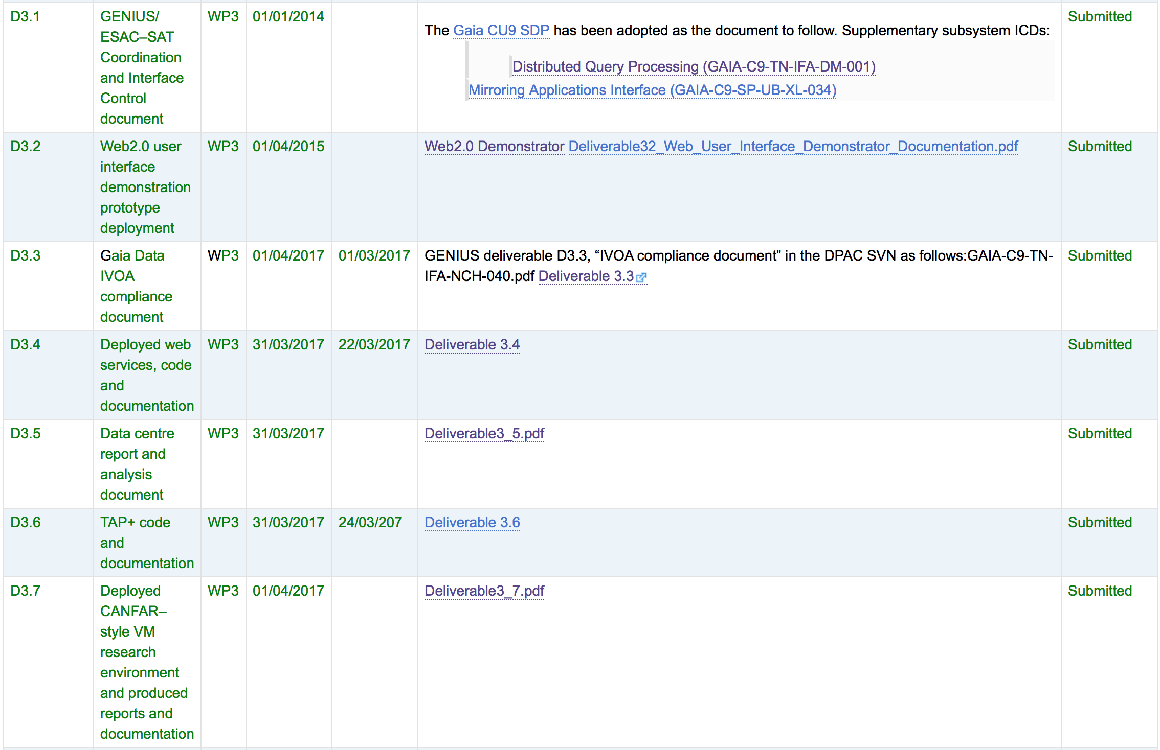
Deliverables: status summary

Slide 23
GENIUS legacy from WP3
We take seriously our responsibility for dissemination of results and SW coming out of the R&D programme using well-established Digital Curation mechanisms (and avoiding ad-hoc, ephemeral web resources):
  Software and associated documentation in GitHub
  Mainstream electronic publishing (e.g. article in Astronomy & Computing)
  Participation and integration in the international Virtual Observatory (developments of which adhere to the first two points)
  Re-use of knowledge in other areas and projects (e.g. taking forward FP7 GENIUS experience into H2020 ASTERICS)

Slide 24
Examples from WP3
GitHub resources (whole or in part):
  https://github.com/stvoutsin/pyrothorn
  https://github.com/stvoutsin/tap-autocomplete
  https://github.com/stvoutsin/taplib
IVOA contributions:
  http://wiki.ivoa.net/internal/IVOA/InterOpMay2016-DAL/adql-20160509.pdf
A&C paper (submitted end Jan 2017):
  “Use of Docker for deployment and testing of astronomy software”
Data Centres using GENIUS-developed software:
  ESAC Science Data Centre
  Wide Field Astronomy Unit (University of Edinburgh, UK)
  In fact anywhere that uses IVOA infrastructure, e.g. ADQL parser

