Slide 1


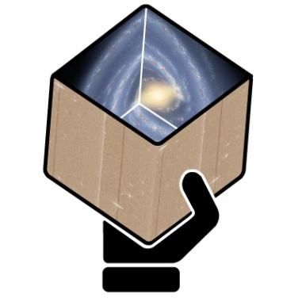
GENIUS
Final Report
for WP5
Frédéric Arenou
CNRS / GEPI, Observatoire de Paris
On behalf of WP5/DPAC940 contributors

Slide 2
The Catalogue validation
The preparation of the Gaia archive before its publication requires a careful, detailed and in-depth validation of its contents.
The scientific and statistical challenge of this task on a one-billion data set containing a wide variety of data (astrometric, photometric, spectrophotometric, spectroscopic…) is daunting, and would be impossible without tools adapted to work on such a massive and data-diverse archive.
This work package aims at producing such tools, based on the actual validation needs and on the characteristics of the archive system, thus making them as efficient as possible.
Furthermore, the validation process will rely on methods and tools that can also be used, with little or no adaptation, for the scientific analysis of the catalogue.

Slide 3
Summary of Validation Work
Done thanks to GENIUS support:
Validation Test Specification (VTS) document
  Description of all tests : objective, release, test data
Implement these validation tests
  Development of a S/W environment
  130 000 Source Lines Of Codes within GENIUS duration
Run them at ESAC
  Initially using simulated data then the true data
Generate a Validation Test Report (VTR)
  Proposal of filtering stars for DR1
  Reviewed by a Test Review Board/DPACE/GST
  Validation of the DR1 data, documentation, publication

Slide 4
Work breakdown

Slide 5
GENIUS/CU9 work breakdown
T5.2 – Looking for trouble
  F.A./K. Findeisen (CNRS/GEPI)
T5.3 – Simulation vs reality
  A. Robin/H. Ziaeepour (CNRS/Utinam)
T5.4 - External catalogues
  C. Babusiaux, L. Ruiz (CNRS/GEPI)+CSIC+KU
T5.5 - Statistical & graphical
  CNRS/OP-GEPI+FFCUL
Transversal (special objects):
  T5.6.1- Solar system objects
    D.Hestroffer/M.Kudryashova(CNRS/IMCCE)
  T5.6.2 - Multiple stars
    D. Pourbaix (ULB)
  T5.6.3 – Variability
    S. Blanco, L. Eyer (UG)
942 – Internal tests
  C. Fabricius (Univ. Barcelona)
943 - Comparison to models
  A. Robin (Utinam, Besançon)
944 - External catalogues
  C. Babusiaux (CNRS/OPM)
945 - Statistical & graphical
  A. Helmi (Groningen), M. Manteiga
Special objects:
  948 - Solar system objects
    P. Tanga (OCA)+D. Hestroffer
  947 - Clusters as tools
    A. Vallenari (INAF)
  946 – Variability
    L. Eyer (U.Geneva)
Notes:
CSIC=Consejo Superior de Investigaciones Científicas / équivalent CNRS Espagne, Enrique Solano, Madrid
KU=Kyoto University, Prof Yamada
FFCUL=Fundação da Faculdade de Ciências da Universidade de Lisboa, André Moitinho
UAC=University of Corunã Minia Manteiga

Slide 6
Task 5.1: technical coordination
Work summary
  Design + R&D + implementation of tests
    Validation Test Specification (VTS) reference document (100+ tests)
    TGAS solutions availability changed completely our schedule
  Creation of simulated Catalogues
    Based on AGISlab simulation added to astronomical data
  Setting a validation environment S/W
    Running at ESAC, sending back results
  Performed 3 TGAS validation rehearsals, then DR1 validation
    Validation Tests Report on TGAS_00.01, sent to Test Review Board
Meetings
  5 plenary meetings
    Vienna 2014, Meudon 2015, Barcelona 2015, Paris 2016, Sitges 2017
  Telecon meetings with WP managers every 1.5 month (22 up to now)
    Once every 2 weeks within WP942/T5.2

Slide 7
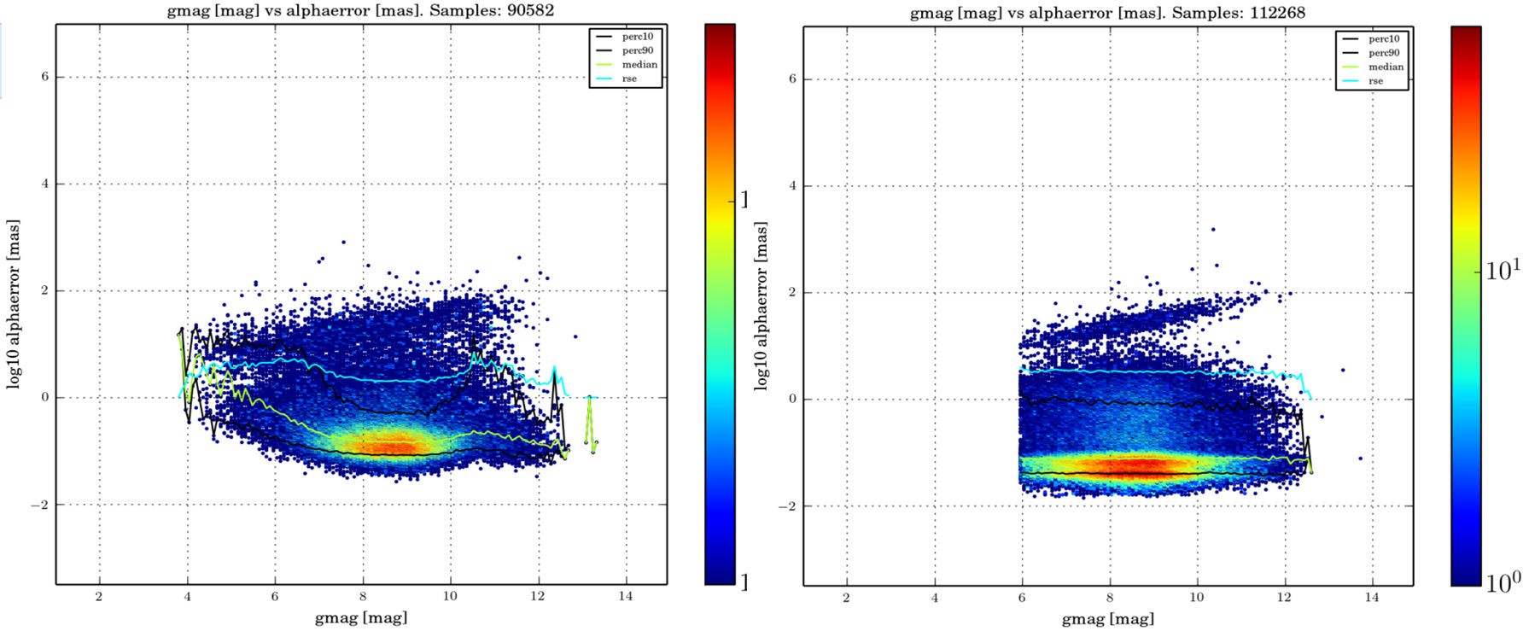
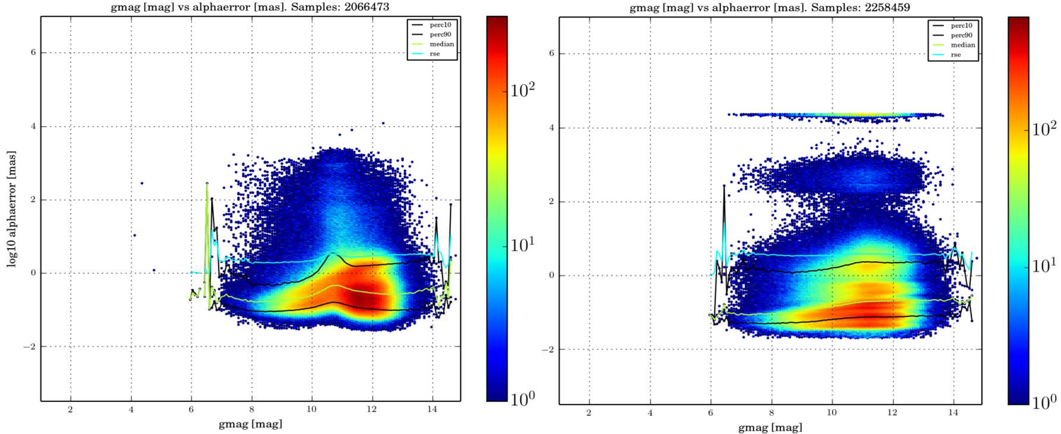
T5.2: Internal consistency
Basic checking: formal validation
  Parameter content (check NaN, field types, etc.)
  All fields are within valid ranges
  Check for outliers or poor solutions
Internal consistency
  Eg. Photometry between bands, coordinate conversions
  Use assumed parameters properties (e.g. true parallax is positive)
  Exploit intrinsic redundancy between instrument data (colours)
Build scenarios based on what is known to produce errors, e.g.:
  Duplicate sources or sourceIds
  Check for calibration problems, e.g. gate transitions
  Environment of bright stars

Slide 8
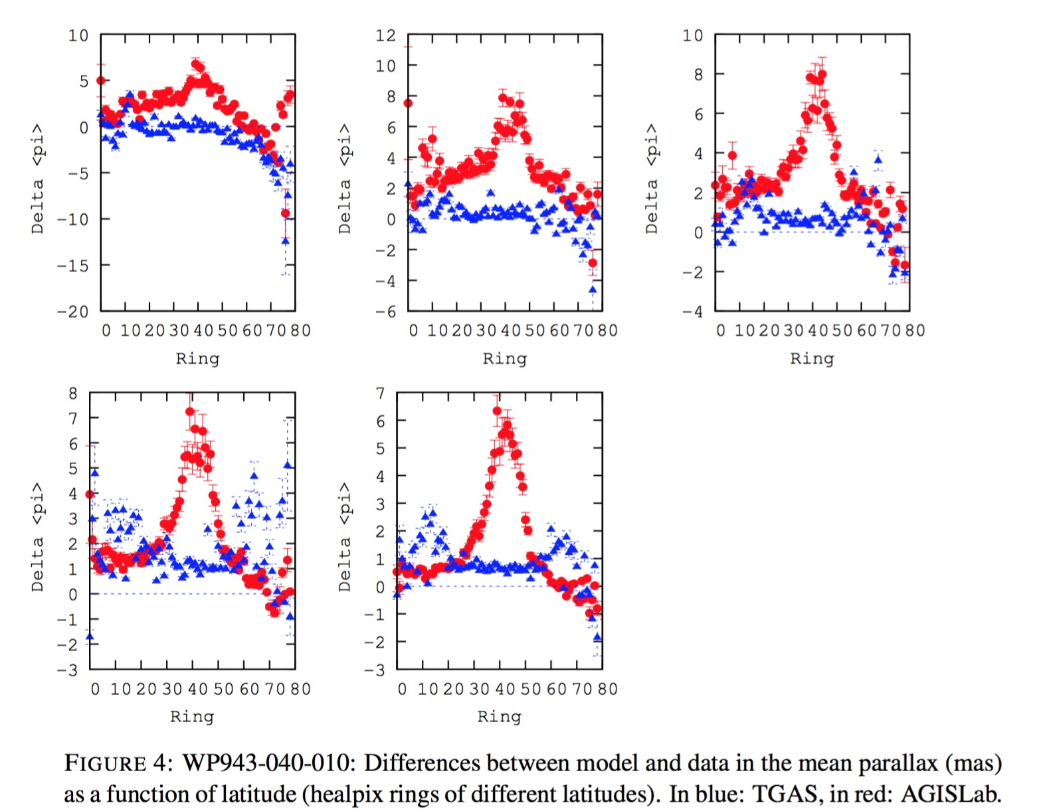
T5.3 : Model-based tests
Make statistics on Gaia simulated data
  Extract statistical properties + conf. interval for all observables: distribution, correlations
Compare this to actual Gaia data
  Checking whether the large, expected structures are present (not going into details)
  Can help to understand and explain the main structures (see e.g. Hipp. Vol 1)
  Complement where external data is incomplete
Implement tests as func(mag, latitude)
  Stellar density
  Mean p.m. and standard deviations
  Mean parallax and standard deviations

Slide 9
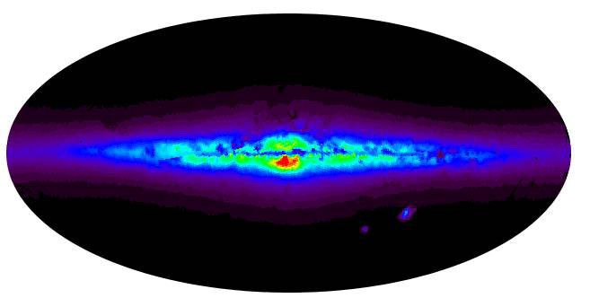
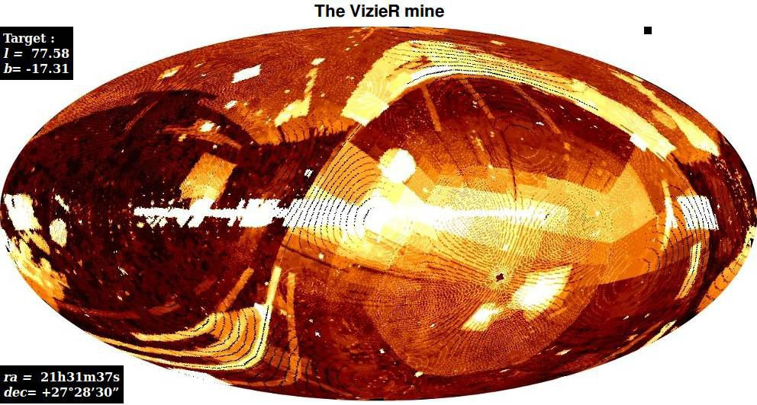
T5.4: External data
A difficult recipe
  Get external data
  Make cross-matching
  Compare to Gaia data
Completeness
  search for duplicate or missing entries
  homogeneity of the sky distribution, with mag., colour or p.m. ranges
  small scale completeness of the catalogue
  performance of visual double stars observations
  Tycho-2 + 2MASS + UCAC4 + HST (HSC+ACS) + OGLE + WDS
Parallaxes
  Astrometry: VLBI + HST + RECONS + Hipparcos
  Galactic stars distant enough: Cepheids+RRLyrae+APOKASC+ APOGEE + LAMOST
  Extragalactic: LMC + SMC
Proper motions
  Accuracy+precision
  Tycho-2 + Hipparcos + VLBI
  High-proper motions stars
Photometry
  Hipparcos + SDSS strip 82 + CFHT SNLS + Hubble Caspec
Other
  QSOs ICRF2
  double stars WDS

Slide 10
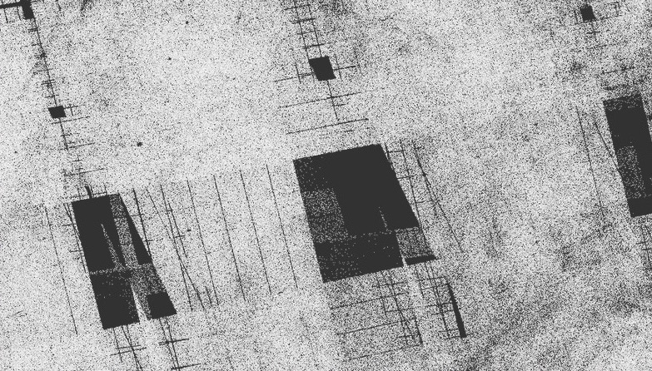
T5.5 : Statistics & Visualisation
Goal: define statistical tools for:
  Clustering and sub-population statistical characterisation tools
  Study of correlations between observables
  Find outlying substructures
  Comparisons to simulations
Currently implemented
  FFCUL visualisation input for the
    Statistical analysis of the data content.
    Discovery of special spatial structure
  the Kullback-Leibler divergence (KLD)
    degree of clustering from comparisons
    to simulations for all two-dimensional
    subspaces. Input from external centers
  Work on a visualisation prototype
    Vaex, also used in WP970
    Used to analyse correlations.
FFCUL T5.5 visualisation near galactic center
A. Helmi
alpha-muAlphaStarError

Slide 11
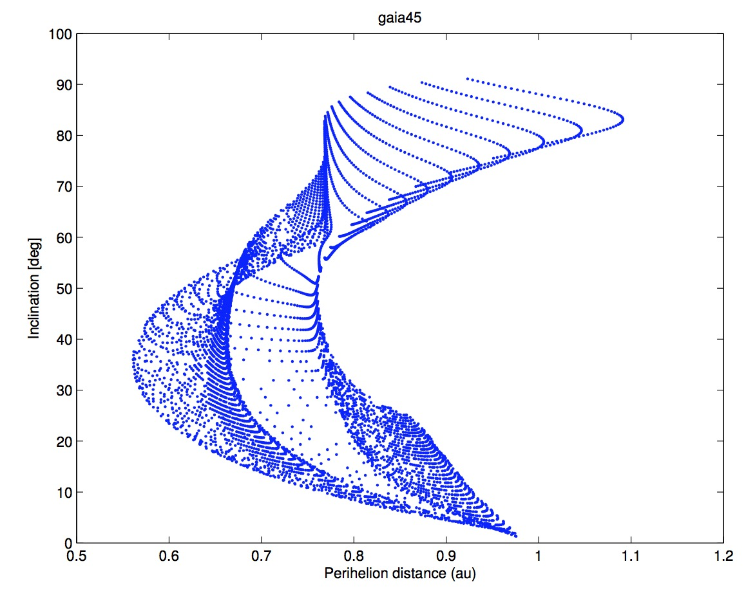
T5.6.1: solar system objects
Motivations
  Avoid spurious detections of new SSO
  Avoid corruption of data / anomalous stellar signals due to close approach of asteroid to stars
  Photometric outliers (may indicate peculiar shape/binarity effects)
  This requires special competence different from stellar validation mainstream
Tests planned
  Short arc validation: systematic ranging method for the computation of the initial asteroid orbits, select regions where the object could be, or reject if the object seems to be contaminant
  Orbital Validation Software : prediction of positions known from external databases vs Gaia data reduction + dates of actual obs.s vs predicted
  Backward occultation verification
perihelion vs inclination for the
possible NEA gaia45 (F. Spoto)

Slide 12
T5.6.2: non-single stars (ULB)
See Dimitri Pourbaix presentation

Slide 13
T5.6.3: Time series,variability(UG)
See Nami Mowlavi’s presentation

Slide 14
Software development of validation tests

Slide 15
S/W development environment
Developing a common framework
  Rationale: automatize most tests
    Software and configurations
    Input, output, results of the tests (email/ftp)
  Access standardized
    TAP interface + VO tools
    Gbins for all “serial” tests when large fraction of rows returned
Software environment
  Using all tools what DPAC has put in place
    Under svn
    Jira, Hudson, Nexus, etc.
  language: most developments in Java
  Software has to run at ESAC

Slide 16
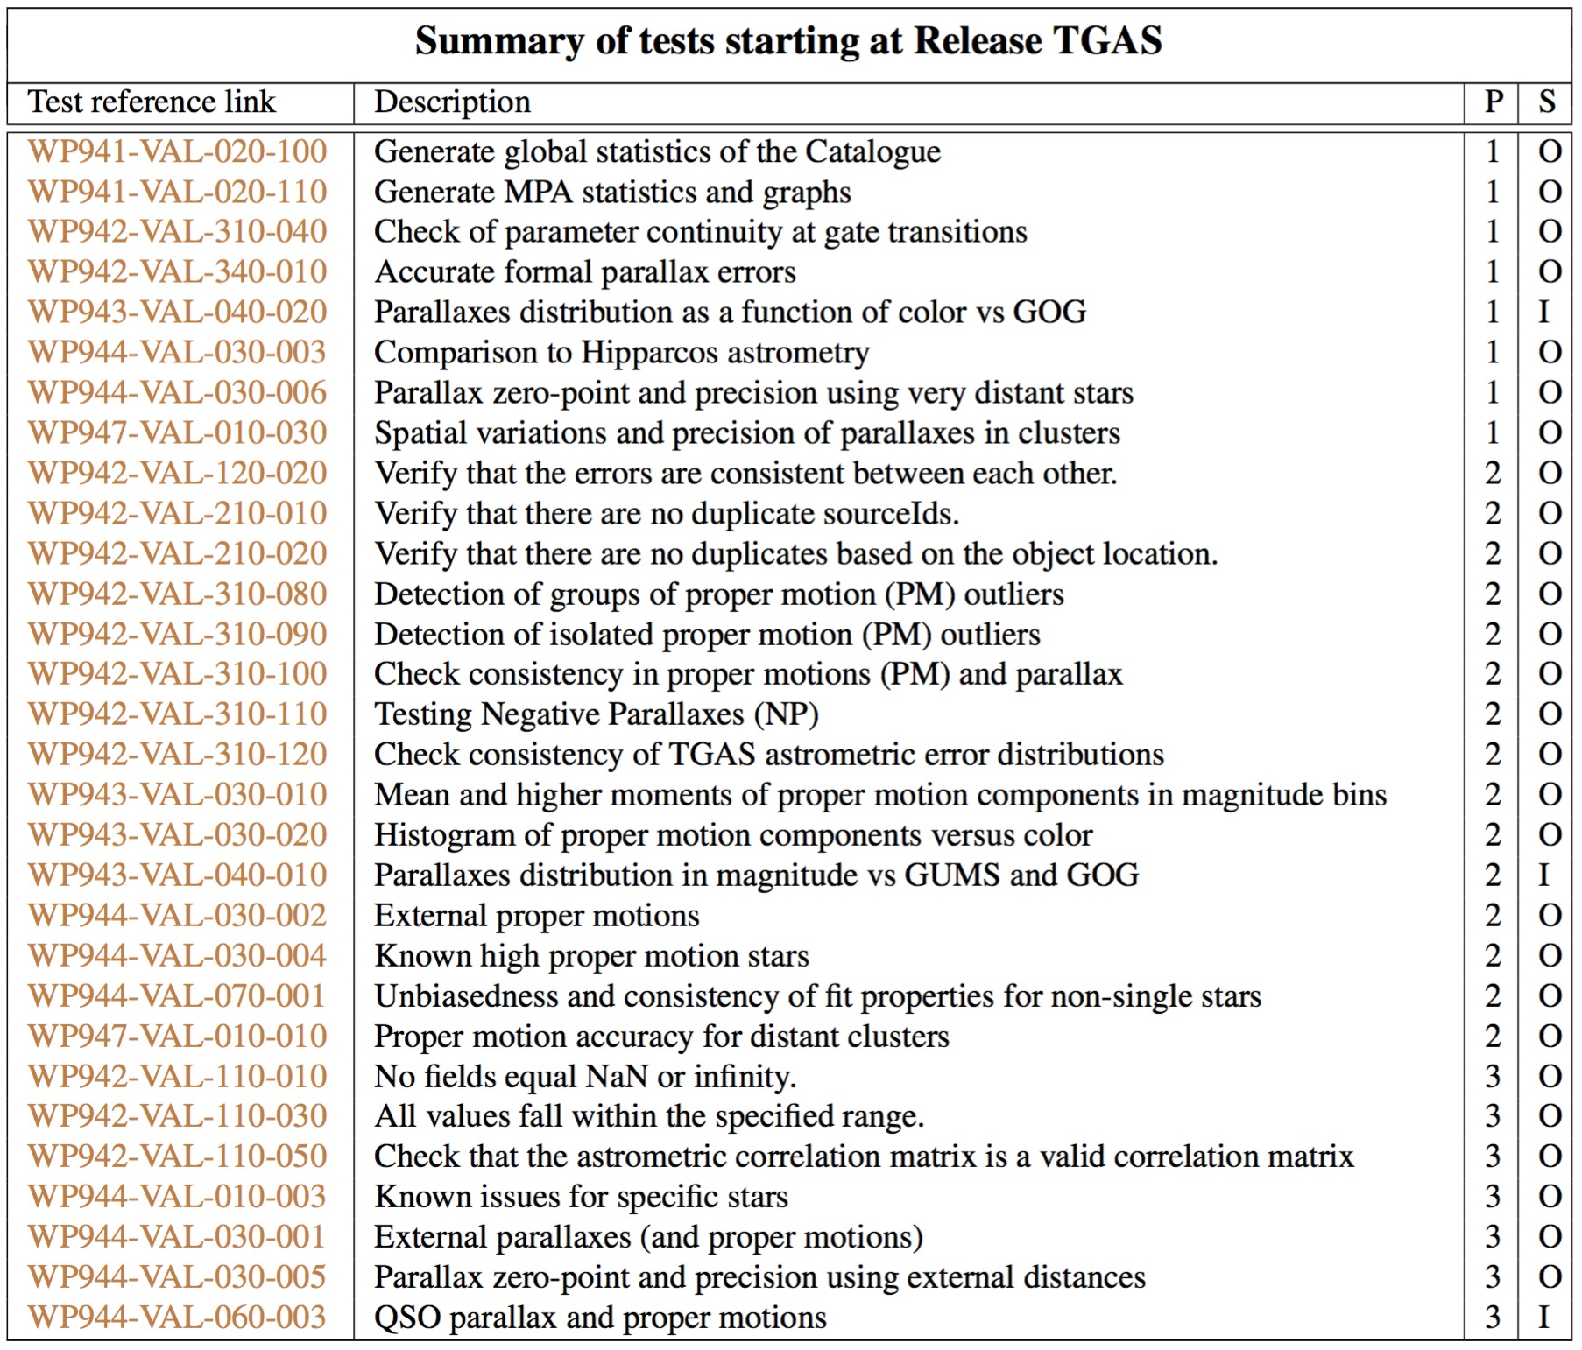
VTS: tests for TGAS subset

Slide 17
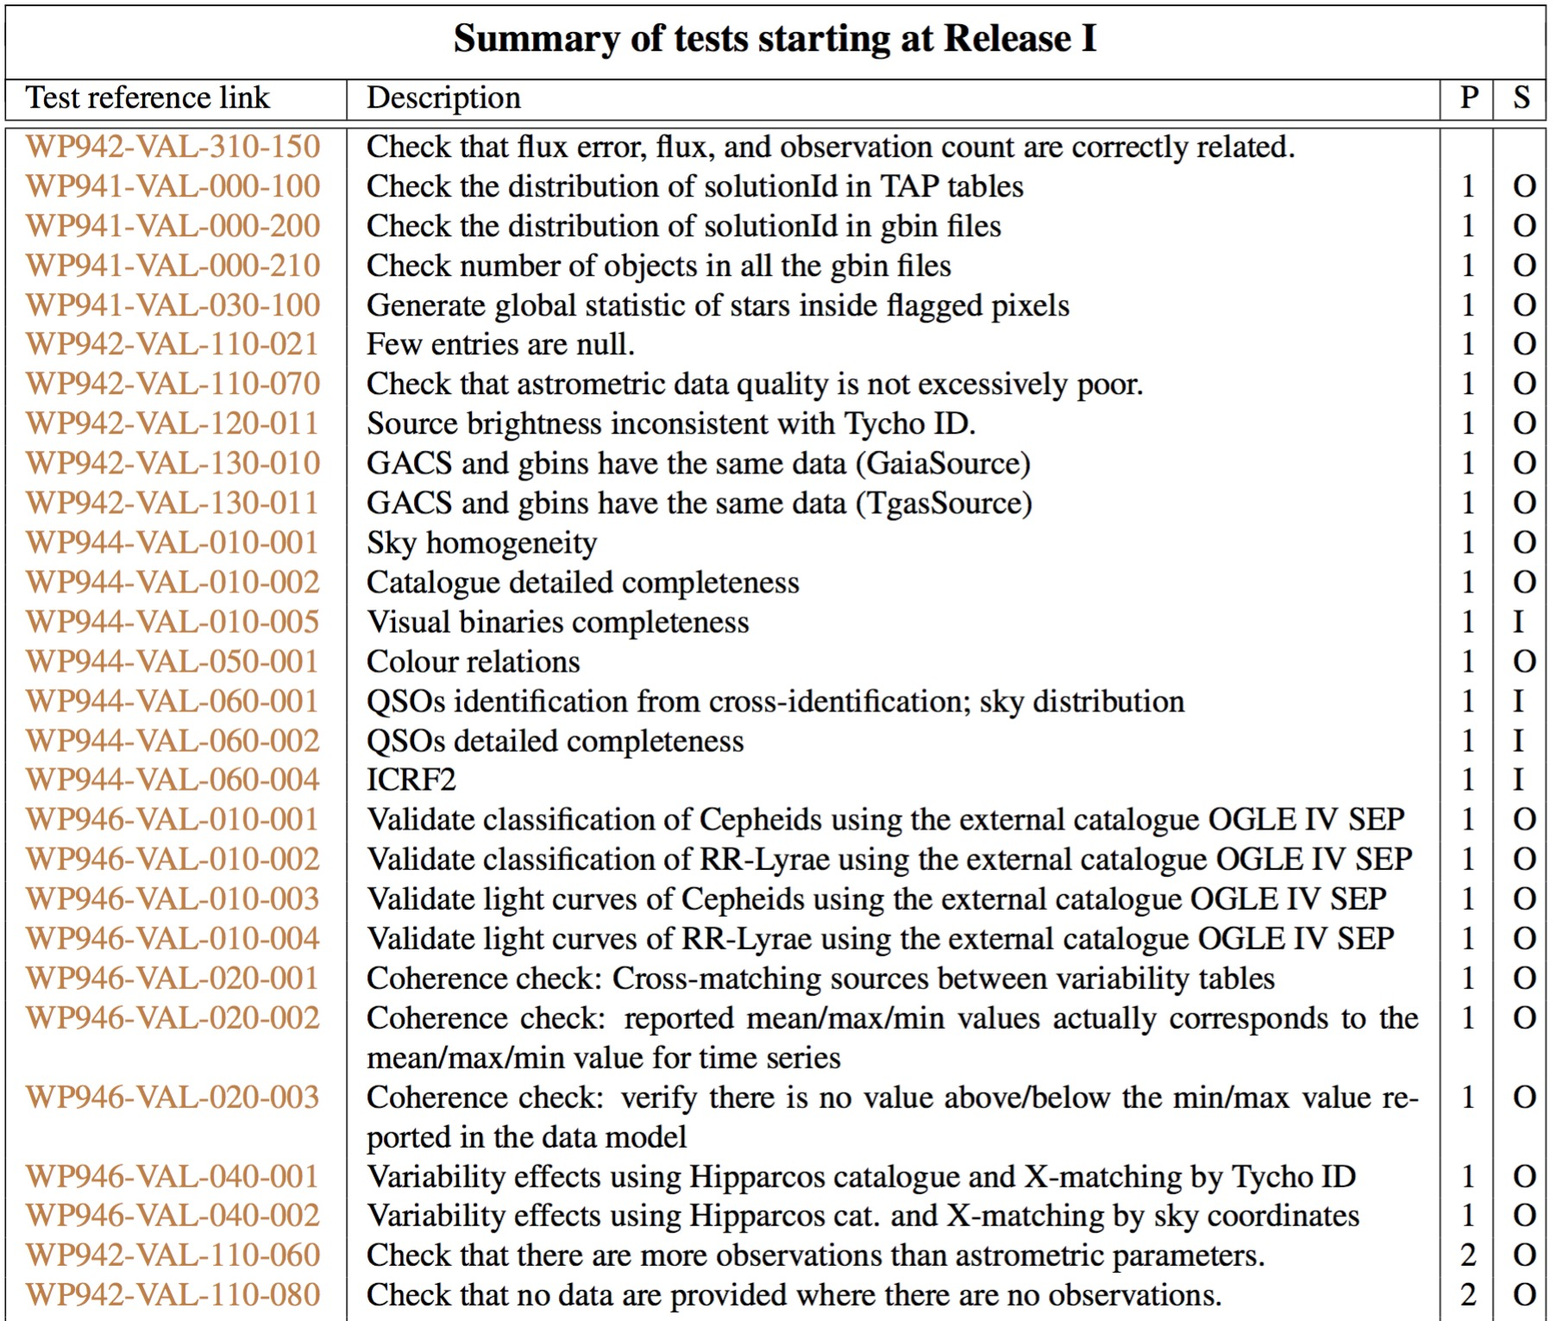
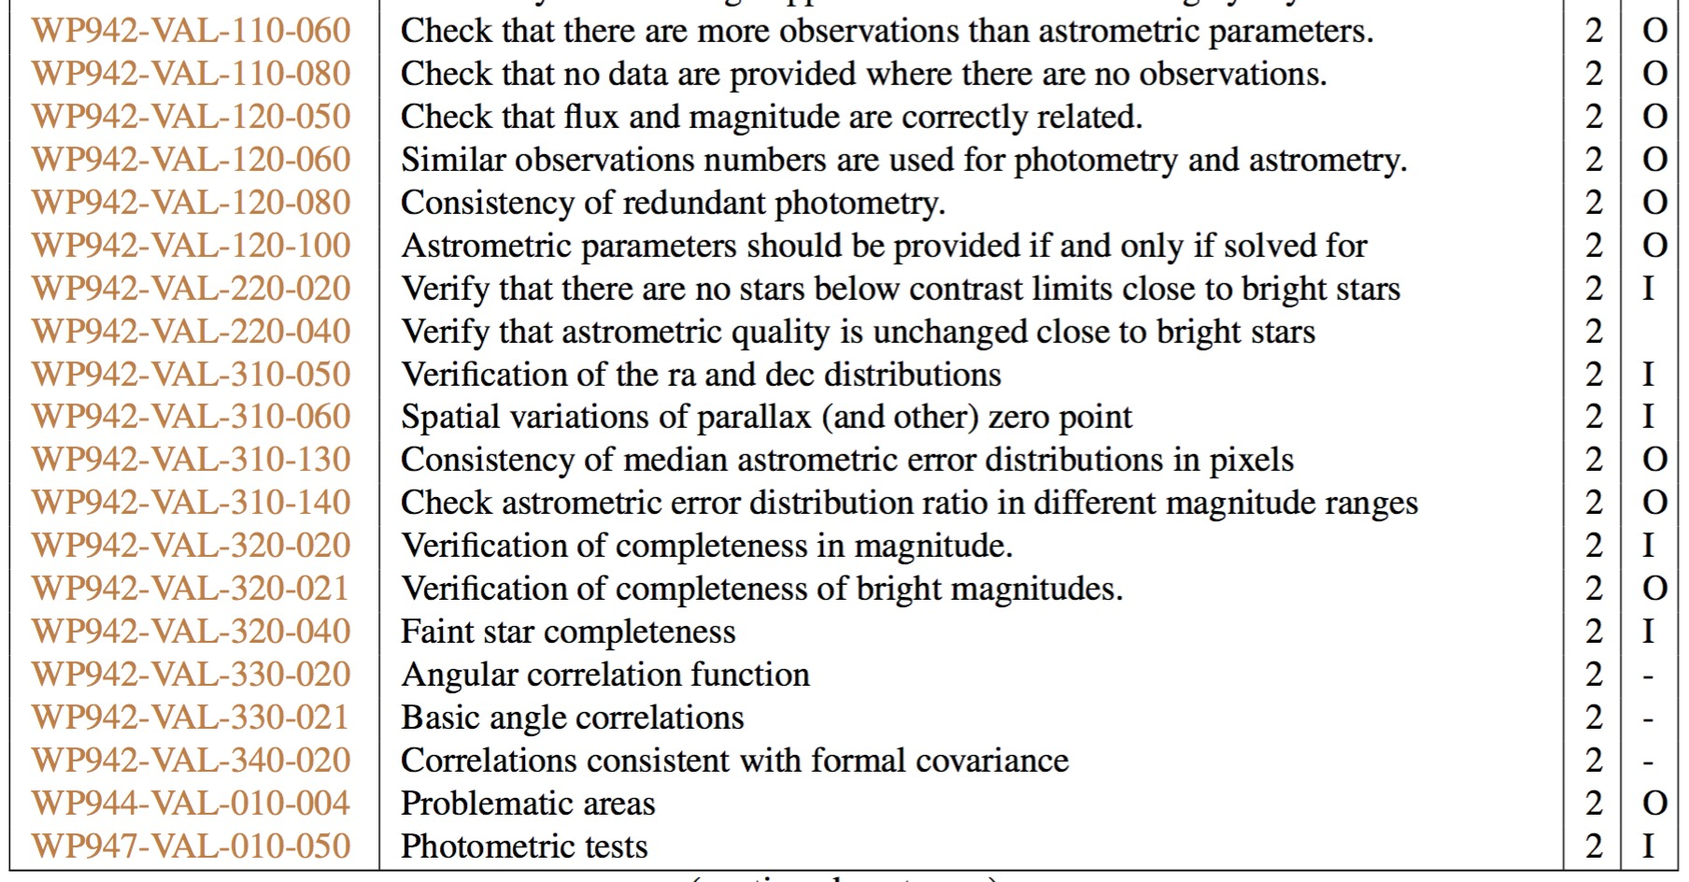
VTS: tests for the rest of DR1

Slide 18
Summary of DR1 results
Published in A&A A&A 599, A50 (2017), see D5.9

Slide 19
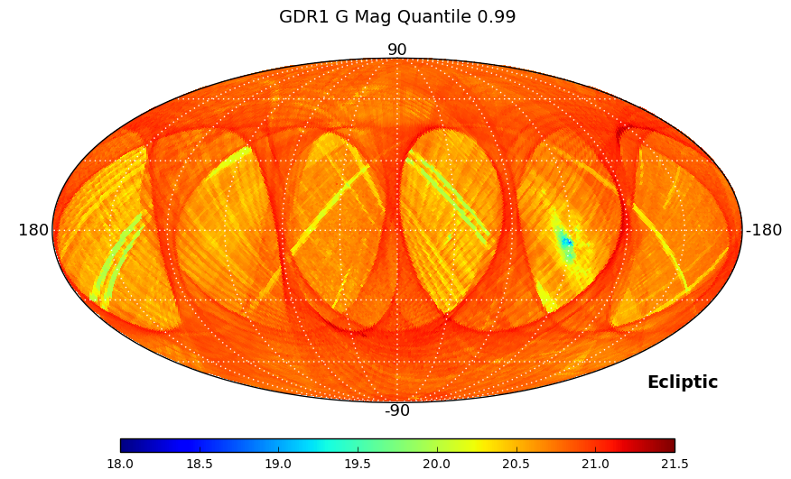
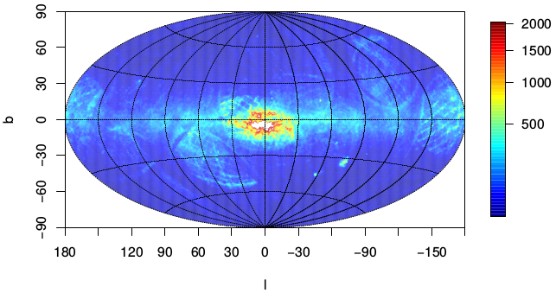
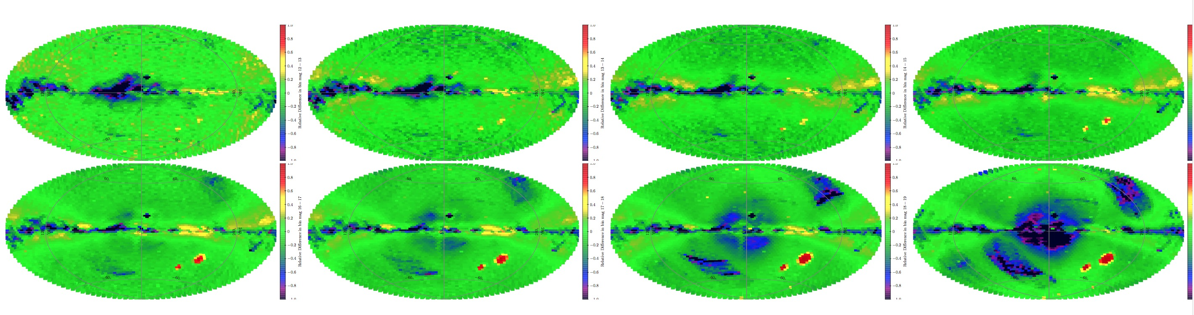
Incompleteness: large scale
S. Soria/T5.2
C. Babusiaux / T5.4
UCAC4 sources not in DR1
A. Robin/T5.3
16<G<17 17<G<18 18<G<19 19<G<20

Slide 20
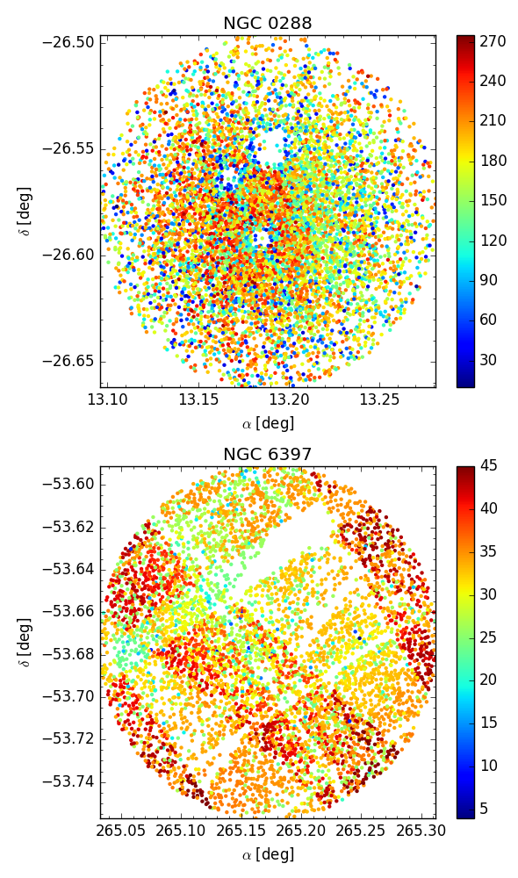
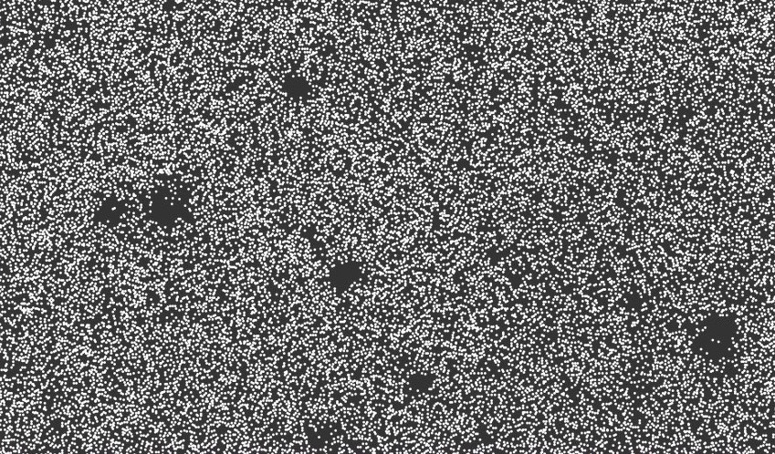
Completeness: intermediate scale
F.A./ T5.2
A. Vallenari / WP947
Size ~3 square degrees
C. Babusiaux / T5.4
l=330, b=3, Size ~200 square arcmin
Completeness vs G, OGLE bulge field
⬆ Work done thanks to FFCUL visualization tool, T5.5

Slide 21
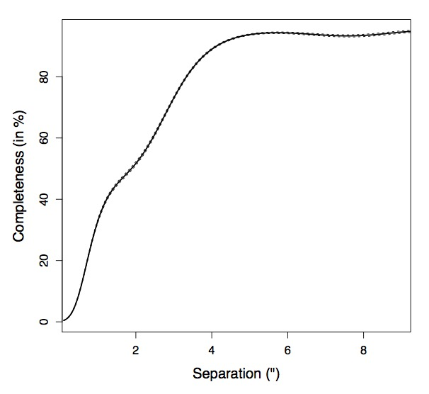
Completeness: small scale
C. Fabricius / T5.2
DR1
C. Babusiaux / T5.4
Simulation
Completeness vs separation for double stars in WDS
Distance between sources (’’) in high density field

Slide 22
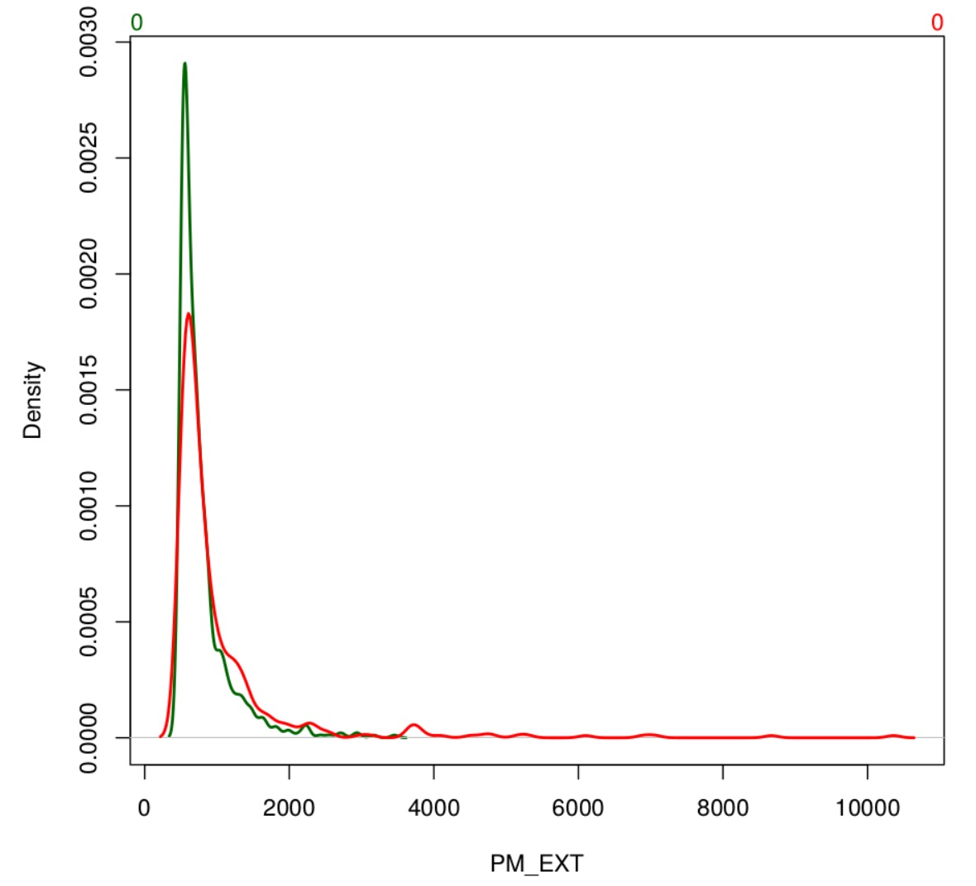
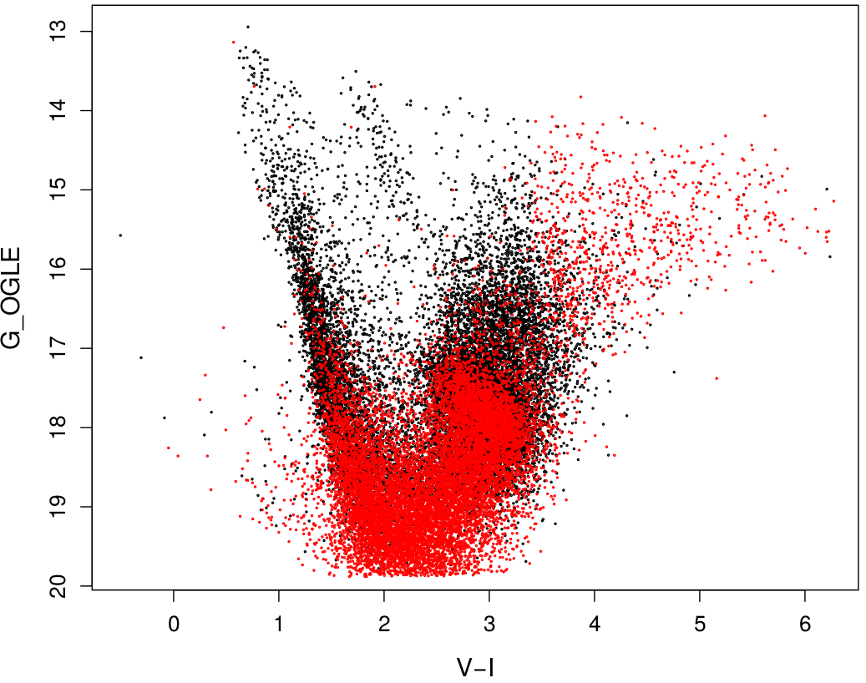
Other selection effects
As a function of color or magnitude
  Very bright, very red stars missing
Missing high proper motion stars
C. Babusiaux/T5.4
C. Babusiaux / T5.4
Missing high proper motion stars
OGLE bulge CMD: stars in red are missing in DR1.

Slide 23
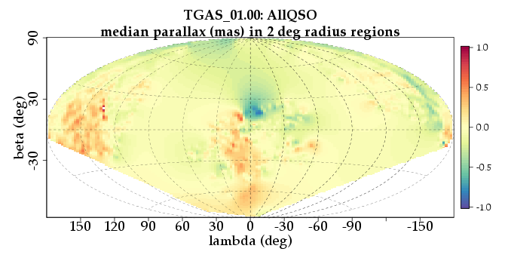
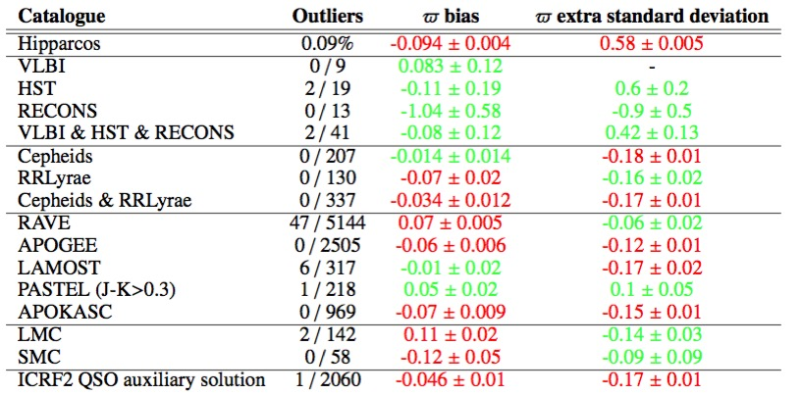
Parallax accuracy
F.A. / T5.2
C. Babusiaux / T5.4
QSO parallaxes
RAVE (ϖ ratio -1)
A. Helmi / T5.5
C. Babusiaux
Fully consistent with internal results: −0.036 ± 0.002 mas
(weighted)
Notes:
Cepheids. The catalogue of Ngeow (2012) has been used. It provides distance modulus for the Cepheids using the Wesenheit function. The error on the distance modulus has been estimated by adding quadratically the dispersion around the We- senheit function, the uncertainty on the distance modulus of the LMC used to calibrate this relation, the I-magnitude error and the overall dispersion seen by Ngeow (2012) when comparing their distance modulus to other methods (0.2 mag). The latter was needed in order the get distance moduli consistent with the Hipparcos parallaxes. The catalogue contains 233 Tycho-2 stars with σπE < 0.1 mas.
RRLyrae. For TGAS we used the catalogue of Maintz (2005).
We computed the distance modulus using the magnitude inde-
pendent of extinction KJ−K= K − AK (J − K). The extinction AJ −AK
coefficients were computed applying the Fitzpatrick & Massa (2007) extinction curve on the Castelli & Kurucz (2003) SEDs. MK was derived from the period-luminosity relation of Mu- raveva et al. (2015) and the colours were derived from Catelan (2004) transformed in the 2MASS system using the transforma- tions of Carpenter (2001). The catalogue contains 150 Tycho-2 stars with σπE < 0.1 mas.
RAVE (Kordopatis et al. 2013) with distances from Binney et al. (2014). It contains 6850 Tycho-2 stars with σπE < 0.1 mas. A comparison with Hipparcos has shown the presence of 24% of outliers, mainly due to dwarf/giant mis-classifications. Strong outliers are also seen in the comparison with TGAS but they represent only 1% of the sample. A global parallax offset of 0.07±0.005 mas is seen with a strong variation with sky posi- tion (with 0.3 mas amplitude). This is the only catalogue, to- gether with the LMC, that present a significant positive parallax bias (Table 2). To further study the presence of systematic ef- fects in localized regions on the sky that could affect the RAVE results, another test has been made using this time all the 192 655
LAMOST DR1 (Luo et al. 2015). Same method as for APOGEE. It leads to 451 stars with σπE < 0.1 mas. No sig- nificant parallax difference was detected with this sample.
APOGEE (Holtzman et al. 2015). Distance moduli were computed using a Bayesian method on the Padova isochrones (Bressan et al. 2012, CMD 2.7) and using the magnitude inde- pendent of extinction KJ−K. The prior on the mass distribution used the IMF of Chabrier (2001) while the prior on age was cho- sen flat. Stars too far from the isochrones were rejected using the χ20.99 criterion. It led to 3100 Tycho stars with σπE < 0.1 mas. A global parallax difference of −0.06 ± 0.006 mas was found, with a strong variation with magnitude, the brighter th
PASTEL (Soubiran et al. 2016). Same method as for APOGEE. It leads to 917 Tycho stars with σπE < 0.1 mas. No signifi- cant parallax difference was found except for the blue stars (J- Ks<0.3), with a difference up to 0.3 mas, most probably linked to the spectro-photometric distance determination that has been less tested on those young massive stars and is more dependent on the age prior. Therefore only stars with J-Ks>0.3 are used in the summary Table 2
APOKASC using the distances provided by Rodrigues et al. (2014) derived using both Kepler asteroseismologic and APOGEE spectroscopic parameters. It contains 984 Tycho sources with σπE < 0.1 mas. The median σπE of this catalogue is 0.02 mas. A global parallax difference of −0.07 ± 0.009 mas is seen, with a strong variation with magnitude, similar to what was found with the APOGEE resu

Slide 24
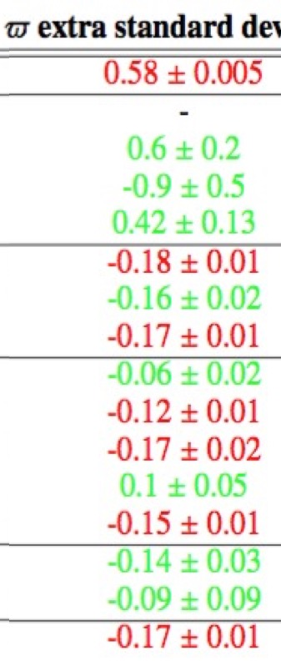
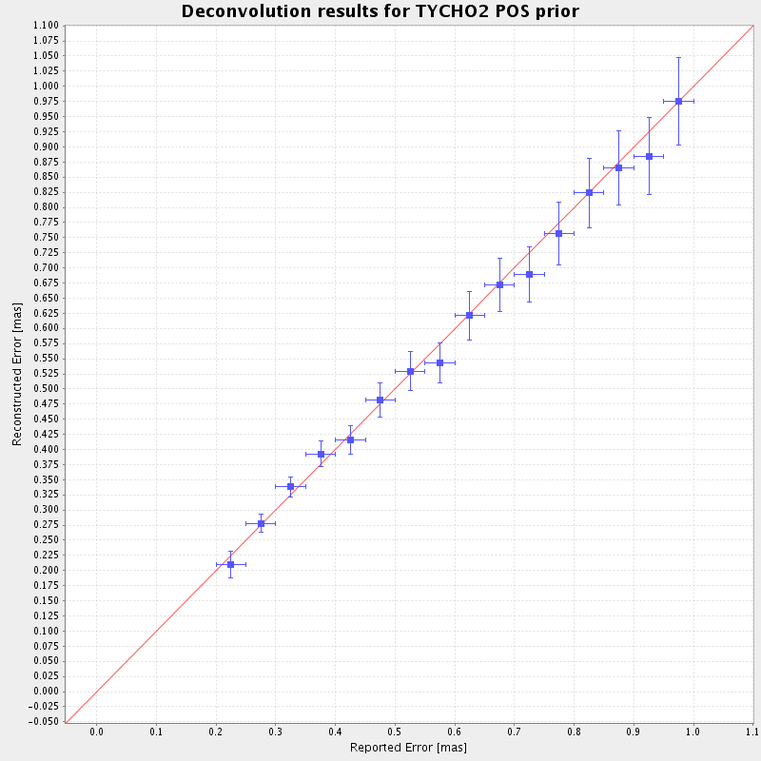
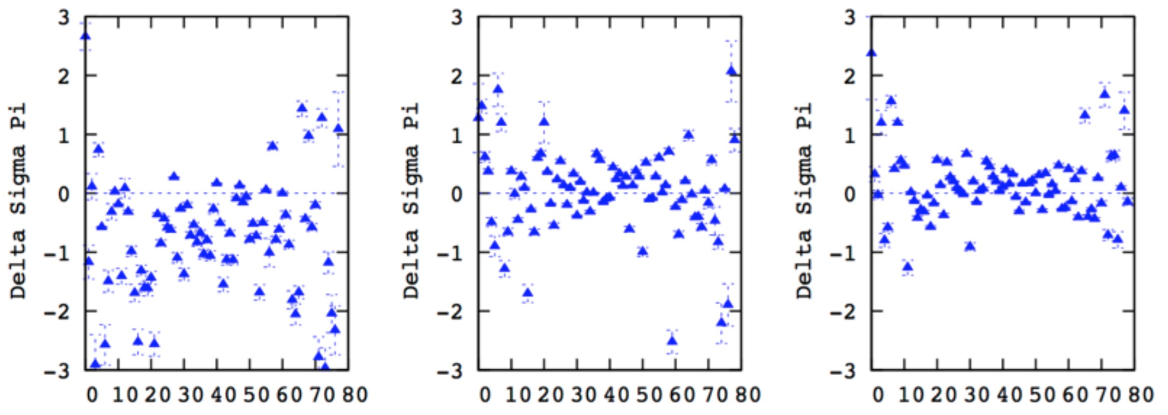
Parallax precision
K.Findeisen / T5.2
C. Babusiaux / T5.4
Standard parallax uncertainty (mas)
Observed dispersion (mas)
Deconvolution of the negative parallax tail for Tycho stars
extra dispersion: −0.11 ± 0.01 mas
Comparison of parallaxes uncertainties f(b) for mag V_{T}=9, 9.5, 10
Extra std. dev on parallax uncertainties (mas)
A. Robin / T5.3
Notes:
Cepheids. The catalogue of Ngeow (2012) has been used. It provides distance modulus for the Cepheids using the Wesenheit function. The error on the distance modulus has been estimated by adding quadratically the dispersion around the We- senheit function, the uncertainty on the distance modulus of the LMC used to calibrate this relation, the I-magnitude error and the overall dispersion seen by Ngeow (2012) when comparing their distance modulus to other methods (0.2 mag). The latter was needed in order the get distance moduli consistent with the Hipparcos parallaxes. The catalogue contains 233 Tycho-2 stars with σπE < 0.1 mas.
RRLyrae. For TGAS we used the catalogue of Maintz (2005).
We computed the distance modulus using the magnitude inde-
pendent of extinction KJ−K= K − AK (J − K). The extinction AJ −AK
coefficients were computed applying the Fitzpatrick & Massa (2007) extinction curve on the Castelli & Kurucz (2003) SEDs. MK was derived from the period-luminosity relation of Mu- raveva et al. (2015) and the colours were derived from Catelan (2004) transformed in the 2MASS system using the transforma- tions of Carpenter (2001). The catalogue contains 150 Tycho-2 stars with σπE < 0.1 mas.
RAVE (Kordopatis et al. 2013) with distances from Binney et al. (2014). It contains 6850 Tycho-2 stars with σπE < 0.1 mas. A comparison with Hipparcos has shown the presence of 24% of outliers, mainly due to dwarf/giant mis-classifications. Strong outliers are also seen in the comparison with TGAS but they represent only 1% of the sample. A global parallax offset of 0.07±0.005 mas is seen with a strong variation with sky position (with 0.3 mas amplitude). This is the only catalogue, together with the LMC, that present a significant positive parallax bias (Table 2). To further study the presence of systematic effects in localized regions on the sky that could affect the RAVE results, another test has been made using this time all the 192 655
LAMOST DR1 (Luo et al. 2015). Same method as for APOGEE. It leads to 451 stars with σπE < 0.1 mas. No significant parallax difference was detected with this sample.
APOGEE (Holtzman et al. 2015). Distance moduli were computed using a Bayesian method on the Padova isochrones (Bressan et al. 2012, CMD 2.7) and using the magnitude independent of extinction KJ−K. The prior on the mass distribution used the IMF of Chabrier (2001) while the prior on age was chosen flat. Stars too far from the isochrones were rejected using the χ20.99 criterion. It led to 3100 Tycho stars with σπE < 0.1 mas. A global parallax difference of −0.06 ± 0.006 mas was found, with a strong variation with magnitude, the brighter th
PASTEL (Soubiran et al. 2016). Same method as for APOGEE. It leads to 917 Tycho stars with σπE < 0.1 mas. No significant parallax difference was found except for the blue stars (J- Ks<0.3), with a difference up to 0.3 mas, most probably linked to the spectro-photometric distance determination that has been less tested on those young massive stars and is more dependent on the age prior. Therefore only stars with J-Ks>0.3 are used in the summary Table 2
APOKASC using the distances provided by Rodrigues et al. (2014) derived using both Kepler asteroseismologic and APOGEE spectroscopic parameters. It contains 984 Tycho sources with σπE < 0.1 mas. The median σπE of this catalogue is 0.02 mas. A global parallax difference of −0.07 ± 0.009 mas is seen, with a strong variation with magnitude, similar to what was found with the APOGEE resu

Slide 25
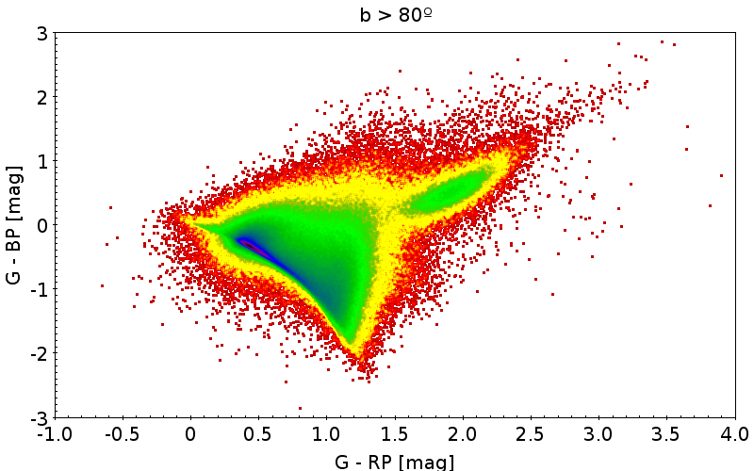
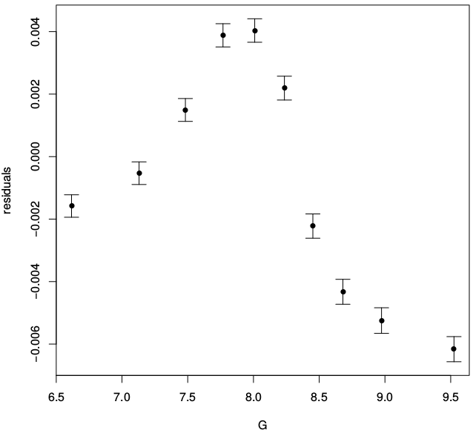
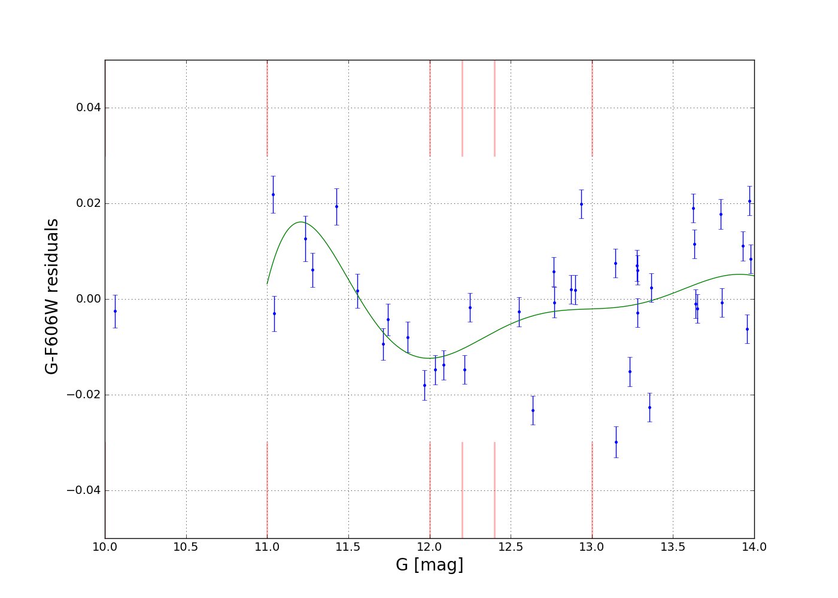
Photometry
C. Fabricius / T5.2
C. Babusiaux / T5.4
G-BP vs G-RP
M4 using G minus HST F606W vs G
Hipparcos, residuals vs G
Folded light curve of an RR Lyrae
A. Vallenari / WP947
S. Blanco / T5.63

Slide 26
Tests overlap between WPs
For DR1
GENIUS DPAC | T5.2 WP942 | WT5.3 P943 | T5.4 WP944 | T5.5 WP945 | T5.63 WP946 | WP947
Completeness, large scale | ✘ | ✘ | ✘
Completeness, small scale | ✘ |  | ✘ |  |  | ✘
Astrometric accuracy |  | ✘ | ✘ | ✘ |  | ✘
Astrometric precision | ✘ |  | ✘ | ✘ | ✘ | ✘
Photometric data | ✘ |  | ✘ | ✘ | ✘ | ✘
Variability data |  |  |  |  | ✘

Slide 27
Summary of work done within GENIUS

Slide 28
Livelink documents
  Minutes of CU9 validation telecons 1-2 28-dec-14 GAIA-C9-MN-OPM-FA-063
  Minutes of CU9 validation telecons 3-8 28-dec-14 GAIA-C9-MN-OPM-FA-064
  Statistical validation of Gaia Archive 18-fev15 GAIA-C9-TN-UB-ELA-017
  Besancon Galaxy Model Simulation for CU9-WP943 11-mai-15 GAIA-C9-TN-UB-RMC-001
  Simulated TGAS data used for validation Interface Control 13-mai-15 GAIA-C9-SP-OPM-FA-066
  WP943 validation code, Software Release Notes 19-mai-15 GAIA-C9-TN-IUOB-HZ-001
  GWP-947 Cluster selection requirements for the first Gaia data release 5-juin-15 GAIA-C9-SP-OAPD-AV-014
  WP-947 Cluster Validation, Auxiliary data description for TGAS validation 7-sept-15 GAIA-C9-SP-OAPD-AV-016
  TGAS Test description WP947-010-030, Spatial variation and precision 8-sept-15 GAIA-C9-TN-OAPD-TCG-001
  Calibration of Parallax Deconvolution Parameters for WP942-VAL-340-010 14-sept-15 GAIA-C9-TN-OPM-KF-002
  Software User Manual for CU9 ValidationTools 17-sept-15 GAIA-C9-UG-OPM-IS-001
  Validation Tests Specification (WP940) 18-sept-15 GAIA-C9-SP-OPM-FA-061
  CU9 Validation Procedure Specification 18-sept-15 GAIA-C9-SP-OPM-IS-004
  CU9 ValidationTools Software Release Note 30-sept-15 GAIA-C9-SP-OPM-IS-005
  WP944 v18.1 Validation with external catalogues; Detailed Description 25-nov-15 GAIA-C9-SP-OPM-LRD-001
  StatisticalTools 18.2 Software Release Note 3-mars-16 GAIA-CU9-SP-UB-ELA-025
  StatisticalTools Software User Manual 4-mai-16 GAIA-C9-UG-UB-ELA-026-1
  StatisticalTools 18.4 Software Release Note 4-mai-16 GAIA-C9-SP-OPM-KF-004-1
  SSO Short Term processing, validation of the short arc 13-juil-16 GAIA-C9-TN-OCA-FSP-001
  CU9 Validation Tests Report, preliminary TGAS 00.01 data 16-nov-16 GAIA-C9-SP-OPM-FA-067
  Validation Tests Report, preliminary TGAS 01.00 data 14-mars-16 GAIA-C9-SP-OPM-FA-070
  SSO Short Term processing, validation of the short arc Functions 13-JUL-16 GAIA-C9-TN-OCA-FSP-001
  Validation Tests Report, GDR1 (pre- and post-filtering) 03-aou-16 GAIA-C9-TN-OPM-FA-073
  Cookbook of CU9 Scientific Validation for DR1 Functions 10-jan-17 GAIA-C9-TN-OPM-IS-006

Slide 29
GENIUS deliverables (delivered)
Delivery Name Month after K.O. Document name
D5.1 Prototype of internal checking tools (WP 520) 12 GAIA-CO-TN-OPM-FA-062
D5.2 Prototype model-based validation tools (WP 530) 18 GAIA-C9-TN-IUOB-HZ-001
D5.3 Internal checking tools (WP 520) 24 GAIA-CO-TN-OPM-FA-069
D5.6 prototype comp. with external catalogues (WP 540) 24 GAIA-C9-SP-OPM-LRD-001
D5.4 Statistical tools (WP 550) 36 D5.4
D5.5 Model-based validation tools (WP 530) 36 D5.5
D5.7 External validation tools (WP 540) 36 GAIA-C9-SP-OPM-LRD-002
D5.8 Special objects: clusters + variable stars 36 GDR1_master_WP-560
D5.8 Special objects: non-single stars 36 GAIA-C4-TN-ULB-DP-055
D5.8 Special objects: SRS for Solar System Object s 36 SRS-WP-560-SSO
D5.9 Deployment of validation on the archive 42 D5.9
Note: the last document is mostly the A&A paper about the DR1 validation

Slide 30
GENIUS legacy from WP5
The development of a full validation code
  130 000 source lines of code
  Plus the infrastructure for the code execution
  Now being used for DR2 and following data releases
Tools trained on validation then scientific exploitation
  E.g. Kullback-Leibler divergence→ 2017ApJ...836..234S
A published paper (A&A 599, A50):
  Full validation of DR1, about 35p.
Training of new developers in ESA project environment
  One now working for LSST, one in ADS

Slide 31
Thank you for your attention

