Slide 1
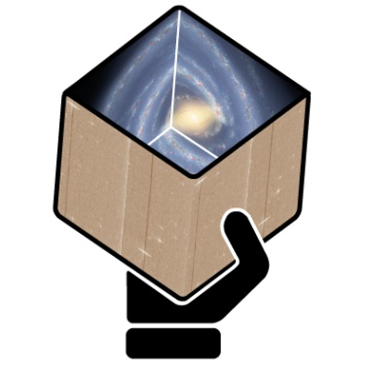
GENIUS
Final Report
for WP7
E. Masana / T. Via
Universitat de Barcelona / CSUC

Slide 2
Outline
WP7 Overview
Main Outreach Activities
Gaiaverse Roadmap
The Gaiaverse Portal
Gaiaverse Twitter Profile

Slide 3
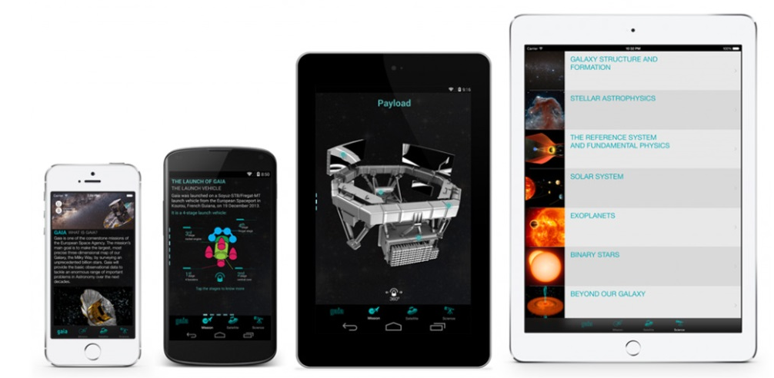
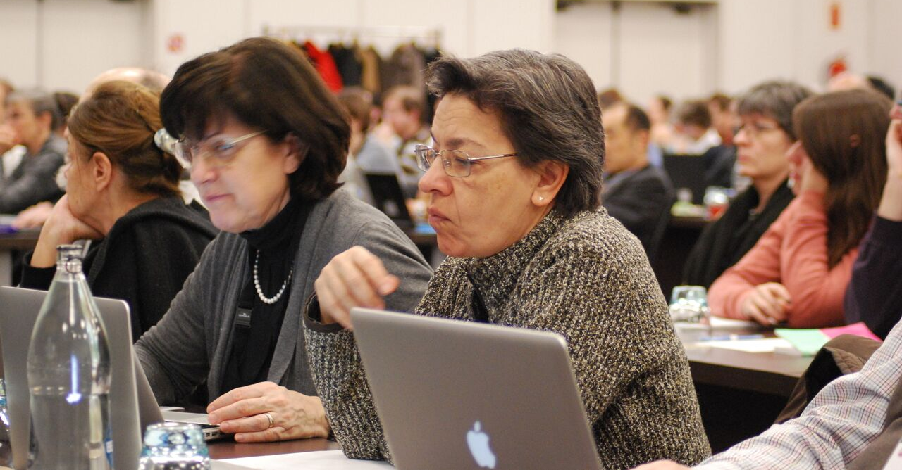
1. WP7 Overview
Development and implementation of the basic infrastructure for the community portal (hardware, content management system, design, etc.).
Covering community portal, outreach and academic activities.
Development of some tools for outreach and academic activities.

Slide 4
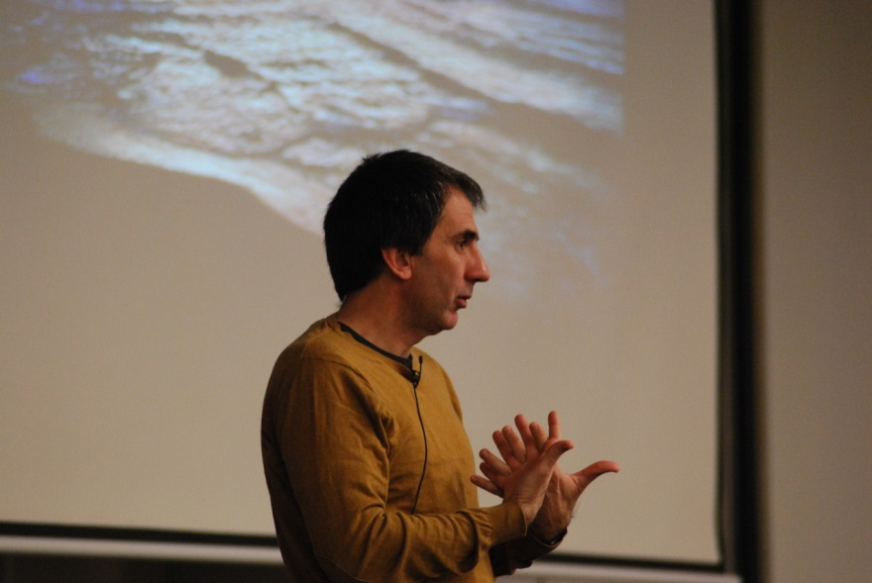
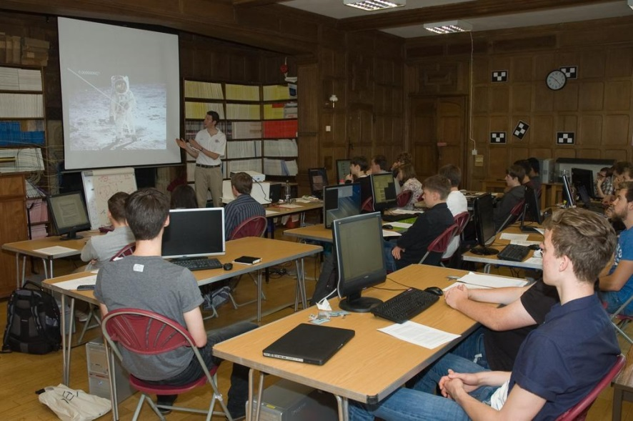
2. Main Outreach Activities
Several local outreach activities have been organized within the project and especially with the occasion of DR1, by all the GENIUS nodes, such as:
Presentations
Talks for students

Slide 5
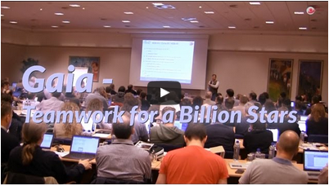
2. Main Outreach Activities
Videos
Press releases
Courses on outreach:
DPAC Consortium Meeting, Leiden, 16-20 November 2015
2nd DPAC Consortium Meeting, Sitges (Barcelona), 23-27 January 2017

Slide 6
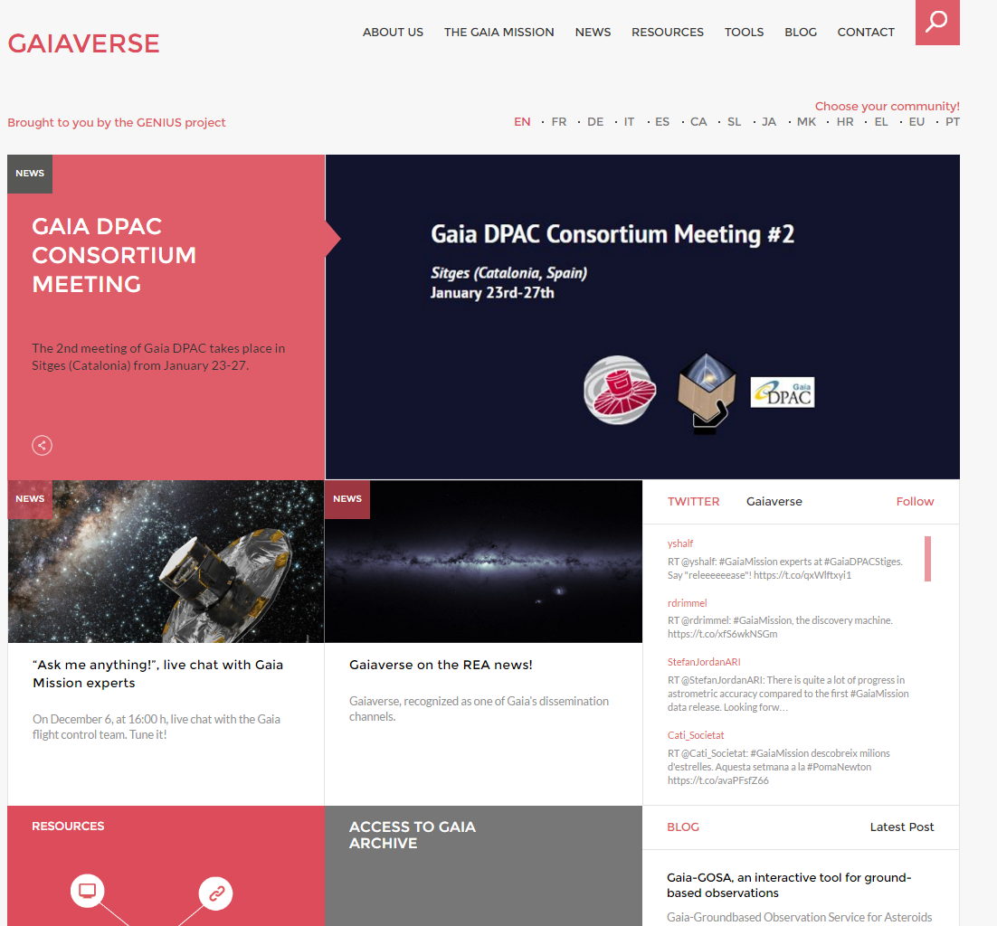
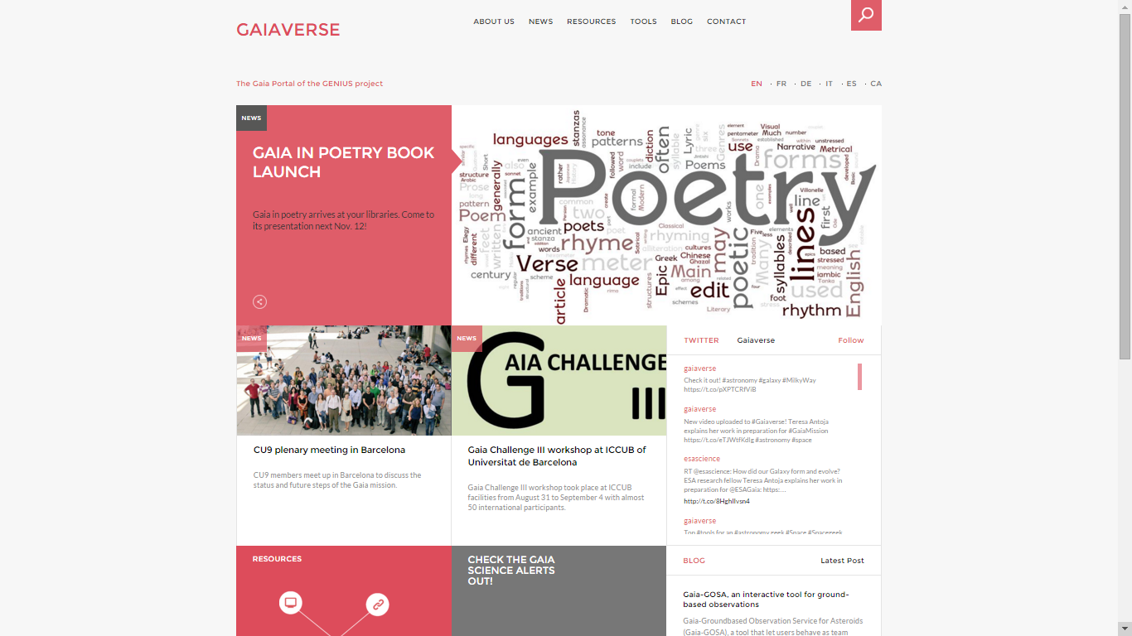
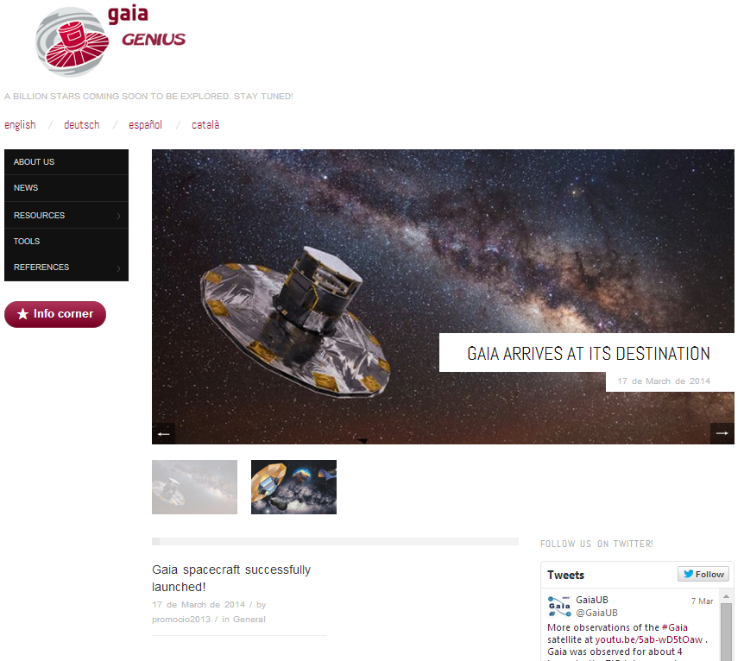
3. Gaiaverse Roadmap
3. Gaiaverse Roadmap
Handover to the Gaia community
31/03/17
14/9/16
DR1
EU PT and DR1 new pages
1/1/16
More languages
SL JA MK HR EL
8/7/15
Gaiaverse launch
EN FR DE IT ES CA
1/9/14
New portal development
1/6/14
Editorial Board
28/3/14
1st portal version
11/2/14
Survey
1/2/14
1st platform
awindowtotheuniverse.csuc.cat
genius-project.csuc.cat
4/12/13
KOM
10/11/13
Tech. note

Slide 7
4 . The Gaiaverse Portal
Homepage Menu:
About Us
The Gaia Mission
News
Resources
Tools
Blog
Contact
Homepage Boxes:
Highligthed News Article (+2 additional articles)
Twitter Timeline
Resources
Link to the Gaia Catalogue
Link to the Official Gaia Mission Website
Link to the Gaia Science Alerts
Blog

Slide 8
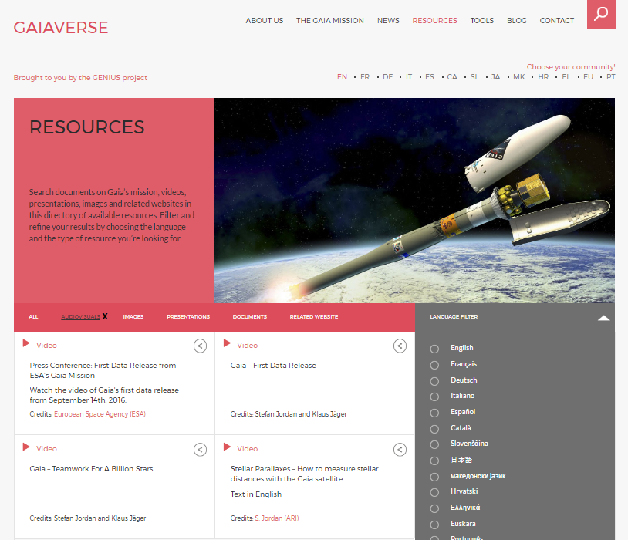

Slide 10
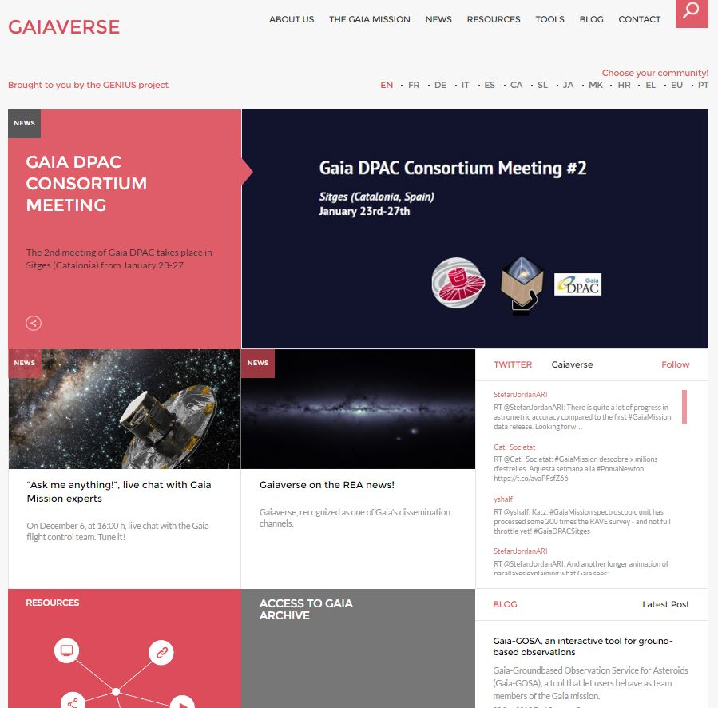
4. The Gaiaverse Portal
Released on July 8, 2015
13 Languages (6+5+2)
20 Collaborators
>9,000 Sessions
>6,200 Users
69% New Visitors
31% Returning Visitors
>22,771 Page Views
2.51 Pages/Session
00:02:40 Avg. Session Duration
Notes:
Languages (13):
July 2015: English, Spanish, Catalan, German, Italian and French.
January 2016: Slovene, Japanese, Croatian, Macedonian, Greek.
September 2016: Portuguese, Euskera.
Period: July 8, 2015 – January 23, 2017

Slide 11
4.1. Website evolution
1st Gaia Data Release
DR1 page + Direct access to Gaia Archive
>1,000 Visited Pages
2.55 Pages/Session
Gaia’s 1st year of scientific observations
Notes:
First peak (Sept./Oct. 2015) coincides with Gaia’s first year of scientific observations: we published a news post. On the blog part, Toni Santana wrote a post talking about Gaia-GOSA, which got great feedback (many visitors went to Gaiaverse to read this post).
Second peak is on Sept. 14 and following days, coinciding with the first Gaia Data Release, with new pages available dedicated to such release and direct access to the catalogue.

Slide 12
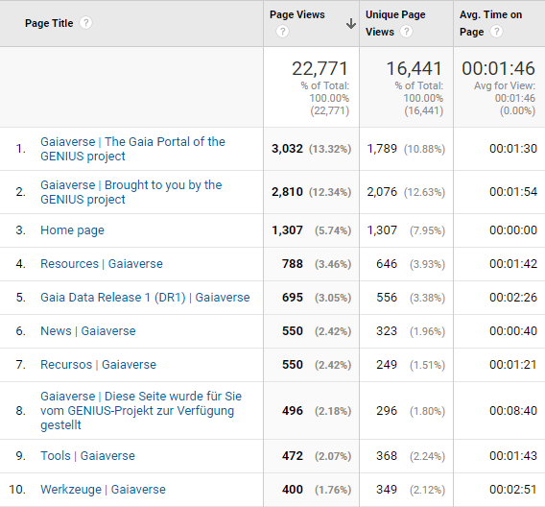
4.2. Top 10 most visited pages

Slide 13
4.3. Traffic Channels
85.44%
9.29%
3.70%
Others
1.57%

Slide 14
4.4. Country and Language

Slide 15
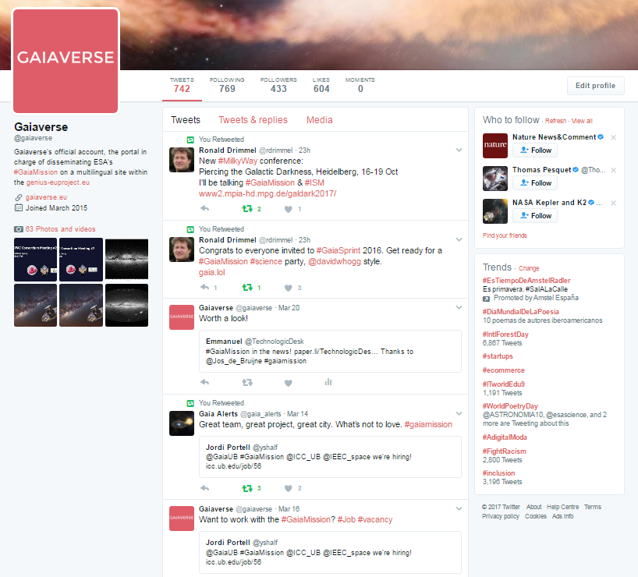
5. Gaiaverse Twitter Profile
+430 Followers

Slide 16
5.1. Twitter Analytics

Slide 17
5.2. Twitter Analytics

Slide 18
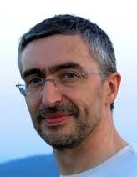
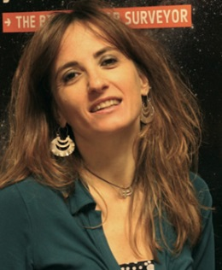
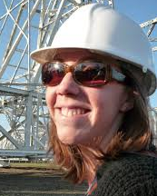
Editorial Board
Frédéric Arenou
Eduard Masana
Gráinne Costigan
Mariateresa Crosta
Heather Campbell
Notes:
After the plenary meeting in Vienna, an editorial team was created
Editorial Team: high-level supervision of the portal contents
Anthony Brown suggested this group to be a subset of the outreach team within DPAC
Members: Frederic Arenou -Paris-, Anthony Brown -Leiden- (Gráinne Costigan), Mariateresa Crosta -Itàlia-, Heather Campbell -Cambridge- and Eduard Masana)

Slide 19
List of collaborators
André Moitinho (PT)
Márcia Barros (PT)
Sónia Antón (PT)
Angela Kochoska (MK)
Antonios Karampelas (EL)
Catherine Turon (FR)
Danijela Birko (HR)
Frédéric Arenou (FR)
George Seabroke (EN)
Gráinne Costigan (FR)
Heather Campbell (EN)
Josep M. Carrasco (blog)
Maider Insausti (EU)
Maria Teresa Crosta (IT)
Marusa Zerjal (SL)
Ryoichi Nishi (JP)
Stefan Jordan (DE)
Tomaz Zwitter (SL)
Toni Santana-Ros (blog)
Yoshiyuki Yamada (JP)

Slide 20
THANK YOU!
Comments? Questions?

Slide 22
5.4. Twitter Analytics
Country
Language

Slide 23
5.3. Twitter Analytics
Gender
+5%
Age
Notes:
Organic audience includes the set of users who have interacted with organic content (= naturally shown in people’s feeds) belonging to Gaiaverse.

