Slide 1
GENIUS Final
Report for WP1
L. Balaguer-Núñez
Universitat de Barcelona / FBG

Slide 2
Management
This package provides the overall administrative management of GENIUS.
This work package includes the administrative tasks to fulfil the EC requirements and rules as well as the global administrative tasks inside the consortium, including financial management, intellectual property management and project documentation. These tasks are carried out by the GENIUS coordinator assisted by a hired project manager.

Slide 3
T1.1 Global administrative tasks
Task leader: UB
General tasks:
coordination of EC reporting,
maintenance of the TWiki internal information system,
management of the WebEx teleconferencing system,
financial management of the project,
tracking of the project technical requirements and schedule through monthly teleconferences.

Slide 4
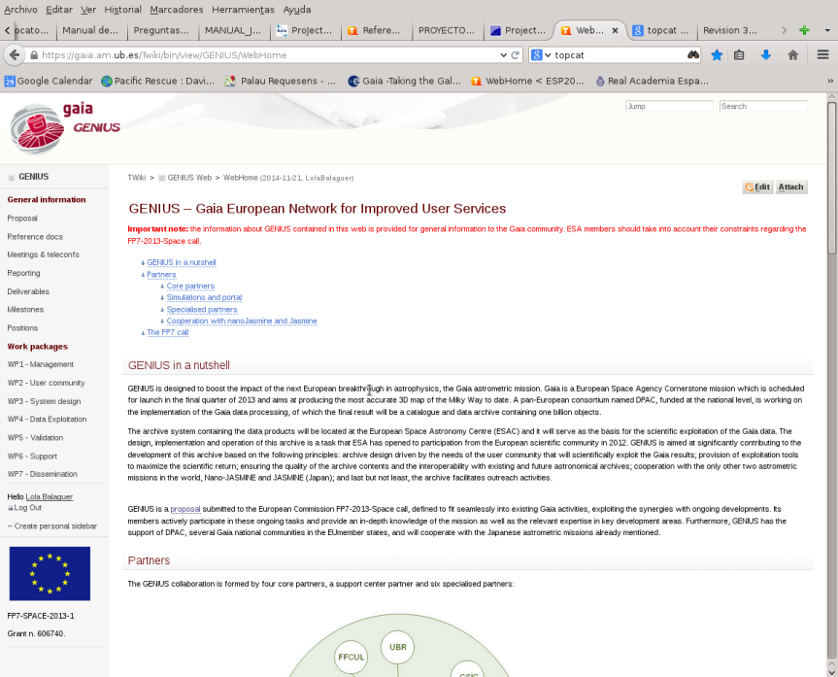
Coordination
Twiki system developed for internal information management
https://gaia.am.ub.es/Twiki/bin/view/GENIUS/
SVN Internal repository for file management at UB server

Slide 5
Work - life balance
Commitments on DOW "5.1.Providing for good work–life balance" in GENIUS:
Required equipment to make this happen:
Webex licence for teleconferences (360€/yr) and
Philips Conference Microphone LFH-9172 (300€)
Monthly progress tracking teleconferences
A total of more than 120 teleconferences, an average of 3 per month. The average number of participants is 7 and the average duration is 3 hr 20 mins. For meetings with small number of participants (up to three), Webex does give a free licence for everybody.
Their cost is smaller than only one meeting with seven participants from different nodes, whatever the city, the origin of participants or duration of the meeting

Slide 6
General Meetings
KOM organized in Barcelona (Dec 2013)
Joint Gaia CU9-GENIUS meeting in order to fully integrate the GENIUS activities in the overall Gaia DPAC effort, (Vienna Jul 2014)
GENIUS First year review (Brussels Dec 2014)
Gaia Archive Review #1: joint meeting with ESAC Science Archives (Madrid Jan 2015)
Coordination meeting (ESA-GENIUS-CU9) for cross-match activities (Rome Feb 2015)
Joint GENIUS-CU9 Plenary Meeting (Barcelona Sep 2015)
GENIUS Second year review (Barcelona Oct 2015)
Mid-term external review (Leiden Nov 2015)
GENIUS Third year review (Sitges Jan 2017)
External Advisory Board review, 27 March 2017
Final Review Meeting, Brussels 19 of April 2017

Slide 7
Reporting
We have developed a reporting system where we report every three months to the project officer from the information collected by each WP on our Twiki..
Semestral report 1 – May 2014
Semestral report 2 – First year report Nov 2014
Semestral report 3 – May 2015
Semestral report 4 – Second year repot Oct 2015
Semestral report 5 – May 2016
Semestral report 6 – Dec 2016

Slide 8
Effort
Effort of all the nodes per WP (% of total)

Slide 9
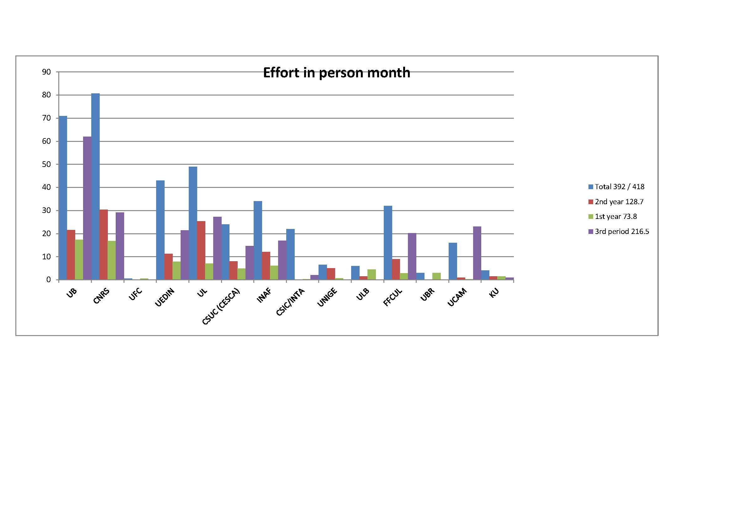
Total project effort in PM per node

Slide 10
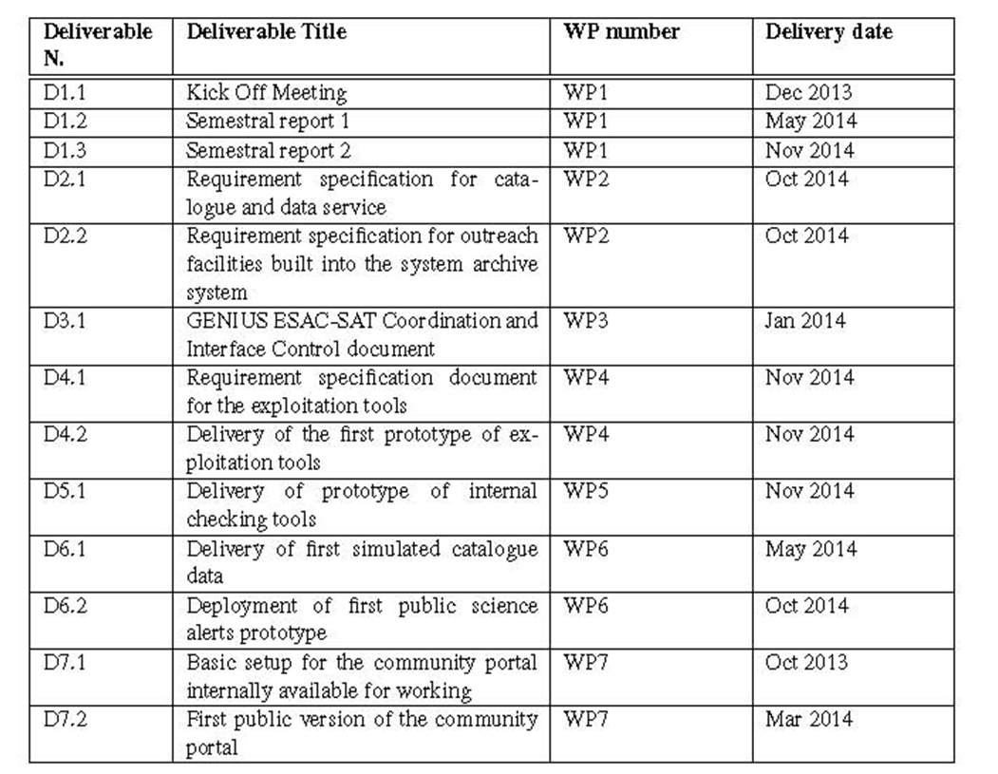
First year Deliverables

Slide 11
Second year Deliverables
May 2016

Slide 12
Third year Deliverables
Deliverable N. | Deliverable Title | WP number | Deliverable date
D1.8 | Semestral report 6 | WP1 | Dec 2016
D2.7 | Requirements specification for the archiving of raw and intermediate data | WP2 | Dec 2016
D2.8 | Requirements specification for the archiving of the original software with which the archive was produced. | WP2 | Dec 2016
D5.4 | Delivery of statistical tools | WP5 | Nov 2016
D5.5 | Delivery of model-based validation tools | WP5 | Nov 2016
D5.7 | Delivery of external validation tools | WP5 | Nov 2016
D5.8 | Delivery of special object tools | WP5 | Dec 2016
D6.3 | Delivery of second simulated catalogue data | WP6 | Apr 2016
D6.5 | Delivery of third simulated catalogue data | WP6 | Nov 2016
D6.6 | Deployment of third public science alerts prototype | WP6 | Nov 2016

Slide 13
Final Deliverables
Deliverable N. | Deliverable Title | WP number | Deliverable date
D1.9 | Completion Meeting (plenary) | WP1 | Jan 2017
D1.10 | Final report to the External Advisory Board | WP1 | Mar 2017
D1.11 | Report on dynamics of the gender balance | WP1 | Mar 2017
D2.9 | Requirements specification for model comparison and optimization tools | WP2 | Feb 2017
D3.3 | Gaia Data IVOA compliance document | WP3 | Mar 2017
D3.4 | Deployed web services, code and documentation | WP3 | Mar 2017
D3.5 | Data centre report and analysis document | WP3 | Mar 2017
D3.6 | TAP+ code and documentation | WP3 | Mar 2017
D3.7 | Deployed CANFAR-style VM research environment and produced reports and documentation | WP3 | Mar 2017
D4.6 | Deployment of exploitation tools on the Gaia archive | WP4 | Mar 2017
D5.9 | Deployment of validation tools on the Gaia archive | WP5 | Mar 2017
D7.4 | Final version of community portal. Handover | WP7 | Mar 2017

Slide 14
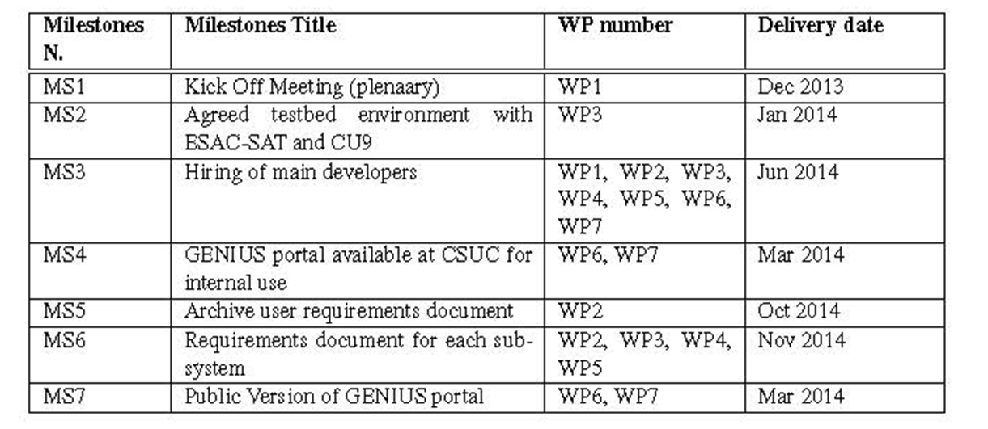
Milestones
Jan 17
Jan 2017

Slide 15
Final Milestones
Milestone N. | Milestone Title | WP number | Delivery date
MS13 | Stress test | WP3 | Dec 2016
MS14 | Load of actual Gaia data | WP3, WP5 | Jan 2017
MS15 | Completion meeting & final external review | WP1 | Mar 2017
MS16 | GENIUS products availability | ALL | Jan 2017
MS17 | Handover of GENIUS portal to Gaia community | WP7 | Jan 2017

Slide 16
Report on Gender Dynamics
Percentage of female contracted by GENIUS.
Six of the 12 nodes have contracted female on a higher rate than the average on the field.
Three of the four main nodes are among those.
In computer science projects, the IAU statistics show that a 21% female staff is the average. In the GENIUS hiring we have managed to improve this percentage to 28% in the newly hired personnel (calculated by number of contracts not FTEs). See deliverable D1.11 for more info.

Slide 17
Career Paths
People contracted by GENIUS project once their contract finished:
72% of the contracted personnel still remains in the same institution with different funds (soft money).
But looking at the gender:
76% of men stayed, while
62% of the total of women remained
Personnel that left the institution:
100% of women still looking for a job
100% of the men, now working in big companies or big projects. 60 % moved to another country while a 40% came back or remained on their country of origin, so mobility does not seem a factor.
Small number statistics but it is nonetheless interesting as a study case.

