Slide 1


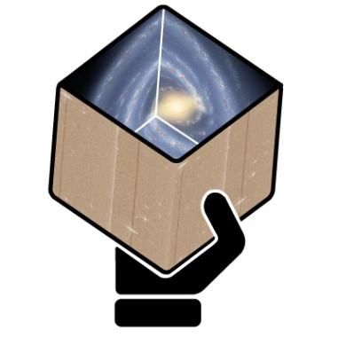
GENIUS
Final Report
for Validation of NonSingle Stars
T5.6.2
D. Pourbaix
FNRS @ ULB (Brussels)
Notes:
<number>

Slide 2
Validation of NonSingle Star solutions
It is fair to assume that 95% of the objects observed by Gaia behave like single stars of constant brightness.
What about the other 5%, should one simply throw them away?
Within DPAC, that garbage is recycled into scientific gems (stellar masses, extrasolar planet candidates, ...).
Even if the recycling codes have been extensively tested on simulated data, should one trust them on real data?
This WP deals with the validation of these potential gems.

Slide 3
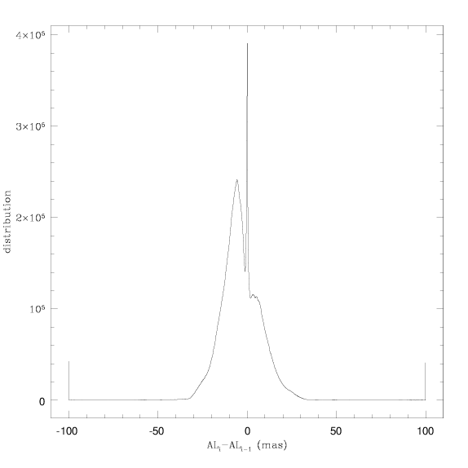
Positional input
Any validation of a NonSingle Star solution begins with the detection of its abnormal behaviour wrt genuine single stars.
The position of a star should not change much over a 6h interval.
Troublesome inputs should be fixed first!

Slide 4
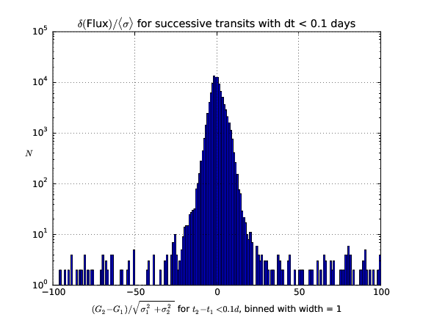
Brightness stability
Though less constrained, should that constancy hold on brightness too?
Variable stars do exist but one does not turn a star off in two hours.

Slide 5
Management
Post-doc paid by GENIUS for 3 months out of a long-term PRODEX (ESA) contract
+ know-how available right away;
- no additional manpower.

