Slide 1
GENIUS
Final Report
for Financial Management
Xavier Gutiérrez
Fundació Bosch i Gimpera – Universitat de Barcelona

Slide 2
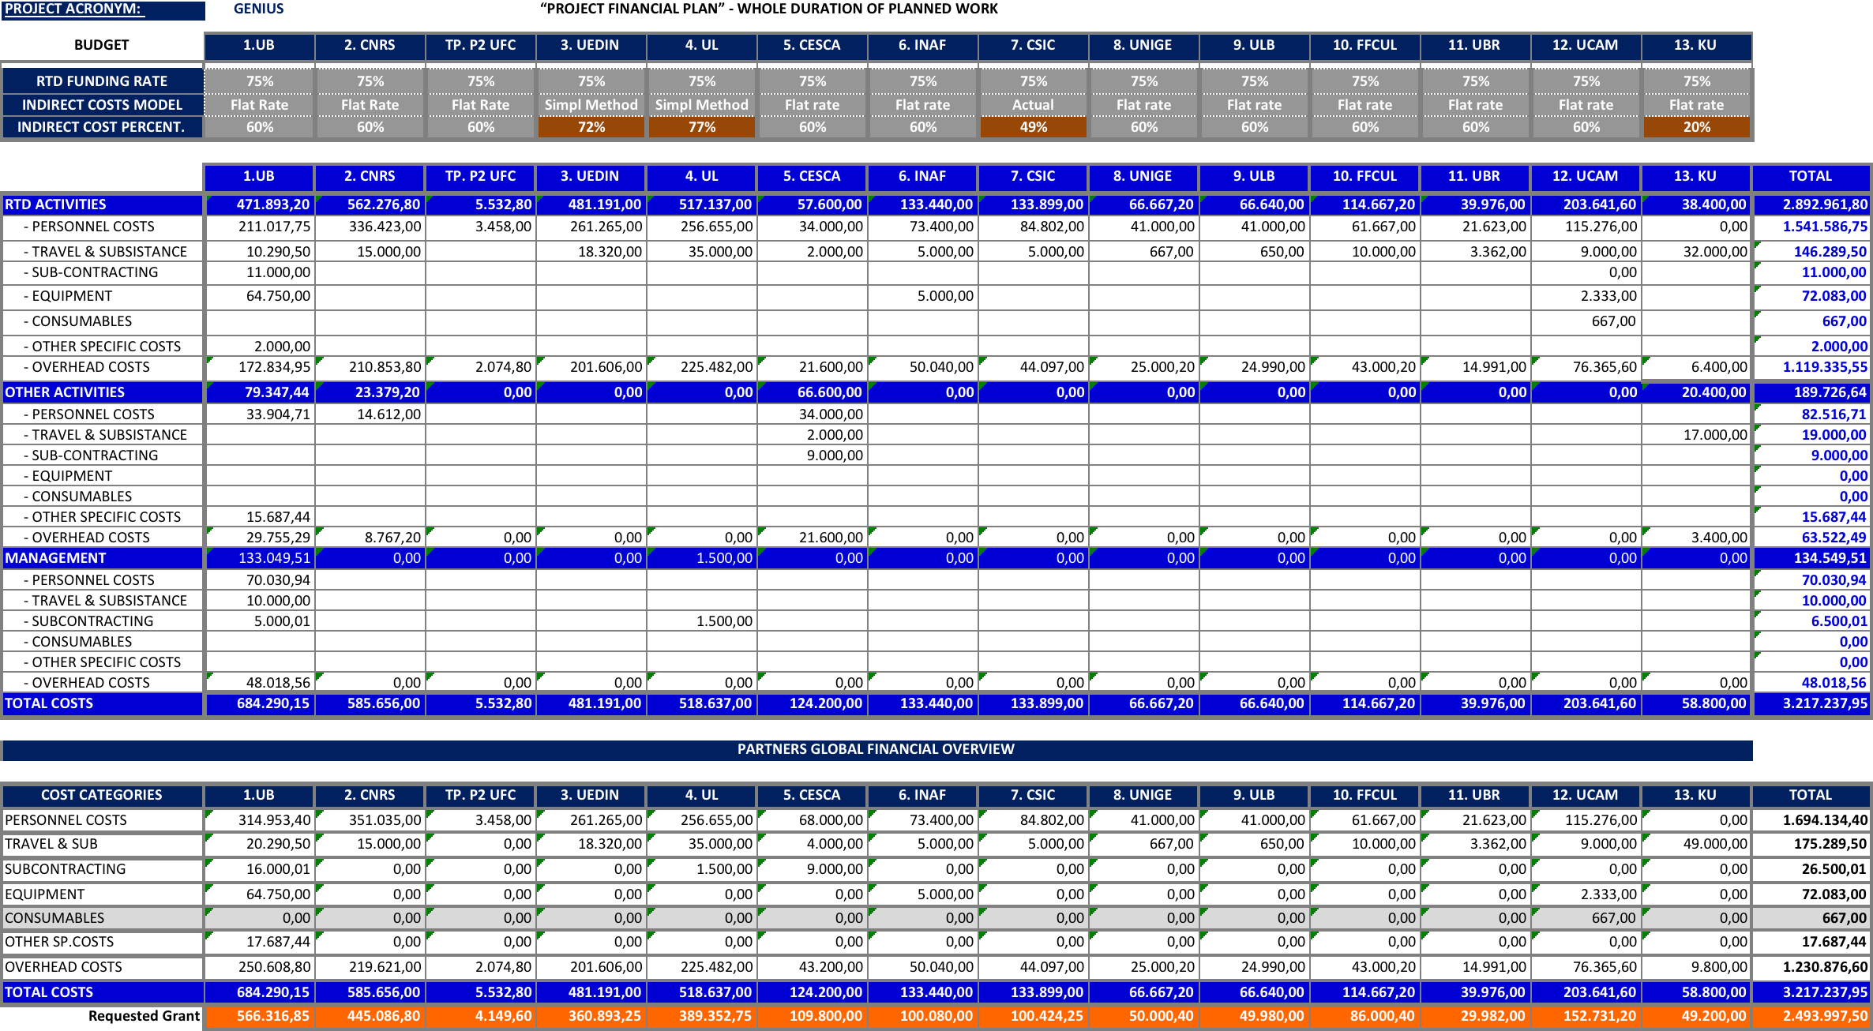
GENIUS Budget Overview in Dow

Slide 3
GENIUS Budget after amendment

Slide 4
GENIUS Payments

Slide 5
GENIUS 1st period Report

Slide 6
GENIUS 2nd period Report

Slide 7
GENIUS Execution of the project
After 2nd period report

Slide 8
GENIUS 3rd period Report
Preliminary Draft Cost for the Final Meeting
Reporting Period |  |  | 01/10/2015 - 31/03/2017
PARTICIPANT |  | Personnel costs | Travel costs | Equipment costs | Consumables costs | Others | Audits costs | Subcontracting costs | Overheads costs | Adjustments | TOTAL COSTS
1.UB |  | 262.795,70 | 17.955,40 | 0,00 | 0,00 | 7.505,95 | 5.466,00 | 0,00 | 172.954,23 | 0,00 | 466.677,28
2. CNRS |  |  |  |  |  |  |  |  | 0,00 | 0,00 | 0,00
3. UEDIN |  | 114.431,50 | 7.447,63 | 1.054,11 | 0,00 | 0,00 | 0,00 | 0,00 | 84.021,23 | 0,00 | 206.954,47
4. UL |  | 135.040,48 | 0,00 | 0,00 | 0,00 | 8.224,43 | 0,00 | 0,00 | 94.568,55 | 0,00 | 237.833,46
5. CSUC |  | 32.189,48 | 0,00 | 13.800,00 | 0,00 | 0,00 | 0,00 | 0,00 | 27.593,69 | 10.871,12 | 84.454,29
6. INAF |  | 48.262,79 | 1.226,00 | 2.592,46 | 0,00 | 0,00 | 0,00 | 0,00 | 31.248,75 | 0,00 | 83.330,00
8. UNIGE |  | 0,00 | 0,00 | 0,00 | 0,00 | 0,00 | 0,00 | 0,00 | 0,00 | 0,00 | 0,00
9. ULB |  | 1.597,37 | 397,20 | 0,00 | 0,00 | 0,00 | 0,00 | 0,00 | 1.196,74 | 0,00 | 3.191,31
10. FFCUL |  | 35.272,04 | 7.493,60 | 0,00 | 0,00 | 0,00 | 0,00 | 0,00 | 25.659,38 | 0,00 | 68.425,02
11. UBR |  | 3.022,02 | 0,00 | 0,00 | 0,00 | 0,00 | 0,00 | 0,00 | 604,04 | 0,00 | 3.626,06
12. UCAM |  | 109.234,73 | 3.968,80 | 0,00 | 70,74 | 0,00 | 0,00 | 0,00 | 67.964,56 | 0,00 | 181.238,83
13. KU |  | 0,00 | 9.756,34 | 0,00 | 0,00 | 8.418,29 | 0,00 | 0,00 | 3.634,93 | 0,00 | 21.809,56
14. INTA |  | 7.451,68 | 1.365,74 | 0,00 | 0,00 | 0,00 | 0,00 | 0,00 | 9.398,24 | -3.097,28 | 15.118,38
 |  | 749.297,79 | 49.610,71 | 17.446,57 | 70,74 | 24.148,67 | 5.466,00 | 0,00 | 518.844,34 | 7.773,84 | 1.372.658,66

Slide 9
GENIUS 3rd period Report
Financial Summary Cost Justified ( not Requested)
Budget | TOTAL | Accepted Cost EC 1st Period | Accepted Cost EC 2nd Period | DRAFT Cost EC 3rd Period | ∑ Amount Justified | Budgetary Deviations
1.UB | 747.620,59 | 123.969,96 | 153.155,45 | 466.677,28 | 743.802,69 | 3.817,90
2. CNRS | 592.056,00 | 155.468,85 | 251.464,58 |  | 406.933,43 | 185.122,57
2. TP - UFC | 5.532,80 | 4.529,10 |  |  | 4.529,10 | 1.003,70
3. UEDIN | 481.191,00 | 81.971,41 | 122.431,51 | 206.954,47 | 411.357,39 | 69.833,61
4. UL | 518.637,00 | 55.521,20 | 198.568,28 | 237.833,46 | 491.922,94 | 26.714,06
5. CESCA | 156.200,00 | 28.068,51 | 29.981,04 | 84.454,29 | 142.503,84 | 13.696,16
6. INAF | 133.440,00 | 41.193,81 | 45.027,71 | 83.330,00 | 169.551,52 | -36.111,52
7. CSIC | 11.645,69 | 2.491,05 | 9.154,64 |  | 11.645,69 | 0.00
8. UNIGE | 66.667,20 | 0,00 | 72.193,58 | 0,00 | 72.193,58 | -5.526,38
9. ULB | 66.640,00 | 45.930,13 | 17.528,78 | 3.191,31 | 66.650,22 | -10,22
10. FFCUL | 114.667,20 | 11.974,34 | 27.499,90 | 68.425,02 | 107.899,26 | 6.767,94
11. UBR | 39.976,00 | 30.184,03 | 1.013,44 | 3.626,06 | 34.823,53 | 5.152,47
12. UCAM | 203.641,60 | 3.614,26 | 25.193,92 | 181.238,83 | 210.047,01 | -6.405,41
13. KU | 58.800,00 | 8.321,14 | 12.982,50 | 21.809,56 | 43.113,20 | 15.686,80
14. INTA | 17.600,00 |  | 8.851,17 | 15.118,38 | 23.969,55 | -6.369,55
 | 3.214.315,09 | 593.237,79 | 975.046,50 | 1.372.658,66 | 2.940.942,95 | 273.372,13

Slide 10
GENIUS Last steps
On May 1st 2017 a new reporting module will be opened on the Participant Portal
We are entitled to submit 3rd periodic report within a period of 60 days, no later than May 31st 2017
UB, CNRS and UL should submit a Certificate on Financial Statements (CFS) attached to their Financial Report according to their expected expenses

Slide 11
Many thanks
XAvier Gutierrez Muñoz
Head of Management Unit Oficina de Projectes Internacionals de Recerca (OPIR)
Fundació Bosch i Gimpera| Universitat de Barcelona
Oficina de Transferència de Tecnologia
T. +34 93 403 53 85 / 610.10.56.72| www.fbg.ub.edu

