Slide 1

GENIUS kick-off meeting
The Gaia context: DPAC & CU9
X. Luri

Slide 2
The Gaia Data Processing & Analysis Consortium (DPAC)
Notes:
r

Slide 3
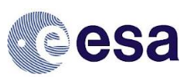
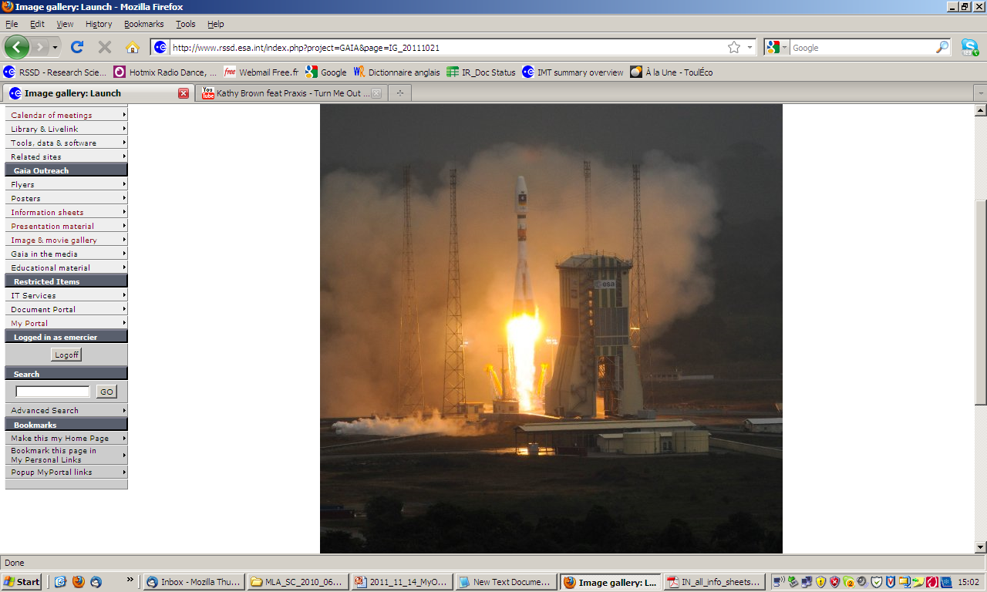
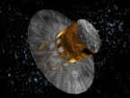
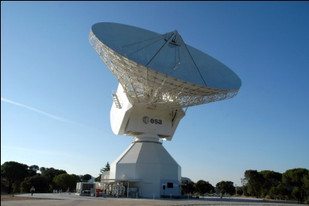
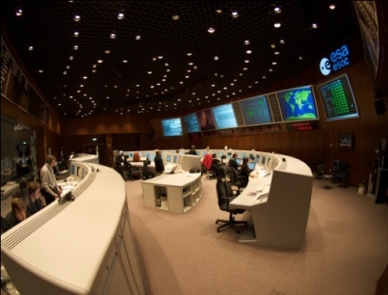
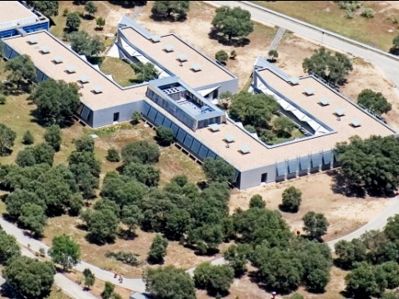
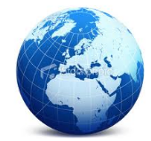
Industry/ESA CSG/ESOC
(2013)
One consortium: the DPAC
The final responsibility
of the Mission is
in the hands of ESA
Data reduction is a responsibility of the scientific community, funded by the member states

Slide 4
Data Processing and Analysis Consortium
Formed to answer the Announcement of Opportunity (AO) for Gaia data processing
Involves large number of European institutes and observatories (>400 people, >20 institutes)
The science community must fund the majority of the Gaia processing (not ESA)

Slide 5
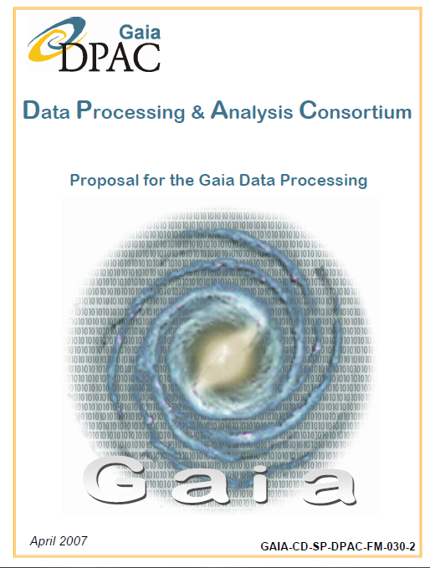
AO response (2006)
711 pages
Presents the initial design for the processing of the Gaia data
Also defines the structure of DPAC
Concepts have evolved since then

Slide 6
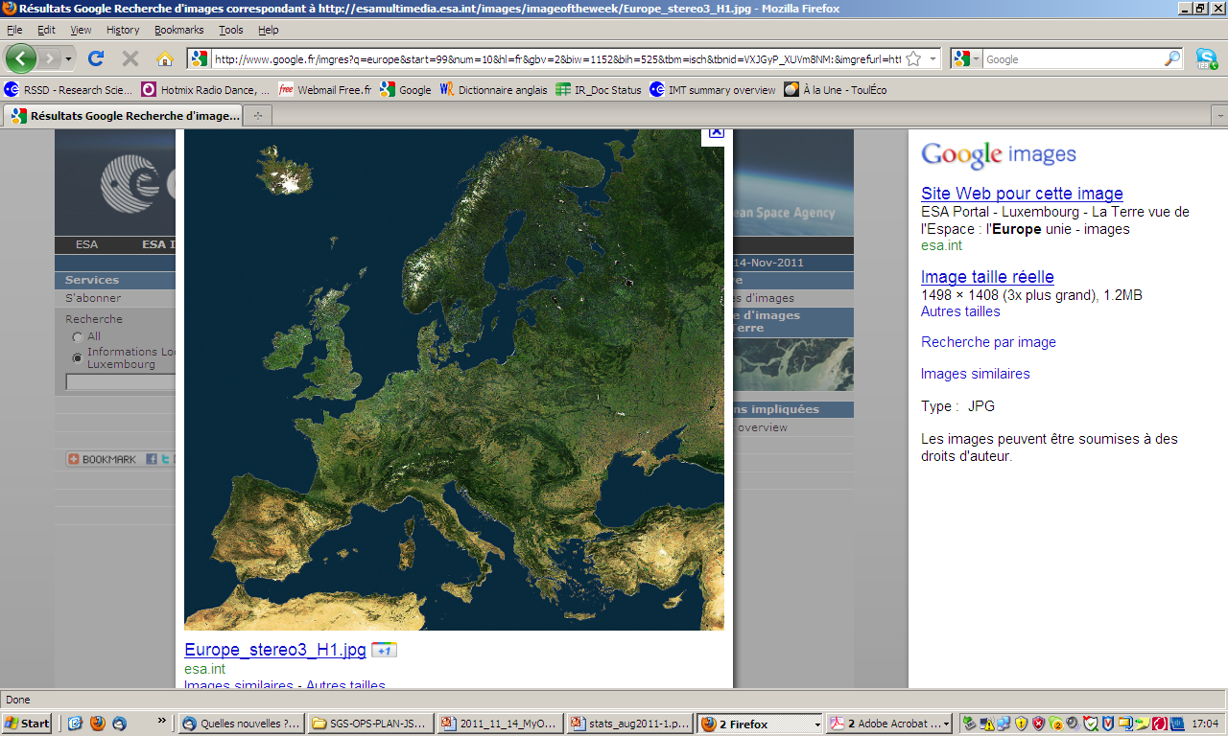



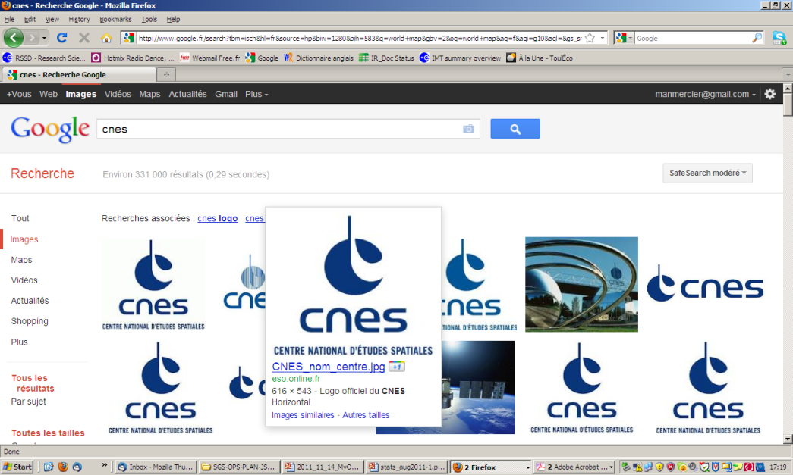
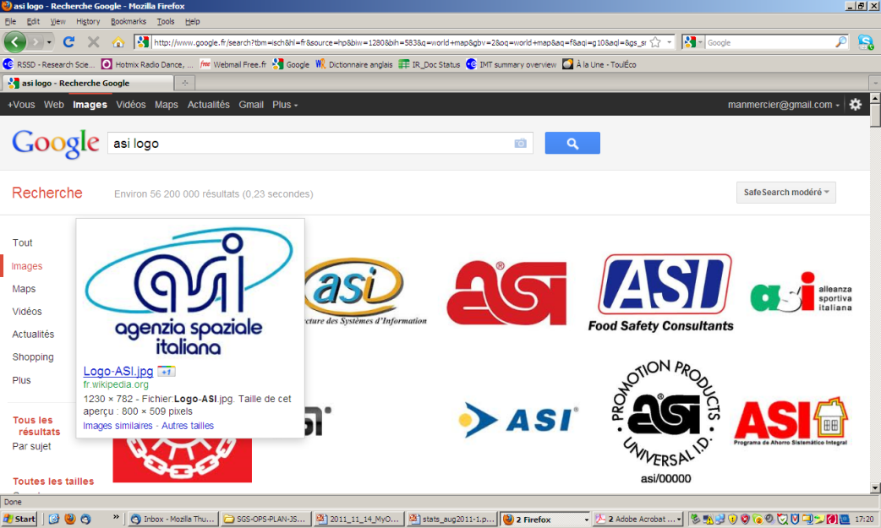





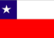

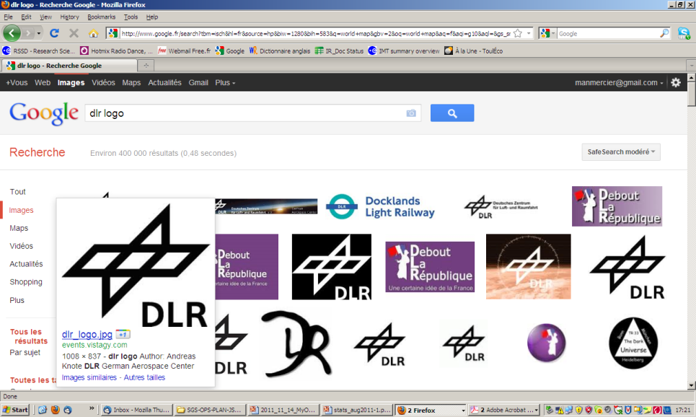
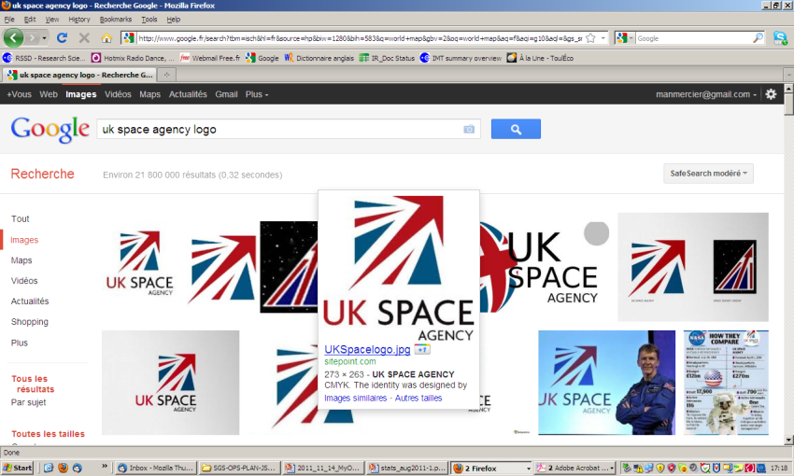





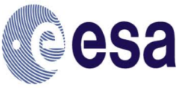
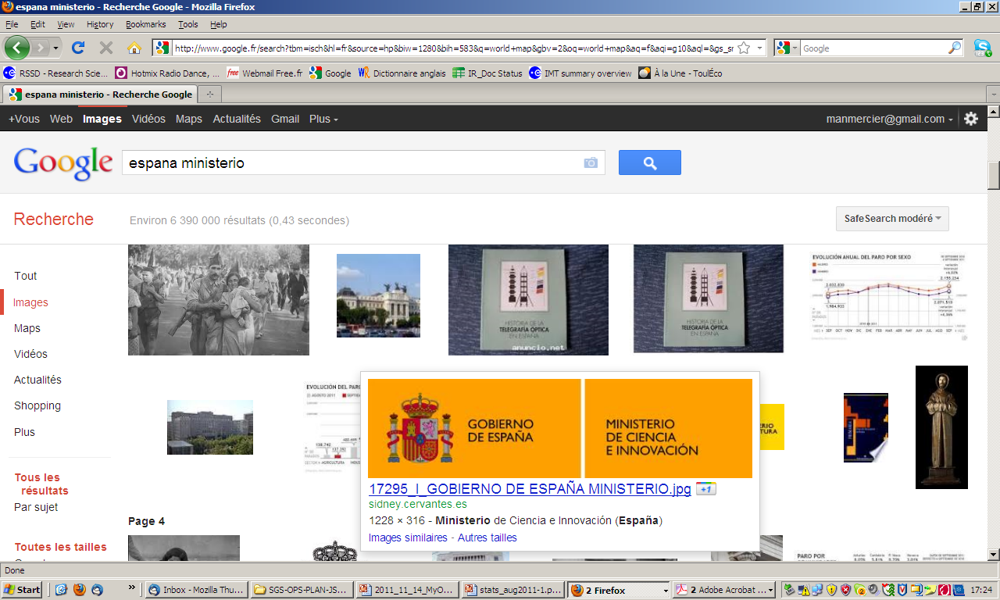


459 members
24 Funding Agencies
93% in the 10 largest
With a 5 years mission, ~33% of DPAC cost will be dedicated to Operations
MLA duration: 2007-2022
FTEs/year up to 2011: 270
Average yearly cost: ~30Meuros
Global cost: ~500M€

Slide 7
MLA SC
DPAC
Gaia Project
Executive Committee
MOC
Project
team
SOC
Project Office
WGs
WGs
CUs+DPCs

Slide 8
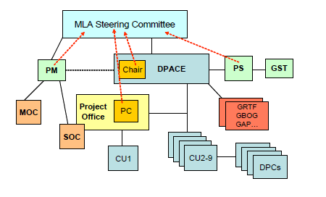
Coordination
units
Data processing
centers

Slide 9
The leaders of CUs and the PO + very few others
  organize the work
  see it is carried out
  resolve schedule conflicts/dependencies
The Gaia Science Team (GST)
  looks after the science
  ensures DPAC is on track
  DPAC chair sits in GST

Slide 10
DPAC coordination units
CU1: System Architecture
CU2: Data Simulations
CU3: Core Processing
CU4: Object Processing (multiple objects)
CU5: Photometric Processing
CU6: Spectroscopic Processing
CU7: Variability Processing
CU8: Astrophysical Parameters
CU9: Catalogue Access

Slide 11
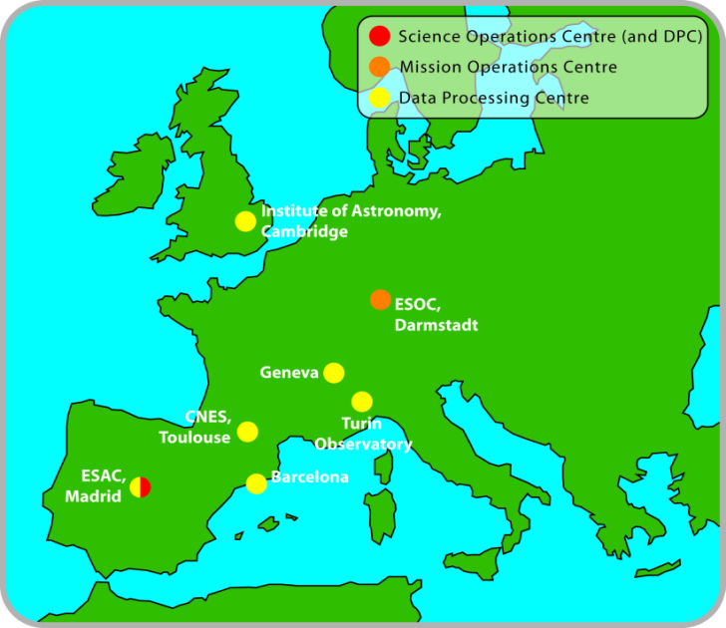
DPCs underpin and support CUs
  Software support and production
  Operation of processing system(s)
ESAC (CU1,3,9) Madrid
BPC (CU2,3, GENIUS) Barcelona
CNES (CU4,6,8) Toulouse
ISDC (CU7) Geneva
IoA (CU5) Cambridge
OATO (CU3) Torino

Slide 12
The CU9
Notes:
r

Slide 13
CU9 role
The CU9 is in charge of designing, implementing and operating the Gaia archive. It is responsible of actually making the Gaia data available to the scientific community.
GENIUS will integrate its work into the CU9 activities

Slide 14
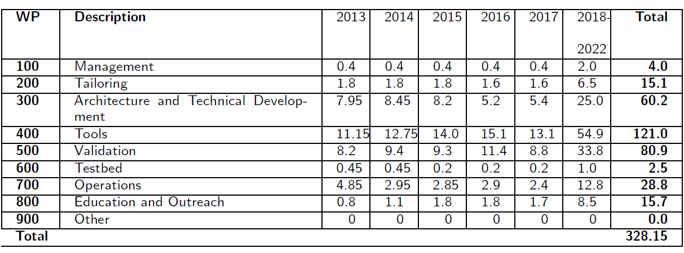
Tasks

Slide 15
Proposed data releases
First release: launch + 22 months (~90% of the sky)
  Positions (α,δ) and G magnitudes for all stars where the formal errors on the position are acceptable. The catalogue will be for the mean epoch 1 of observation and only for sources exhibiting single star behaviour
  The Hundred Thousand Proper Motions (HTPM) catalogue based on the Hipparcos stars
GENIUS

Slide 16
Second release: launch + 28 months (~90% of the sky)
  Positions (α,δ) with five-parameter solution where available, and G magnitudes for all stars where the formal errors on the position are acceptable. The catalogue will be for the mean epoch 1 of observation and only for sources exhibiting single star behaviour
  Integrated photometry BP/RP, with appropriate error estimates for sources where basic astrophysical parameter estimation has been verified (such parameters would also be released).
  Mean radial velocities for stars in the catalogue which do not exhibit any deviation from a constant radial velocity, and for which, in the absence of atmospheric parameter estimates, an appropriate synthetic template could be selected. These will be based on single epoch radial velocity determination hence probably only bright stars.
GENIUS

Slide 17
Third release: launch + 40 months (~90% of the sky)
  Five parameter astrometric solution with appropriate error estimates for at least 90% of the sky for bona fide single stars.
  Orbital solutions (including the 5-parameter astrometric term) for periods between 2 months and 75% of the observation duration
  Integrated photometry BP/RP with appropriate errors
  Spectrophotometry from BP/RP for sources for which astrophysical parameters aresimultaneously released
  Source classifications (probabilities) plus stellar effective temperatures and line-of-sight extinctions based on BP/RP and astrometry for stars with sufficiently high quality data (expected to be most stars).
  Mean RVS spectra for sources where single epoch spectra are usable and astrophysical parameters are simultaneously released.
  Mean radial velocities for those stars in the catalogue that do not exhibit any deviation from a constant radial velocity and for which astrophysical parameter estimates are available.

Slide 18
Fourth lease: launch + 65 months
  Updates of astrometry with appropriate error estimates.
  Spectrophotometry from BP/RP for sources for which astrophysical parameters are simultaneously released.
  Mean RVS spectra for sources where single epoch spectra are usable.
  Source classifications (probabilities) plus multiple stellar astrophysical parameters derived from BP/RP, RVS and astrometry for the majority of stars.
  Orbital solution (including the 5-parameter astrometric term) for periods between 2 months and 75% of the observation duration
  Variable star classifications and parameters as available, and the epoch photometry with appropriate error estimates, on which these results are based, are simultaneously released
  Solar system results with preliminary orbital solutions and individual epoch observations
  Non-single star catalogue

Slide 19
Final release: end of mission + 3 years (2022-2023)
  Full astrometric, photometric, radial velocity catalogue
  All available variables and non-single Star solutions
  Source classifications (probabilities) plus multiple astrophysical parameters derived from BP/RP, RVS and astrometry for stars, unresolved binaries, galaxies and quasars.
  Precision improved with respect to 4th release. Some parameters may not be available for fainter stars.
  Non-single Star solutions and exo-planet lists
  All epoch and transit data for all sources
  All Ground Based Observations made for data processing purposes (or links to it)

Slide 20
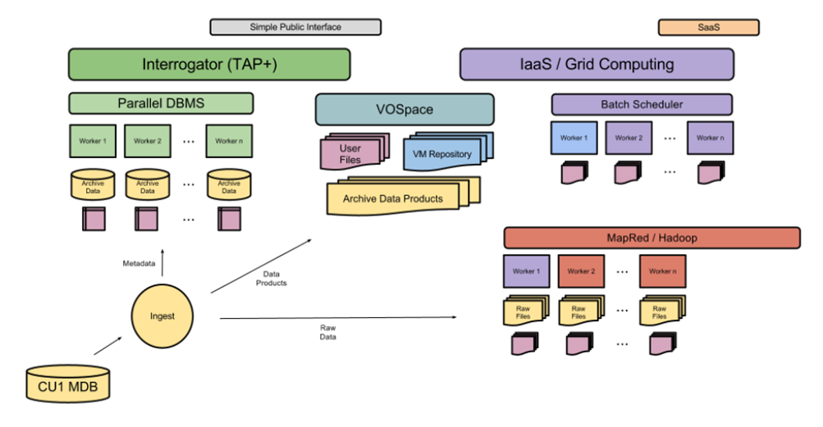
Archive architecture at SOC (initial ideas)

Slide 21
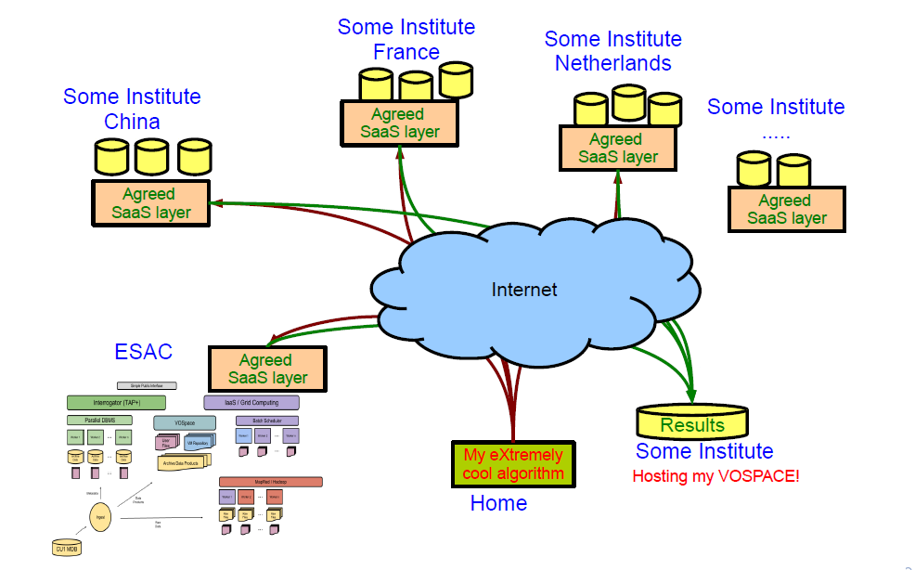
A possible “cloudy” future

Slide 22
2000
2004
2008
2012
2016
2020
Concept & Technology Study (ESA)
ESA Acceptance (2001)
Re-assessment:
Ariane-5 → Soyuz
Prime contractor: EADS-Astrium
Technology Development
Design, Build, Test
PDR
CDR
Launch
Cruise to L2
Observations
GDAAS
DPAC: Preparation of processing
DPAC: Data Analysis
MLA
Sci. .Comm
First GIS prototype +
Simulator
Early Data
Catalogue

Slide 23
CU9 Software Development Plan
First version almost ready
It defines the CU9 structure and schedule
Basic reference for GENIUS work

