Slide 1

GENIUS
Kick-off meeting
THE CONTEXT, and Guidelines for a good start
Traian BRANZA
REA Unit S2- Space Research
Barcelona, 04/12/2013

Slide 2
REA set up and organisation
REA created 14 December 2007 (EC/2008/46)
Autonomous since 15 June 2009
2013: 550 for REA & about 30 for Space Research
Under Horizon 2020, tasks to be increased
Total budget managed: about € 6.5 billion
(including 630 M€ for Space Research)
  Around € 100 Millions per call for Space Research
Notes:
REA - Space Research
14/09/2009
2
2

Slide 3
REA mission and tasks
The REA implements some actions:
  SME-specific actions (Capacities)
  Marie Curie actions (People)
  Security and Space actions (Cooperation)
The REA provides horizontal services across all programmes:
  Runs the evaluation facility (reception of proposals and support to evaluation)
  Provides administrative services for registration of beneficiaries (central validation)
  Runs a central FP7 enquiry service
Notes:
3

Slide 4


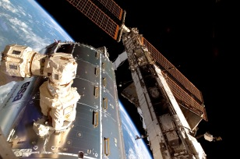


European Space Policy & FP7
The strategic mission of the European Space Policy, jointly developed by the European Commission and the ESA, is based on the peaceful exploitation of outer space.
- Expert assistance
- Implementation
implementation
policy

Slide 5


REA Space Unit
REA and EC's role in Space Research
The REA Space Research unit is responsible for implementing the part of the Space work programme
The REA is in charge of:
organising the evaluation of proposals
negotiation of proposals
technical and financial management of projects
Policy work remains within the Commission - DG Enterprise & Industry (ENTR)
this includes the definition of the Space work programme

Slide 6
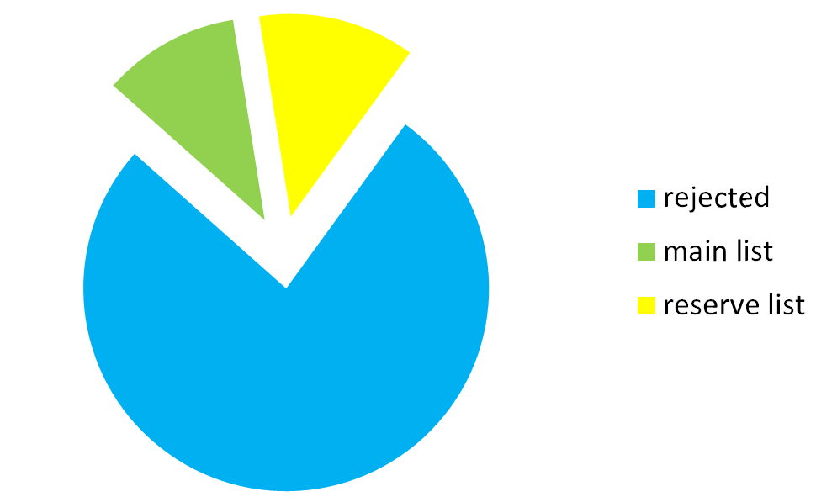
FP7-SPACE-2013-1 evaluation results topic 2.1.01 (Exploitation of space science and exploration data)
Proposals: Exploitation of space science and exploration data
10%
12%
78%

Slide 7
Communication with REA Project Officer
Good practice:
Every three months short email with actual progress of the project (activities in progress, planning, deviations …)

Slide 8

Grant agreement: Core text + Annexes
All partners should
read these!
Annex
I | Description of Work -DoW
II | General conditions
III |  |  | Not applicable
IV | Form A | Accession to the grant agreement | Each partner sign 3 copies of Form A ⇒ coordinator to sign 1 copy retained by coordinator, 1 copy sent back to beneficiary, 1 copy sent to the REA Coordinator sends to REA one signed Form A per beneficiary at latest 45 calendar days after the entry into force and can pay the pre-financing only to those who provided the Form A
V | Form B | Request for accession of a new beneficiary to the Grant Agreement | In case of a termination of a beneficiary, the addition of a new one would be also possible (see Annex II – General conditions)
VI | Form C | Financial statement submitted by each beneficiary at the end of the reporting period | To be electronically submitted via the Participants Portal After Coordinator’s approval, they are (printed, signed &) sent within 60 days after the end of the reporting period Further information see: ftp://ftp.cordis.europa.eu/pub/fp7/docs/presentation-force_en.pdf

Slide 9
Grant agreement annexes
Annex
VII | Forms D | Certificate on the financial statements Only if a partner will requests more than € 375 000 | The certificate shall be submitted for claims of payments when the amount of the EU financial contribution claimed by a beneficiary as a reimbursement of costs is equal to or exceeds € 375 000, when cumulated with all previous payments for which the certificate has not been submitted Verified as factual by an external auditor Public bodies, secondary and higher education establishments and research organisations may opt for a competent public officer to provide their certificate on the financial statements and on the methodology.
 | Forms E | Certificate of the methodology | Optional, suitable especially for beneficiaries with multiple participations in FP7 Beneficiary may request to opt for this certificate on the methodology for the calculation of costs, which it uses to prepare its cost claims with regard to both personnel and indirect costs This certificate must be forwarded in the form of a detailed description verified as factual by its external auditor When this certificate is accepted, the requirement to provide certificates on the financial statements for claims of interim payments shall be waived Details and advantages explained in 'Guidance Notes on Audit Certification'

Slide 10

Reporting and review
Deliverables
  To be submitted at the date scheduled in the work plan,
  Via SESAM/SEP
  If a deliverable is « late », explain the reason, the corrective action undertaken, the estimate date of delivery
  The PO will make an assessment of the situation.
Annual technical reviews review
  Planned at month 12, 24 and 42
  Present the work carried out, the main achievements and the use of the resources
  REA will be assisted by external reviewers
Notes:
10

Slide 11
Reports
  Give a clear account of the project activities during the reporting period
    What did you do?
    What did you achieve?
    Which problems did you encounter?
    How did you spend your budget? Any deviations?
      Personnel: Who worked on the project? How many person*months? How much?
        KEEP TIMESHEETS
      Travel: which trips? Where? How much in total?
      Any subcontracting?
      Etc.
  Clear, informative, straight to the point, concise
  Transparent communication
  On time
Notes:
11

Slide 12
Prefinancing/Guarantee Fund
Prefinancing:
  60% of the Total EC contribution;
  GENIUS: 1,205,173.78 EUR (paid to the coordinator within 45 days following the date of entry into force of the grant agreement).
Guarantee Fund:
  5% of EC contribution; GENIUS: 124,673.15 EUR
  No collective financial responsibility in FP7 as was the case in FP6 (still collective scientific responsibility)
  At the final payment, the amount contributed to the Fund shall be returned to the beneficiaries via the coordinator

Slide 13
Payments
  Linked to submission of complete and correct report, signed form C’s and deliverables
  « The Commission shall evaluate and approve project reports and deliverables and disburse the corresponding payments within 105 days of their receipt. »
Beneficiaries are allowed to transfer limited budget between different activities and between themselves in so far as the work is carried out as planned in the Description of Work, and upon prior agreement of the PO
Notes:
13

Slide 14
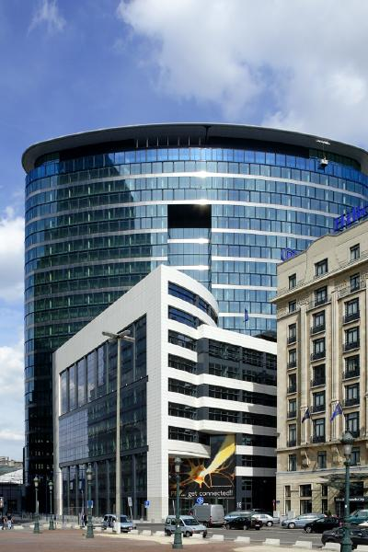
Thank you for your attention!
Traian BRANZA
REA – Research Executive Agency
http://ec.europa.eu/research/rea
@ traian.branza@ec.europa.eu
 COV2 17/102▪ 1049 Brussels ▪ Belgium
site 16 Place Rogier ▪ 1210 Brussels
 +32-2-29 60671
 +32-2-29 79646
Copyright © 2007-2009 Close Comfort
Notes:
14
14

Slide 15
Additional information on project management:
reporting,
auditing,
GA amendments
publication issues

Slide 16
Reporting
During the course of GENIUS, the consortium should submit:
The deliverables identified in Description of Work of the Grant Agreement, according to the timetable specified in the Deliverables list
A periodic report within 60 days of the end of each reporting period (including the last reporting period)

Slide 17

Guidance Notes on Project Reporting
http://ec.europa.eu/research/participants/portal/ShowDoc/Extensions+Repository/General+Documentation/Guidance+documents+for+FP7/Project+reporting/project_reporting_en.pdf

Slide 18
Periodic report
The periodic report comprises:
An overview, including a publishable summary, of the progress of work towards the objectives of the project, including achievements and attainment of milestones and deliverables identified in the Description of Work;
An explanation of the use of the resources;
A Financial Statement (Form C) from each beneficiary + summary financial report for all beneficiaries together;
Financial statements should be accompanied by certificates (Form D), when appropriate.

Slide 19
Final reporting
At the end of the project you should submit:
A final report, within 60 days after the end of the project, comprising:
  A final publishable summary report covering results, conclusions and socio-economic impact of the project;
  A report covering the wider societal implications of the project, in the form of a questionnaire (gender equality actions, ethical issues, etc.)
After receiving final EC payment, the coordinator shall submit a report on the distribution of the Community financial contribution between beneficiaries. To be submitted 30 days after receipt of the final payment.

Slide 20
Submission of reports
Register in ECAS (Commission’s Authentication Service): https://webgate.ec.europa.eu/ecas/index.jsp
Once access granted, log in and submit documents via SESAM through the Participant Portal
What information should be submitted:
  Deliverables
  Publications
  Patents (if relevant)
  Periodic and final reports
Additonal information on SESAM see: http://webgate.ec.europa.eu/sesam/index.do

Slide 21
Submission of financial statements: FORCE
Financial Statements (FORM C) are sumitted via FORCE
  FORCE is a web based tool to edit and submit Forms C
  Use your ECAS registration to enter FORCE (https://webgate.ec.europa.eu/ecas/index.jsp)
Further information see: ftp://ftp.cordis.europa.eu/pub/fp7/docs/presentation-force_en.pdf

Slide 22
Technical Project Reviews / Audits
The REA may initiate a technical audit or review at any time during the implementation of the project and up to up to five years after the end of the project.
Independent experts are appointed as reviewers:
  give external advice to the REA on the project for the period concerned
  assist the REA by recommending any reorientation that may be required.

Slide 23
Technical Project Reviews/Audits
The reviewers assess, among others:
  the degree of fulfilment of the project work plan and of the related deliverables;
  the continued relevance of the objectives;
  the resources planned and utilised in relation to the achieved progress;
  the management procedures and methods of the project;
  the beneficiaries’ contributions and integration within the project etc.
The COO will be informed on the outcome of the review report (submitted via SESAM)
Templates for review report: http://ec.europa.eu/research/participants/portal/page/fp7_documentation;efp7_SESSION_ID=yc0vSdZTy3lG8CH4KmvJM7J2ChfpphJZJKl2vhBQ6ZQJ2g4f1X5J!1893387052

Slide 24
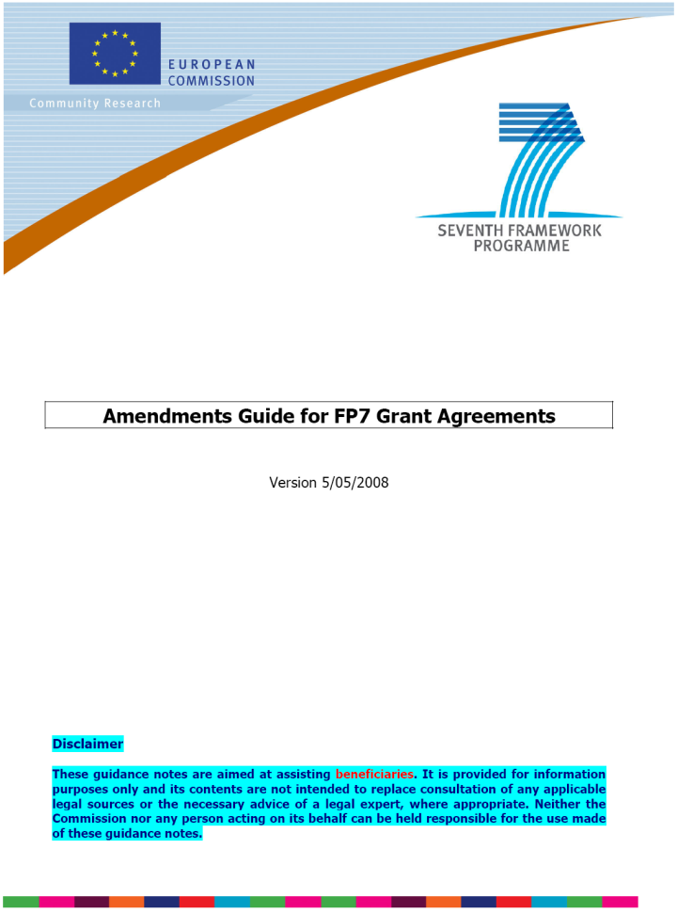
Request for Amendments
An amendment to a grant agreement (GA) is a legal act modifying the commitments initially accepted by the parties and which may create new rights or impose new obligations on them, or modifying significant parts of the GA. It allows the parties to modify the GA during its lifetime.
When does the GA need to be amended by an Amendment Request?
When is an Information Letter sufficient?
See under participant Portal http://ec.europa.eu/research/participants/portal/ShowDoc/Extensions+Repository/General+Documentation/Guidance+documents+for+FP7/Negotiations+and+amendments/amendments-ga_en.pdf

Slide 25
Approval of reports
After reception of the reports the REA may:
Approve the reports and deliverables: REA disburses the corresponding payments within 105 days of their receipt unless the time-limit, the payment or the project has been suspended;
Suspend the time limit if reports/deliverables have not been supplied, are incomplete, unclear or raise doubts concerning the eligibility of costs claimed.
Suspend the payment at any time for the amount intended for the beneficiary(ies) concerned: for details see Article II.5 of Annex II (General conditions) to the grant agreement;
Reject the reports and deliverables by giving an appropriate justification and, if appropriate, start the procedure for termination of the GA.

Slide 26

Financial audits
The Commission/REA may, at any time during the implementation of the project and up to five years after the end of the project, arrange for financial audits to be carried out, by external auditors, or by the Commission/REA services themselves including European Anti-Fraud Office OLAF.
The beneficiaries shall keep the originals or, in exceptional cases, duly authenticated copies – including electronic copies - of all documents relating to the grant agreement for up to five years from the end of the project

Slide 27

Publications and publicity
The beneficiaries shall, throughout the duration of the project, take appropriate measures to engage with the public and the media about the project and to highlight the EC financial support.
Any publicity, including at a conference or seminar or any type of information or promotional material must specify that the project has received EC research funding and display the European emblem.
Any publicity made by the beneficiaries in respect of the project must specify that it reflects only the author’s views and that the Community is not liable for any use that may be made of the information contained therein.

Slide 28
Publications and publicity
All publications shall include the following statement:
The research leading to these results has received funding from the European Community's Seventh Framework Programme ([FP7/2007-2013]) under grant agreement n° 607325 (see Article II.30. of the Grant Agreement).
During and after the project, the coordinator shall provide references and an abstract of all scientific publications relating to foreground at the latest two months following publication (see Article II.30. of the Grant Agreement).
As part of the final project report, the coordinator will be required to submit a full list of publications relating to foreground of the project.

