Slide 1
GENIUS kick-off meeting
WP100 - management
X. Luri

Slide 2
This work package includes the administrative tasks to fulfill the EC requirements and rules as well as the global administrative and coordination tasks inside the consortium, including financial management, intellectual property management and project documentation. It also includes the coordination with institutions and bodies relevant for the development of the Gaia archive like ESA, DPAC and GREAT, as well as the representation of GENIUS in meetings or committees related to this coordination.
These tasks will be carried out by:
• The GENIUS coordinator, assisted by a hired project manager (to be devoted part time to the GENIUS tasks)
• The coordinators of the four main partners through the GENIUS executive board. In addition the coordinator of the UCAM (IoA) node will provide the interface to the wider GREAT community.

Slide 3
UBR
FFCUL
CSIC
UB
ULB
KU
CNRS
Core
development
UED
UCAM
UG
UL
CESCA
Cooperation with
nanoJasmine and Jasmine
Simulations
& portal
INAF
Specialised
development

Slide 5
Partnership agreement
In order to formalise in detail the internal workings of GENIUS and the roles and responsibilities of the partners (described in this section) a Partnership Agreement (PA) will be drawn up and agreed at the start of the programme. It will define the decision taking procedures in GENIUS and the mechanisms for conflict resolution, that will be channelled through the Executive Board, as well as the management of Intellectual Property Rights as described in 3.2.
To be discussed in tomorrow’s session

Slide 6
Gender issues: recruitment
We propose to generate one/two research applications to be filled by young female researchers. In order to achieve this, we propose to have flexible funding be made available for a short period of time in order to stimulate young female researchers to apply for the GENIUS positions. As long as the gender bias exists, such funding should be open specifically to female applicants, because experience shows that otherwise male applicants may obtain a disproportionate share of such funding.
In GENIUS we also propose a transparent access to positions, because insufficient transparency often coincides with downgrading of female candidates. Criteria for open positions and promotion in this GENIUS project is proposed to be transparent and made public (→ GENIUS portal & wiki).

Slide 7
Gender issues: work-life balance
One of the causes for the present distribution is the relatively more limited availability of women, many of who for whatever reason end up siding with their families and are less mobile, both
nationally and internationally.
In order to counter this, we propose to allow for more but shorter trips and virtual international contacts. Working conditions are favourable to work-life balance if meetings and extracurricular obligations outside of regular working hours are kept to a minimum and the option of flexible working hours and working spaces is offered under fully transparent conditions.

Slide 8
Gender issues: conferences
To help increase the pool of female faculty members in computing science, GENIUS proposes an initiative to promote some conferences at the faculties about our project, locating woman as speakers to illustrate that successful women do exist in computing.

Slide 9
Coordinator
WP100 X. Luri
European
Commission
Administrative
management
To be discussed tomorrow
WP600
J. Torra
Executive Board
Main WP managers & coordinator
Advisory
board
Global project
management
Support
activities
Tracking of objectives
WP200
A. Brown
WP300
N. Hambly
WP400
X. Luri
WP500
F. Arenou
Core tasks management
at host nodes
INAF
KU
UCAM
CSIC
UBR
FFCUL
ULB
UG
Management of
specialised tasks
Jasmine
cooperation

Slide 10
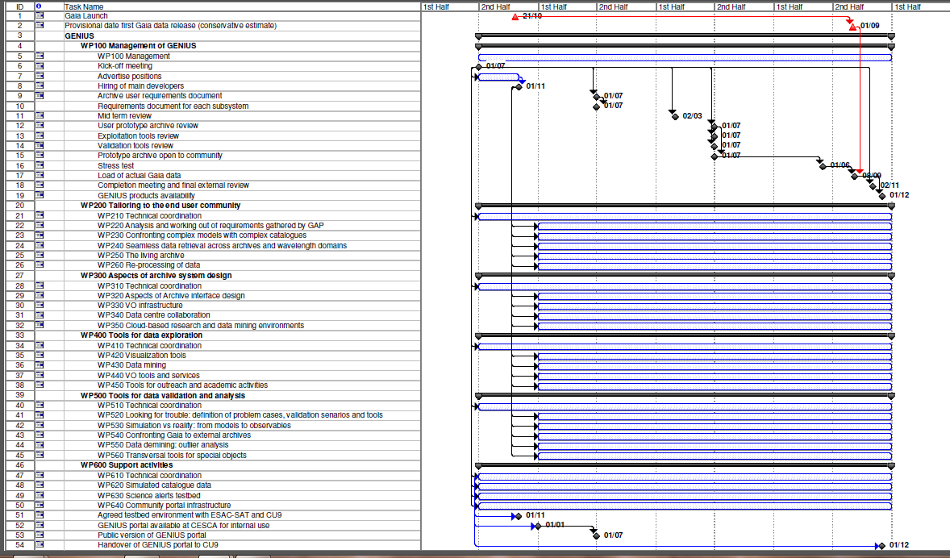
Schedule: to be discussed tomorrow

