Slide 1
GENIUS T4 Teleconference
17-9-2014
X. Luri

Slide 2
Agenda
Preparation of the first year review (XL)
Report of relevant issues (if any) by partners
Coordination of GENIUS and CU9 periodic teleconferences (XL)
AOB

Slide 3
First year review confirmed by PO
2/3 of a day in Brussels
Attendance: WP managers
Date: December → Proposal for the 2nd week, after the GREAT meeting in Barcelona
Three weeks before the review we should have submitted all deliverables in due and the 1st Periodic Report → Mid November
Notes:
r

Slide 4
Agenda: to be proposed by us
making sure that progress both overall (more tuned toward management) and per work package is presented.
The presentation on the management needs to cover the first year from financial point of view by partner. This means, that it should cover in 4-5 slides some high level administrative/financial data of the first year (such as Person-Months spent, major other costs, deviations) compared to the original planning in the Description of Work.
Notes:
r

Slide 5
Reporting
Template provided by the PO:
-The PDF /Core part of the periodic report is 3.2. (3.2.1 Project objectives for the period, 3.2.2 Work progress and achievements during the period and 3.2.3 Project Management.) This part should be uploaded in SESAM. I have attached a good structure for the core part of the periodic report, which you might follow within the structure mentioned by the reporting guidelines.
-The rest ( e.g. 3.1 Publishable Summary, 3.3 Deliverables and Milestones) should be directly filled in online in the IT system.
-Explanation of the use of the resources should be filled in the Form Cs next to the corresponding amounts for each beneficiary. The Form Cs should be submitted electronically within 60 days after the reporting period. For your convenience I have sent you hereby some slides which you could circulate among the partners to help them fill in the Form Cs correctly.
Notes:
r

Slide 6
Periodic review: the financial part
2 financial documents:
The explanation on the use of the resources
This is now to be filled within the FORM Cs
How did you spend your budget? Any deviations?
Personnel: Who worked on the project? How many person*months? How much?
KEEP TIMESHEETS
Travel: which trips? Where? Why? How much in total?
Meetings: collect participants’ signatures (especially if you reimburse or claim travel costs)
Any subcontracting?
Etc.
One Financial statement per beneficiary (Forms C) and a summary financial report for the whole consortium
submitted via Participants Portal AND by post
(can be signed by any representative of the beneficiary)
In addition the use of the resources has to be compared with the section “Resources to be committed” in the Description of Work to explain deviations.
Notes:
6

Slide 7
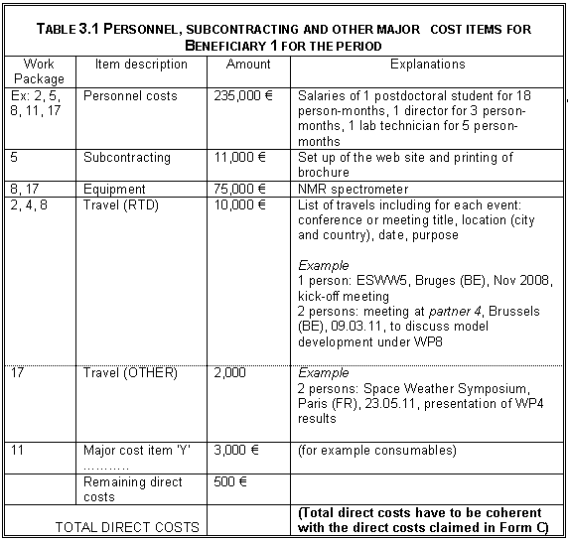
Explain the use of the resources: an example
For each item, specify type of activity:
RTD
Demonstration
Management
OTHER (e.g. dissemination)
Personnel: specify position (not name) and no. of person-months of work
Equipment: has to be depreciated
Travels:
distinguish between travels claimed under RTD and travels for dissemination (OTHER)
indicate title of meeting, date, location, « purpose » of travel
Note to the coordinator: if one partner overspends, it is up to the coordinator to decide how much the partner can claim as EU contribution (i.e. full amount if the overspending is due to anticipated work, or only the budget share agreed for the reporting period and lower than the amount which could be claimed).
* All the entries are examples and purely for illustration
Notes:
7

Slide 8
Some important financial rules
1. Interests generated by the pre-financing
Coordinator to identify the interests generated by the prefinancing due to the beneficiaries, if any, at the end of the 1st Reporting Period
2. Purchase cost of durable equipment and Depreciation
Durable equipment (e.g. software, computers, etc.) is subject to depreciation, according to the usual accounting rules of each partner
Please check the Financial Guidelines
3. Participation in conferences and other public events
Costs can be charged to a project ONLY if justified by a public presentation of the project activities and results
“Just to listen and network" cannot be charged
Participation of several beneficiaries and/or various representatives of the same partner to be justified
If presentation of the project, the FP7 funding has to be properly acknowledged (see later)
A copy of the submitted paper and/or the presentation, and the event agenda, have to be delivered to the REA project officer (i.e. as deliverable).
Notes:
8

Slide 9
Please contact your European Project offices and provide the UB with all the required financial information

Slide 10
Remember also to fill the trimestral reporting on the GENIUS wiki

