Slide 1
GENIUS Telecon T1 WP100 - Management
30-5-2014

Slide 2
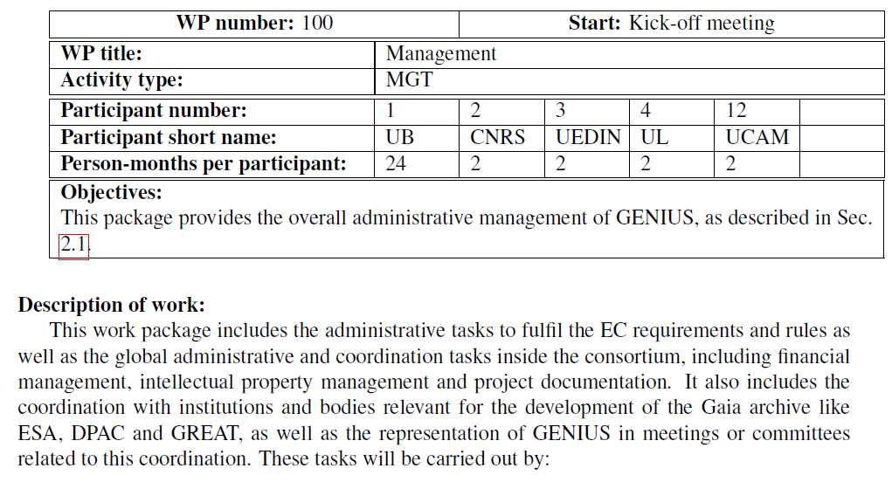

Slide 3
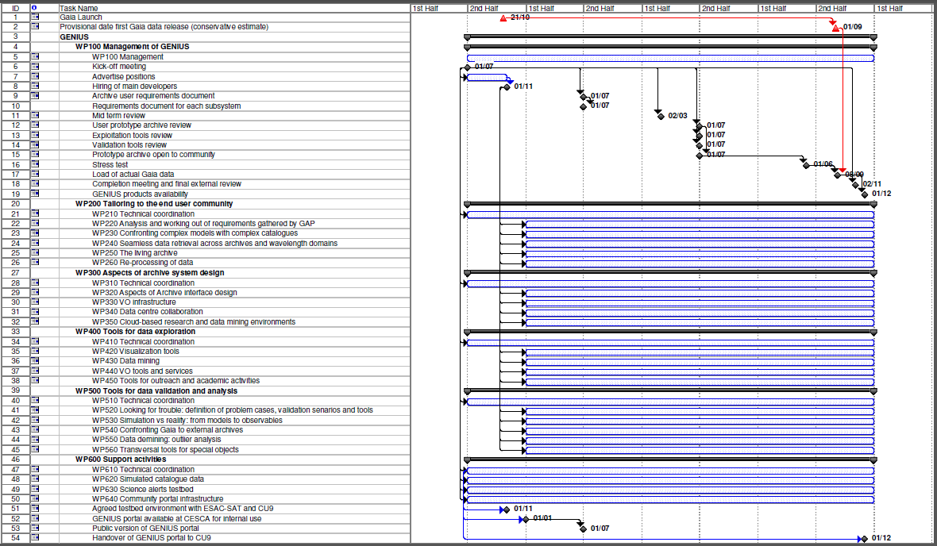

Slide 4
Pending

Slide 5
Pending (needed before year 1 review)
Coordinator
WP100 X. Luri
European
Commission
Administrative
management
WP600
J. Torra
Executive Board
Main WP managers & coordinator
Advisory
board
Global project
management
Support
activities
Tracking of objectives
WP200
A. Brown
WP300
N. Hambly
WP400
X. Luri
WP500
F. Arenou
Core tasks management
at host nodes
INAF
KU
UCAM
CSIC
UBR
FFCUL
ULB
UG
Management of
specialised tasks
Jasmine
cooperation

