Slide 1
GENIUS Telecon T1 WP700 – Dissemination
30-5-2014

Slide 2
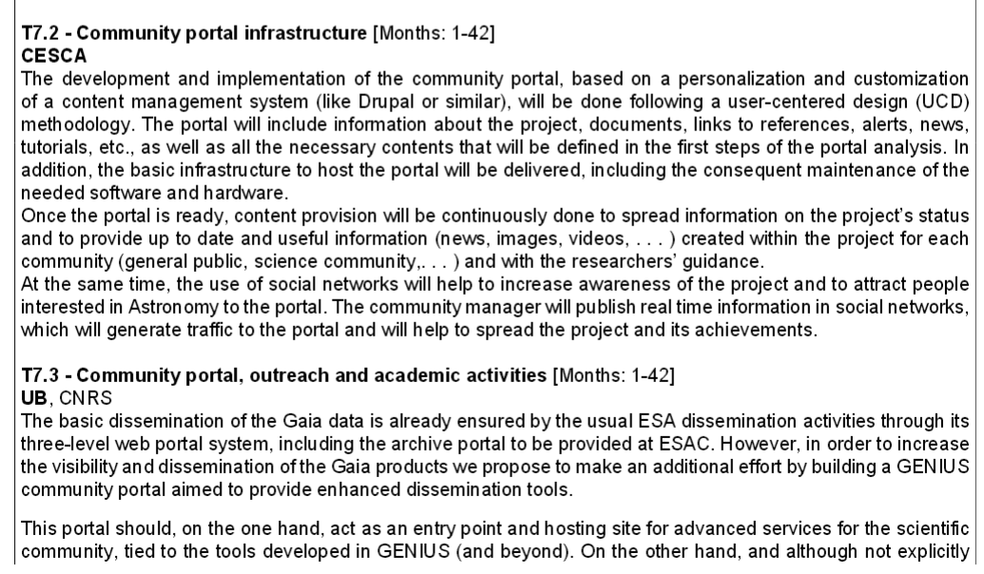
Important: notice that WP700 was introduced only in the final version (DOW_Part_B) to gather all the dissemination activities

Slide 3
Portal infrastructure: see T. Via presentation

Slide 4
Outreach & academic activities
Information on dissemination collected in the WP960 pages of the Gaia Wiki: webs, material, contacts
In the process of locating and coordinating national contact points. Goal to provide portal as hub for these national activities.
Science Alerts: coordination pending through Heather Campbell

