Slide 1
GAP M3 - General meeting
OUTREACH
X. Luri, S. Jordan

Slide 2
Areas of work
Academic
General public
Media
Resources

Slide 3
Academic
Specific contents for the teaching of astronomy using Gaia data:
Documents
Videos
Educational games
Fancy learning tools interacting with the real catalogue (see RTIGE from Meudon later on)
Adapted at three different levels
Primary level
Secondary level
University level

Slide 4
General public
Generation of news and audiovisual material for the general public
Daily/weekly news: diffusion through web pages and social networks
Picture of the week
Videos: visually attractive presentation of the Gaia discoveries for YouTube, FaceBook, etc. (see UB video later on)
Specific attention to amateur astronomers; higher level news, link to alert system, …
Planetariums

Slide 5
Media
Special care to establish a good link with the media
Gathering of news from DPAC members/institutes
Generation and distribution of press notes
Generation and distribution of contents: videos, pictures, etc.
Maintenance of a list of contacts in the main communication media: press, TV, etc. + internet
Contacts with specialized press
Needs a professional to coordinate it all
Close cooperation with the press offices of the DPAC institutes and ESA; no duplication, complementarity

Slide 6
Resources
Needs resources and staff to maintain them:
Web page(s)
Picture & video editing
Document writing & editing
Press office
Community manager for social networks
Translation of contents to different languages

Slide 7
WP 800 – Education and outreach
WP | Title
810 | Management
820 | General Resources
821 | Web pages
822 | Social networks
823 | Picture & video editing
824 | Document writing & editing
825 | Translation
830 | Academic
831 | Primary level
832 | Secondary level
833 | University level
WP | Title
840 | General public
841 | Daily/weekly news, Pict. of the day
842 | Gaia science videos
843 | Link to amateur astronomers
850 | Media
851 | Press office
852 | Coordination with DPAC & institutes

Slide 8
General considerations
Education and outreach should be a crucial part of CU9. However, it will be difficult to secure funding and participation in front of other, more critical activities.
Even taking this into account we should aim for more than “best effort”. Some minimum commitments for education and outreach should be fixed.
AO milestones

Slide 9
Cooperation & gathering of resources
Many (if not all) institutions participating in GAP/CU9 have already ongoing educational/outreach activities related to Gaia
Increasing the visibility of these activities can provide ideas to other centers and make easier the requirements for funding (existing examples)
Also, polling of resources among several institutes can in some cases make possible projects that would otherwise have to be discarded..

Slide 10
Some collected ideas
as a starting point for discussion

Slide 11
WP820 – General resources
Web
ESA web (ESTEC?) should play a central role, but close cooperation with the rest of us may be unrealistic?
SAT@ESAC will also have a web, mainly for professional use
Should we make an independent CU9 web? Or rather a Gaia web?
Instead, would a federation of webs at national level, sharing resources and fostering synergies be possible?
gaia.fr, gaia.de, gaia.es, … (Reserve the domains now!!)

Slide 12
Web archive interface for the general public (Els):
Simple, easy to use
Easily accessible, front page stuff
Follow the US example (stsci.edu)
Mobile Apps (Carrasco):
GoogleSky type app tied to the Gaia archive
Science alerts?

Slide 13
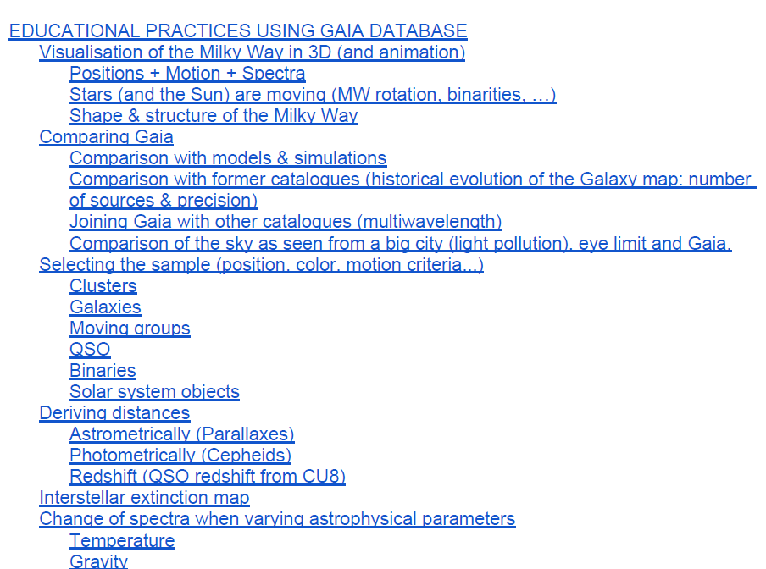
WP830 – Academic
Compendium of, pre-packaged, hands-on activities with the Gaia archive (Carrasco, PDF available )
E.g. CLEA like

Slide 14
Courses: the mission, the archive (Carrasco)
Podcasts
Interactive on-line
Classical text
Proactively reach the schools (Els)
Don’t wait for them to ask, offer talks to primary/secondary schools
Probably should be carried out at national level?
A similar already-existing experience in Spain for general astronomy

Slide 15
WP840 – General public
3D visualization:
Real-Time & Interactive Galaxy for Edutainment (Arenou) - RITGE
3D visualization of nearby stars (Pourbaix) – Hipparcos 3D movies precedent
Haus der Astronomy (Jordan) – GAVO, AIDA
Planetarium show, in preparation(ESA) – could use 3D visualization of simulated data

Slide 16
Scale models & papercrafts (Carrasco)
Precedent of Gaia scale models not good (expensive, fragile, …) but maybe simpler, cheap, plastic models could be ordered somewhere?
Already existing Gaia paper model, but outdated. Update?
3D constellations
Soyuz launcher with Gaia

Slide 17
Gaia exhibit:
Set of panels with real pictures, synthetic images complemented with a short text with explanations, describing the mission and its science.
Precedent in AIA2009 (link)
Could make a common design with versions in different languages
Can travel to many local scientific events for the general public during the mission

Slide 18
Gaia books (Carrasco):
History of astrometry and stellar catalogues
The mission, the archive
The milky way
(could be an e-book?)

Slide 19
Set of standard presentations for the general public:
Write once, use many times
Covering all areas of the mission
Can start as a compilation from already available material (surely everybody here has Gaia presentations!)
They can be polished into a set of well-designed, rigurous, eye catching presentations. Can include audio, video, …

Slide 20
A comic explaining Gaia to the kids (Carrasco):
Existing examples: Venus transit , the little books of Gaia
Could be made available electronically, in several languages.

Slide 21
WP850 – Media
Videos for TV, web:
Already existing:
ESA PodCast
UB video (already provides nice footage for general use; can be tailored)
Ideally we should produce new/updated videos periodically: coinciding with the data releases?

Slide 22
Make noise (Els):
press releases, regular updates
e.g., "Gaia observed it's 100 millionth star", "Gaia detects 20% more stars than in its original specs", "Gaia measures angles to an unprecedented level of precision"...)
Also, ask each CU a key and eye catching item to be made public with each catalogue release
E.g. the parallax of δ-Cephei at a precision of 0.1mas for the 2nd release
Followup on technology fallout from Gaia (ESA?)

Slide 23
Next step: put all this in a proposal

