Slide 1
Gaia simulators, GUMS and GOG
F. Figueras (+UB team)
GREAT ITN School : Galaxy modelling, Besançon October, 2012

Slide 2
GUMS: Gaia Universe Model Generator
It provides the astronomical sources to be observed by Gaia
(position, velocity, magnitude and physical parameters)
It is being used by GASS, GIBIS and GOG
Robin, A., Luri, X., et al., 2012

Slide 3
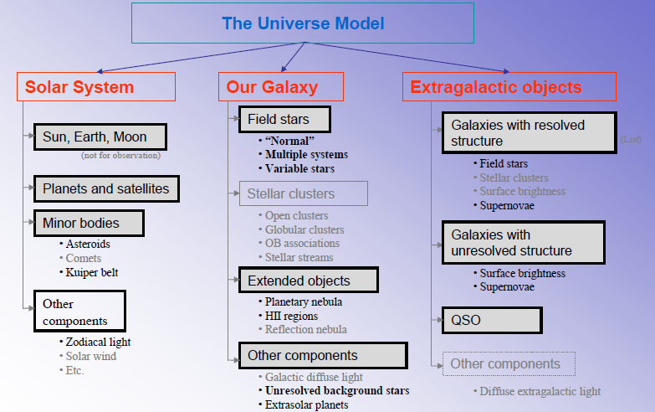

Slide 4
GUMS field stars in our Galaxy
Based on Besançon Galaxy Model (Robin et al. 2003)
Ingredients:
3D extinction model (Drimmel 2002)
All populations: thin/thick disk, spheroid and bulge (Hess diagram is frozen)
Binaries and multiple systems included (no dynamical self-consistency)
Variable stars are generated (CU7)

Slide 5
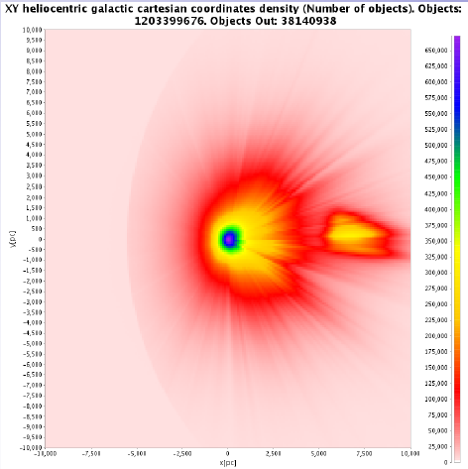
GUMS: simulation of the Gaia Catalogue up to G<20 (CU2)
Catalogue access through Vizier (CDS, Strasbourg) 2012yCat..35439100R (soon available)

Slide 6
GOG: Gaia Object Generator
An attempt to simulate Gaia products
You will work with GOG 10.0
(GOG 11.0 in progress )

Slide 7
GOG
Provides:
Epoch (transit) and combined (end-of-misssion) data
True data, data as observed by Gaia and their errors
Is based on:
A model of the Gaia instruments
Error models provided by the CUs (DPAC) (final Gaia data will be more complex)
Has two main simulation modes :
The GUMS universe model (integrated in GOG)
An external list of sources provided by the user

Slide 8
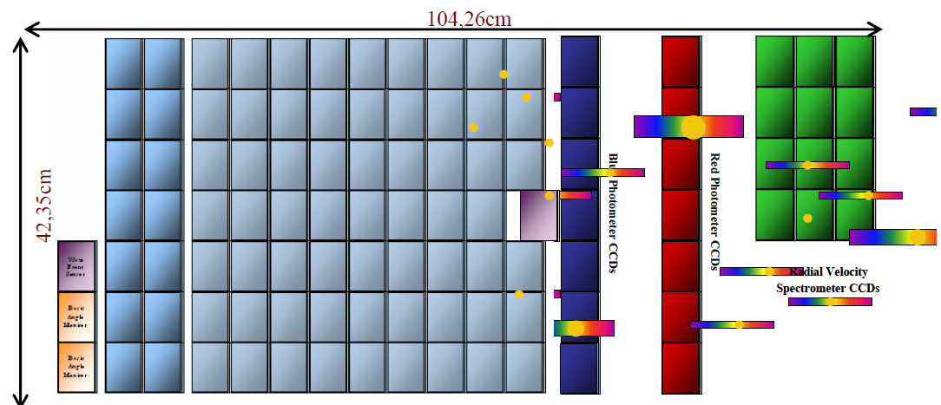
Gaia focal plane
Astrometry
G band
LR spectra
GBP, GRP bands
HR spectra
GRVS band, Vr, Vsini
Astrophysical parameters: Teff, logg, [Fe/H], Ao (interstellar absorption) , [α/Fe]

Slide 9
GOG: epoch parameters (per transit)
Epoch data will be provided in the last Gaia releases and will be mostly used to determine properties of multiple systems and variable sources

Slide 10
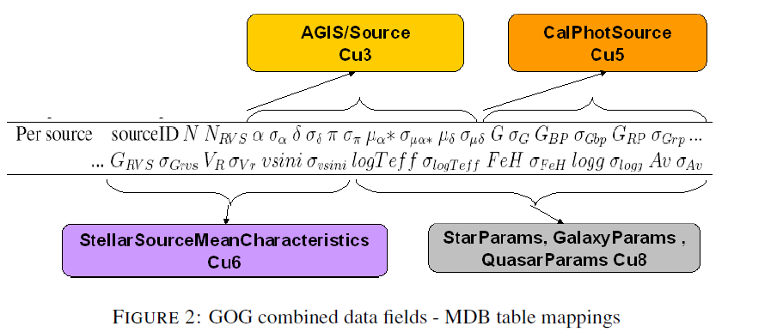
GOG: combined parameters (end-of-mission)

Slide 11
Gaia error models
Astrometry
Photometry
Spectra
Radial Velocities
Rotational velocities
Astrophysical Parameters
We describe here both GOG approach and the receipts published in the Gaia Science Performance website

Slide 12
Astrometry

Slide 13
Astrometric standard errors Gaia Science Performance website
The mean end-of-mission standard error for parallax includes:
all known instrumental effects
an appropriate calibration error
20 % margin (results from the on-ground data processing are not included)
It depends sensitively on the adopted TDI-gate scheme (G < 12 mag)
(The decrease of the CCD exposure time to avoid saturation of the pixels)
Notes:
Tot i que això és formalment veritat, l'error a les estrelles brillants està dominat pels errors de calibració i no pel soroll dels fotons i per tant, l'esquema de gates no hi té massa influència. Per què no poses també una figura ????? http://www.rssd.esa.int/SA/GAIA/docs/SciencePerformance/figureAstrometryWithOriginal.htm

Slide 14
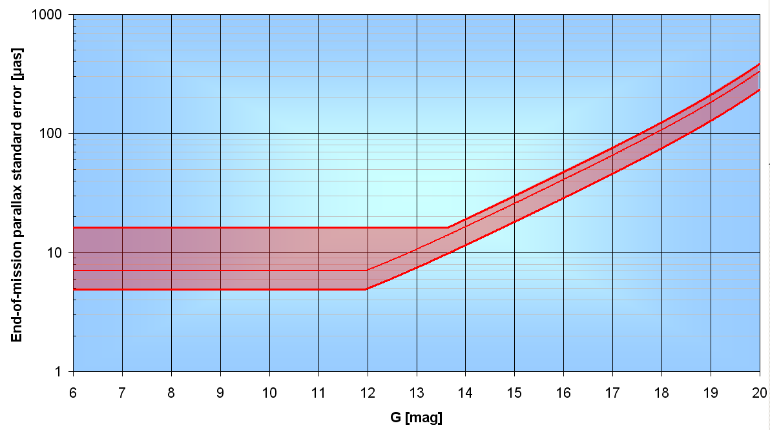
End-of-mission parallax standard error
For bright stars (G<12 mag) the standard error is dominated by calibration errors, not by the photon noise

Slide 15
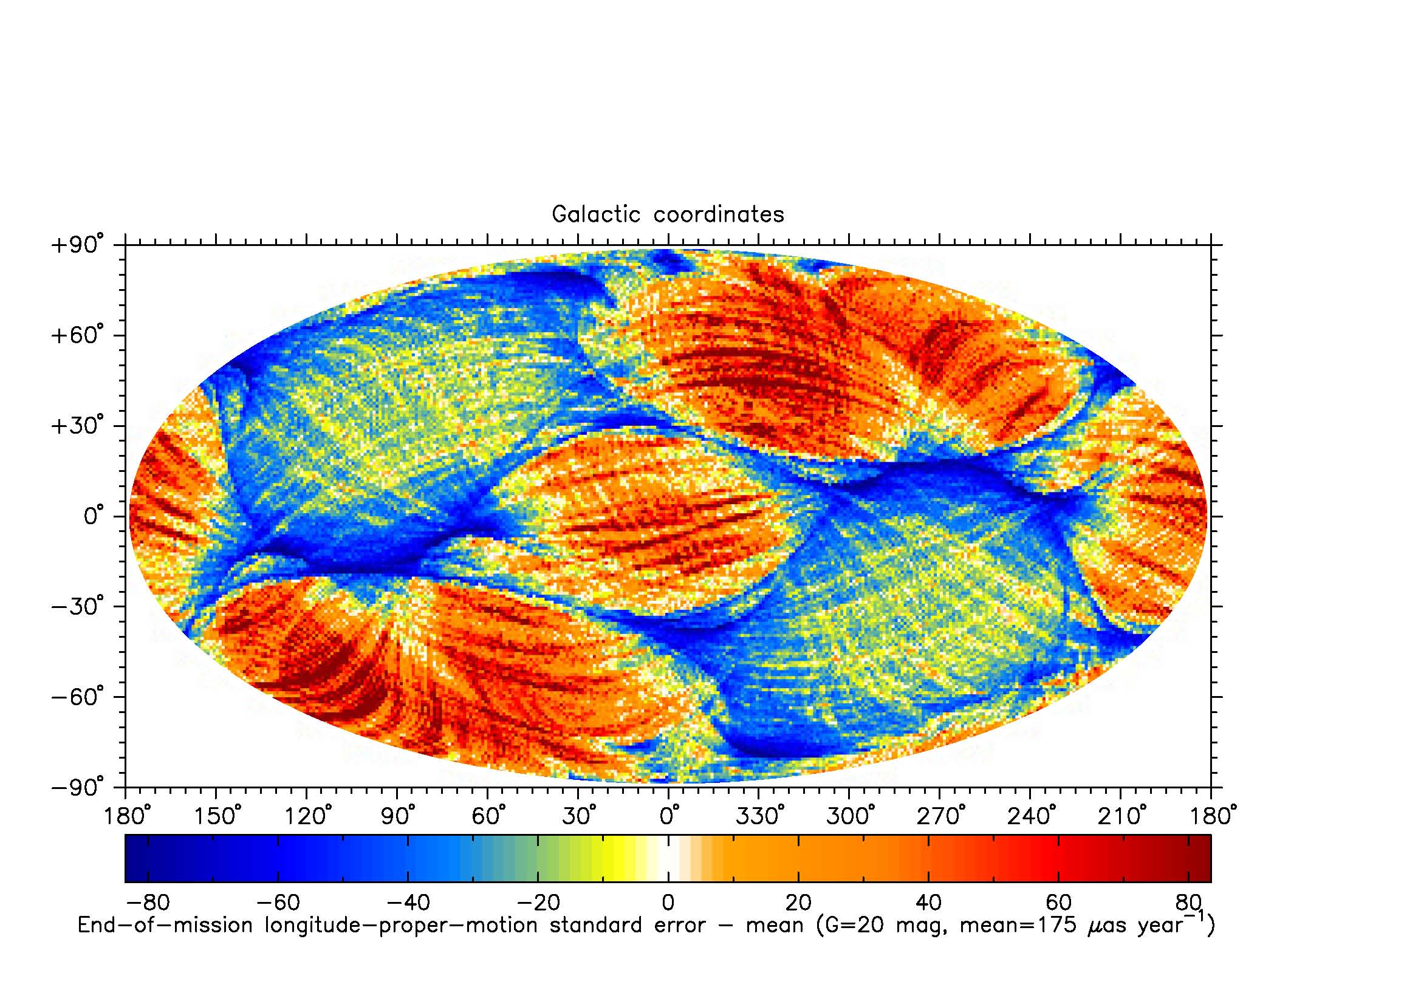
Astrometric End-of-mission errors Gaia Science Performance website
The end-of-mission performance depends on the scanning law. A more accurate standard error can be computed by:
Multiplying the mean value by a geometrical scaling factor (g), different for each of the five parameters (see figure and table)
Taking into account the individual number of transits the star will have by multiplying the mean value by
Both corrections depend on the mean ecliptic latitude β (ecliptic-longitude-averaged)
Geometrical scaling factor:
Each particular transit does not carry the same astrometric weight. The weight depends on the angle between the along-scan direction (where we make the measurement) and the circle from the star to the sun (the parallax shift is directed along this circle). Therefore, a large number of transits does not guarantee a small parallax error (Jos de Bruijne)
Notes:
Depenent de la llei d’escaneig tindrem que els diferents transits de l’estrella passaran molt paral·lels o en totes direccions. Es millor que passin en totes direccions per tal de poder determinar millor els paràmetres.
Si a latituds ecliptiques de 50 graus tenim molts més transits pero tots son mes paral·lels (poc distribuits en totes direccions) pot passar que tinguem uns errors més grans (com s’observa a la figura)
Els factors g estan definits a la página 262 del gaia redbook
Sí, això és perquè només tenim resolució al llarg del cercle màxim de l'escombrat i no en direcció perpendicular. La manera d'augmentar la precisió no és que hi hagi molts escombrats, sinó que aquests escombrats estinguin molt ben repartits en direccions diferents per tenir cercles màxims en totes les direccions per a una estrella donada i així tenir resolució d'aquesta estrella en totes les direccions.
Tenir molts escombrats en cercles màxims molt semblants no augmenta la precisió.

Slide 16
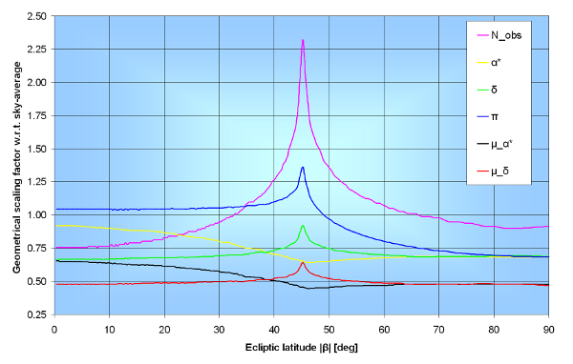
Geometric factor (g) to be applied to the sky-averaged astrometric errors for the five astrometric parameters as function of ecliptic latitude β.
Notes:
Numerical factor to be applied to the sky-averaged astrometric errors for the different astrometric parameters as function of ecliptic latitude β. The quantity N_{obs} in column 4 denotes the end-of-mission number of focal-plane passages for AF, BP, and RP (both fields of view combined). For RVS, the number of focal-plane passages is reduced by a factor of 4/7. The transit numbers in column 4 are based on an assumed 6% dead time / data loss, which is the absolute minimum. A more realistic data loss to consider is ~10% for stars brighter than 13th magnitude, increasing to ~20% for stars around magnitude 20.

Slide 17
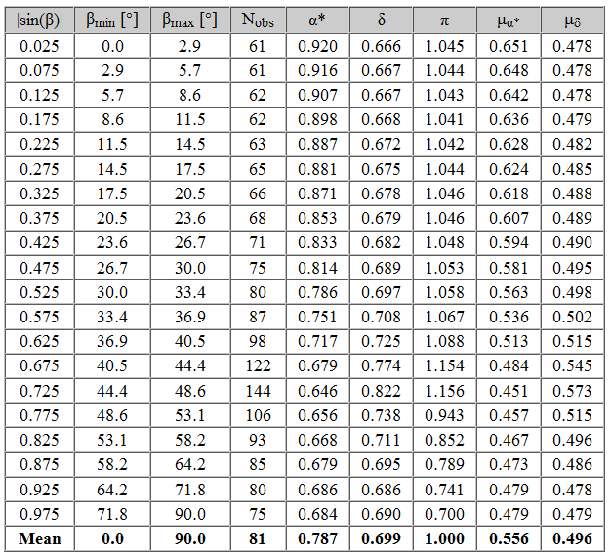
Geometric factor (g) to be applied to the sky-averaged astrometric errors for the five astrometric parameters as function of ecliptic latitude β.

Slide 18
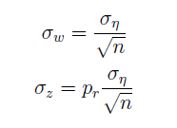
GOG: astrometric Epoch Data
For each transit GOG provides:
Local plane coordinates (ω, z)
Observing time (t), that is mean time per transit
Angle from local plane coordinates to equatorial coordinates (θ)
Precision in the local plane coordinates (σ_{ω}, σ_{z})
n : along scan AF number of CCDs
p_{r} : relation between AC and AL pixel size (=3)
σ_{η}: line spread function centroiding error
Notes:
L'epoch data astromètrica no es dóna fins a les darreres releases, i es pensa que molt poca gent ho farà servir. Bàsicament només interessa a la gent que faci dobles.

Slide 19
GOG: astrometric epoch data
Parameters that can be derived from epoch data:
Local plane parallax factors
(ω, z) and the satellite ephemerides
Equatorial parallax factors
(ω, z), the satellite ephemerides and θ
Epoch (α,δ) equatorial coordinates
(ω, z), attitude of the satellite and ephemerids
(if barycentre equatorial coordinates are required)

Slide 20
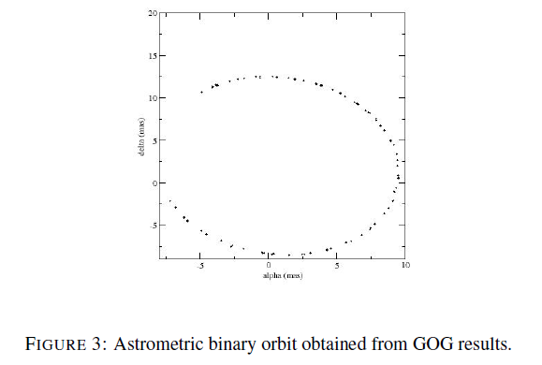
GOG: astrometric epoch data
Example of GOG products:
Orbital motion for a binary system from GOG epoch data astrometry

Slide 21
GOG: astrometric end-of-mission
Parallax accuracy σ_{π}:
σ_{η} : line spread function centroiding error
σ_{cal} : calibration error, a configurable parameter in GOG (5.7 μas by default)
g _{π} : parallax geometrical factor, g _{π}=1.47/sinξ, where ξ is the solar aspect angle
(ξ=45º GPDB)
N_{eff} : number of elementary CCD transits (N_{strip} x N_{transit}) according to the Gaia scanning
law
m : the contingency margin (configurable parameter in GOG

Slide 22
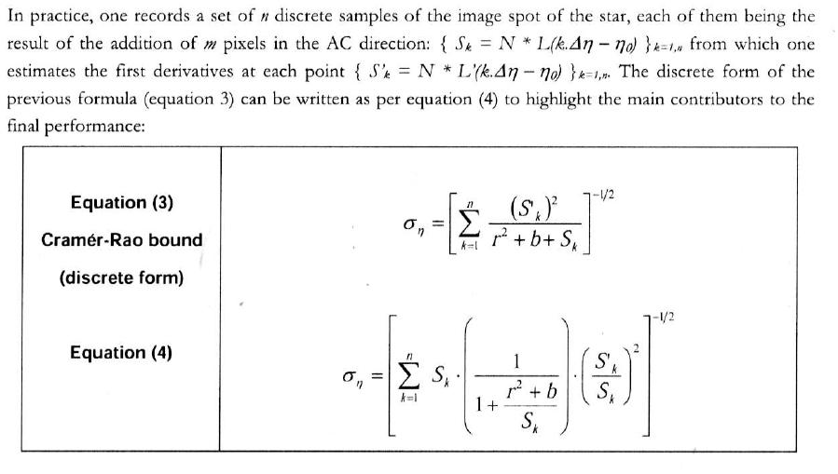
GOG: astrometric end-of-mission
Computation of the line spread function centroiding error:
The counts per each sample in an standard window (S_{i}) are computed both from the G magnitude of the star and the LSF. This LSF is computed considering the Teff, logg and [Fe/H] of the star. GOG derives the B-Spline coefficients that describe the LSF using its internal spectral library.
The Cramér-Rao minimum variance bound (MVB) method is used (it is a simplified implementation of the one used by Astrium). See Bastian et al. (2004)
Notes:
The Cram´er-Rao-limit specifies the precision which a hypothetical “optimal” centroid-
ing algorithm could gain from an image.

Slide 23
GOG: astrometric end-of-mission
g_{α} = 0.787·g_{π}
g_{δ} = 0.699·g_{π}
g_{μα} = 0.556·g_{π}
g_{μδ} = 0.496·g_{π}
Only mean values for the geometrical factor are being considered (TB improved)
Notes:
The caption clarifies this: "The transit numbers in column 4 are based on an assumed 6% dead time / data loss, which is the absolute minimum. A more realistic data loss to consider is ~10% for stars brighter than 13th magnitude, increasing to ~20% for stars around magnitude 20."

Slide 24
Photometry

Slide 25
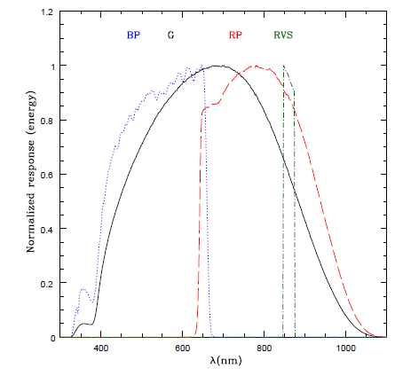
Photometry
Magnitudes:
G : broad-band (white-light), fluxes obtained in the astrometric instrument
GBP and GRP: integrated from low resolution spectra
GRVS: integrated from RVS spectrometer

Slide 26
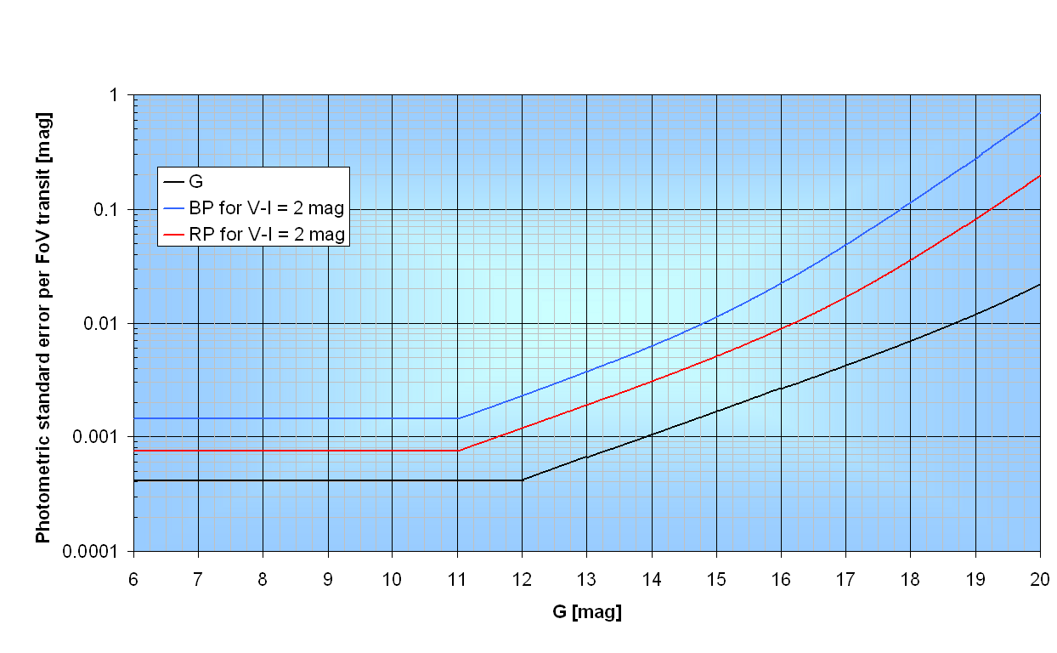
Photometric standard errors per transit Gaia Science Performance website
Includes all known instrumental effects + 20% science margin
This is the single-field-of-view transit, taking into account all CCDs along scan

Slide 27
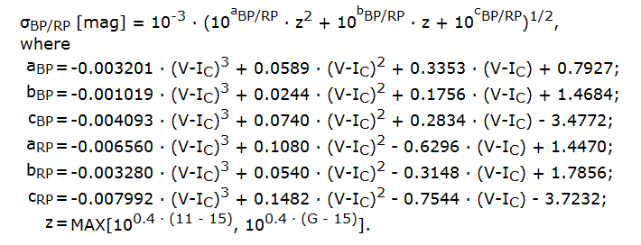
Photometric standard errors per transit Gaia Science Performance website
Includes all known instrumental effects + 20% science margin
Notes:
Single-field-of-view transit

Slide 28
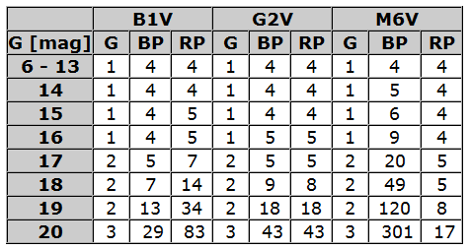
End-of-mission photometric standard errors Gaia Science Performance website
division of the single-field-of-view-transit photometric standard errors by the square root of the number of observations (~70 in average).
With an assumed calibration error of 30 mmag at CCD-level
Units: mmag

Slide 29
GOG: Photometric standard error per CCD-transit
X magnitude error computed taking into account:
the photon noise (n_{s} samples within the window)
the total detection noise per sample r, which includes the detector read-out noise
the sky background contribution b_{X} assumed to be derived from n_{b} background samples
f_{x}: object flux within a given passband X
g_{aper}: factor accounting for the light loss produced because of the finite extent of the window (=1 by default, configurable)
Notes:
About this sigma-cal: At present it is not completely understood to
which level of perfectness effects like saturation, non-linearity,
Sigma-cal will not be zero: radiation damage, and charge transfer inefficiencies on the data can be calibrated

Slide 30
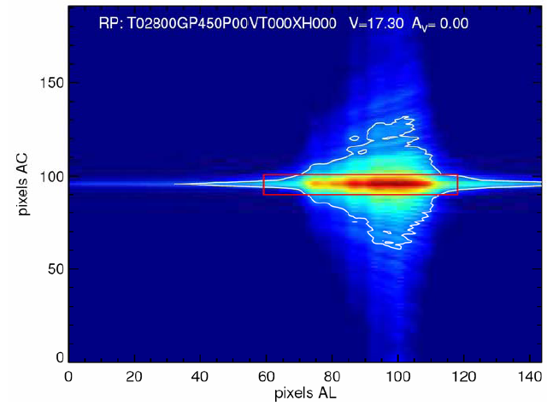

Slide 31
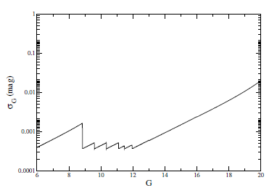
GOG: Photometric standard error per CCD-transit
Estimated precisions for G for one transit on the focal plane with respect to the G The shape for bright stars is due to the decrease of the exposure time to avoid saturation of the pixels.

Slide 32
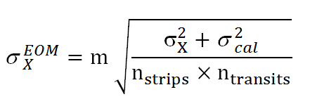
GOG: End-off-mission Photometric standard error
σ_{X} : photometric standard error per CCD-transit
σ_{cal} : the contribution of the calibration error per transit (=30mmag, configurable)
n_{strips :} : the number of columns in each band (9 for G, 1 for GBP or GRP and 3 for RVS)
n_{transits} : number of transits computed from the scanning law
m : overal additonal error margin depending on the calibration error, on the sky density, complex background, etc (m=1.2, configurable)

Slide 33
GOG: End-off-mission Photometric standard error
DPG: factor that takes into account the detection probability. It gives the probability that a star is detected and selected on-board for observation (TB implemented in GOG)
Jordi et al. (2010)

Slide 34
BP/RP/RVS spectra

Slide 35
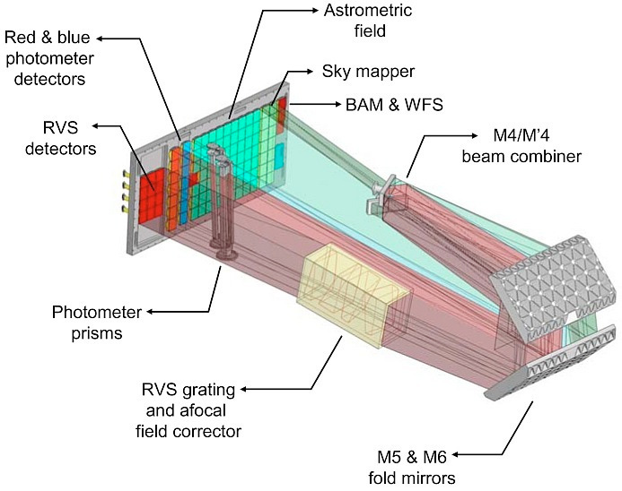
BP/RP/RVS spectra
Low-resolution spectro-photometry obtained in the Blue and Red Photometers
Spectral dispersion & wavelength range:
BP: ~3 to ~27 nm pixel-1 ~330-680 nm
RP: ~7 to ~15 nm pixel-1 ~640-1050 nm
1 CCD along scan each
RVS spectrometer:
Resolving power ~11,500
wavelength range: 847-874 nm.
3 CCDs (strips) along scan

Slide 37
GOG spectra
Epoch Spectra: single transit
BP/RP: reduced into a common wavelength scale
RVS: each spectrum has its wavelength scale
Combined Spectra: the end-of-mission
BP/RP/RVS completely reduced into a common wavelength scale
Sigma spectrum: standard deviation Gaussian noise model
For each GOG output spectrum (epoch and combined)
GOG spectra are obtained by randomly sampling the sigma spectrum to generate a noise vector which is added to the noise-free spectra
User can choose if the output spectra is noise-free or observed
The procedure to provide epoch spectra will change in GOG Cycle 11 (coefficients will be provided)
Notes:
no source blending and no window conflict are simulated.
-→ End-off-mission spectra in GOG-11 will provide the coefficients for a set of basis functions, not the electrons per second per sample (to be fixed) calibrated at the absolute wavelength of the mission. This will be derived multiplying the coefficients for the basis function
→ For the epoch spectra GOG-11 will provide the spectra in samples normalized to the CCD4 (reference row). They will be calibrated to wavelength … but, in this case, each epoch spectra has its wavelenght scale.

Slide 38
GOG Input spectra
GOG can be configured to use:
GUMS and its own integrated libraries
An external list of sources and its own integrated libraries
A user externally defined set of input spectra
The integrated spectral libraries :
LR spectral libraries used for BP/RP simulations: Basel2.2, BeLR (emission line), WD, QSO, Galaxy-Pegase-2
HR spectral libraries used for RVS simulations: MARCS, BeHR (emission line), Galaxy and QSOHR
The spectrum is associated to a source using minimum distance (Teff , logg and [Fe/H]) - interpolation is pending
Notes:
The association of a spectrum to a source is done based, by default, on the minimum distance
method in the source parameters space. For normal stars the parameters are Teff , logg and
[Fe/H] (and for RVS Marcs). For Be stars the parameter R env=R star is also used. For
QSOs (BP/RP only), the association of the spectrum is done using the minimum distance between
the source and spectra parameters z,W (equivalent width) and Slope, and for the galaxies
with the parameters z, inclination and SpectralType.

Slide 39
GOG: from input to observable spectra
Convolve input with rotational (vsini) profile (RVS only)
Normalize to source magnitude and extinction
Apply instrument transmission
Apply PSFs convolution following dispersion relation
Addition of constant background and saturation effects
Transform pixels into samples (to 1D)
Apply GOG photometric error modeling sample to sample
Associate a wavelength to each sample
Produce sigma spectrum associated to the (noise-free) sample spectrum (both for epoch and combined spectra)
Generates observed spectrum
Sartoretti & Isasi (2011), Jordi et al. (2010)
Notes:
Resampling is applied before PSF convolution to avoid computer time. The resampling is very small, less than a pixel (1/3 of pixel)
Background is added later due to the simplification that it is considered constant (if not, it should be applied before convolution)

Slide 40
GOG: epoch spectra error model
Same procedure as for the photometry, now applied to each sample:
Poisson noise in the source and background
Total read-out noise
Background-subtraction noise
Calibration noise
20% error margin added to accommodate unmodelled random errors (charge transfer inefficiency and imperfect geometric calibration)
Systematic errors are currently neglected

Slide 41
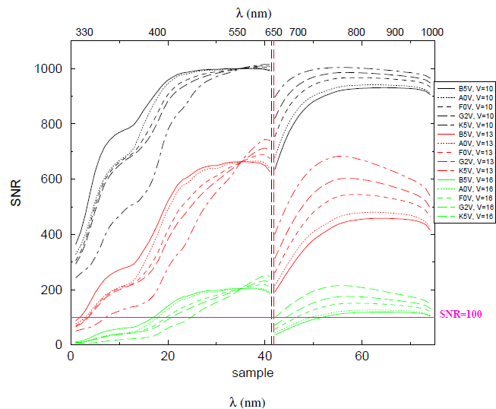
End-of-mission SNR per band
σ_{cal} = 10 mmag, 80 transits, unreddenend stars (Carrasco et al. 2006)

Slide 42
Radial Velocities

Slide 43
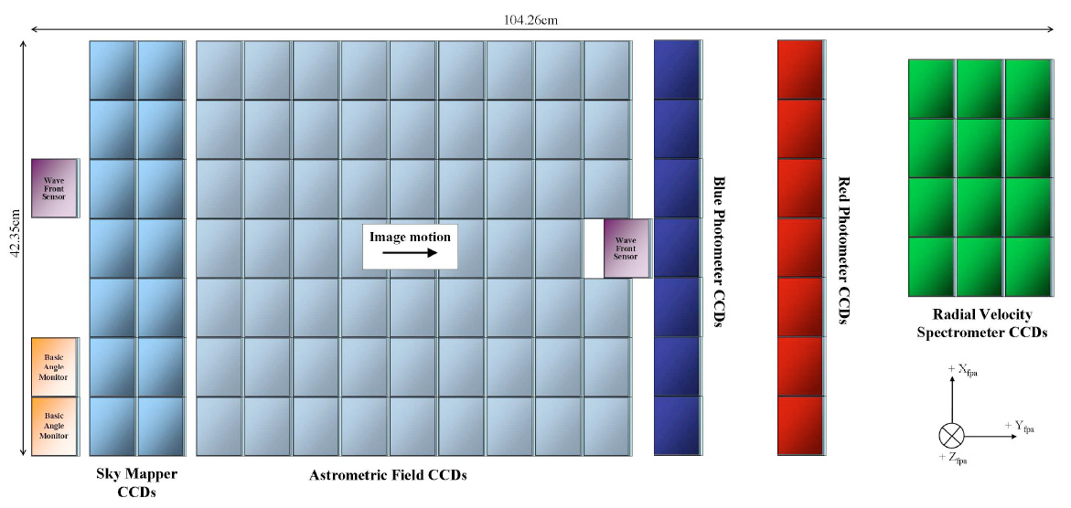
Radial velocities
a star transits the spectroscopic instrument on average ~40 times, leading to ~120 CCD transits

Slide 44
End-of-mission radial velocity error Gaia Science Performance website
Errors are magnitude (V= Johnson Visual) and colour dependent (V-I)
Receipts outlined by JdB-022 (2005) At the time of the Gaia Mission Critical Design Review (April 2011)

Slide 45
End-of-mission radial velocity error Gaia Science Performance website
Included:
all known instrumental effects
residual calibration errors at ground-processing (DPAC) level
Not included:
-the residual "scientific calibration errors“: e.g., template-mismatch errors, residual errors in the derivation of the locations of the centroids of the reference spectral lines used for the wavelength calibration, etc. (result from the on-ground data processing) . They are assumed to be covered by the 20% science margin.

Slide 46
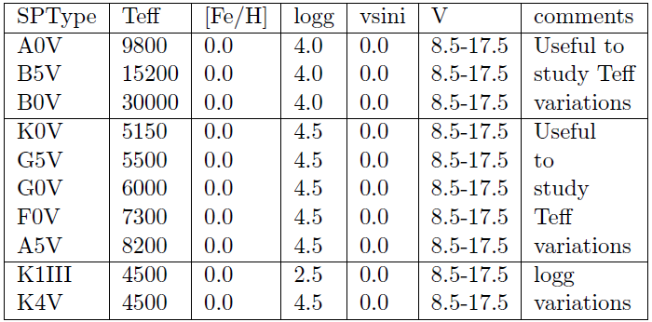
GOG: End-of-mission radial velocity error
From Sartoretti et al. (2007):
Monte Carlo simulations
A margin (factor 1.6) added to account for calibration errors and other instrumental errors not included previously
-lower and upper limit fixed to 1 and 35 km/s
Errors depending on Teff FeH logg vsini Vmag
GOG interpolates looking for the closest combination given priority to Teff and V
All the tables provided up to now have [Fe/H]=0, vsini=0 and Av=0. with 8.5 < V < 17.5
Notes:
Details of the procedure follow by David Katz:
Both the vR and the vsini estimation programs use, as a starting point, the synthetic spectra at
a resolution R = 250000 obtained with the Kurucz program [5]. These Kurucz spectra are used
to produce: (i) RV Sspectra and (ii) template spectra. The RVS spectra simulation procedure
is very simple: the LSF is gaussian (FWHM = 0.0748nm at 860.5nm), the dispersion constant
(0.026nm/pix) and the total response is a rectangular function (= 0.32 for 847 874nm).
Read out noise (5.6e−), poisson noise and a pixel phase errors (i.e. in each observation the
source position is shifted by a random value between +/- 0.5 pixels) are included. No optical
distorsion, no FoV (field of view) variations and no temporal variation of the instrument
characteristics are taken into account. Also, no calibration error is considered and the spectra
combination is a simple sum of the single exposure spectra, after resampling on a common
grid. The template spectra are obtained by convolving the Kurucz spectra at the RVS resolution.
Their spectral type is exactly the same as the RVS spectra and the errors due to spectral
mismatch are not taken into account.

Slide 47
GOG: End-of-mission radial velocity error
To take into account [Fe/H] effects, GOG apply (empirical law):
GOG provides errors for:
single CCD transit RVS spectra,
single transit 3-CCD combined spectra
40 transits 3-CCDs combined spectra.

Slide 48
Rotational Velocities (Vsini)

Slide 49
GOG: End-of-mission rotational velocity error
From Sartoretti et al. (2007) :
Monte Carlo simulations
Single transits for 6 <V<13.5
End-of-mission for 6 < V< 16.5
Tabulated as a function of Teff FeH logg vsini Vmag

Slide 50
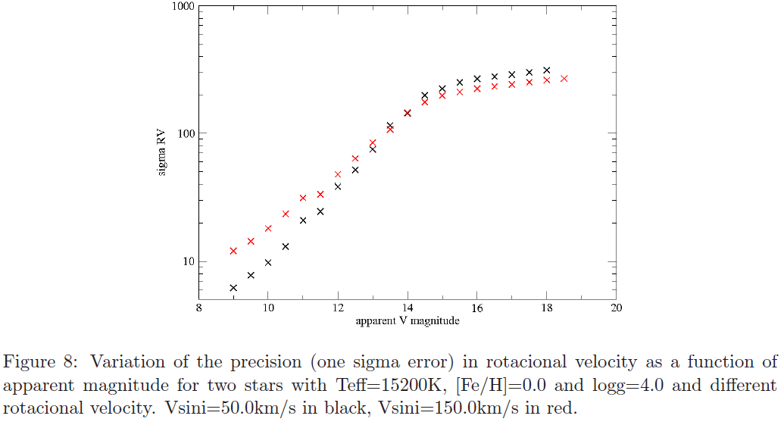
GOG: End-of-mission rotational velocity error

Slide 51
Astrophysical Parameters (AP)
Remember that one of the most important Gaia goals is to reveal the formation and evolution of our Galaxy through chemo-dynamical analysis

Slide 52
Gaia focal plane
Astrometry
G band
LR spectra
GBP, GRP bands
HR spectra
GRVS band, Vr, Vsini
Astrophysical parameters: Teff, logg, [Fe/H], Ao (interstellar absorption) , [α/Fe]

Slide 53
AP error model Gaia Science Performance website
Unredenned stars:
T_{eff} to a precision of 0.3% at G = 15 mag and 4% at G = 20 mag
[Fe/H] and log(g) can be estimated to precisions of 0.1-0.4 dex for stars with G ≤ 18.5 mag (depending on the magnitude and on what priors can be placed on the APs)
If extinction varies over a wide range (A_{V} = 0-10 mag):
T_{eff} and A_{V} can be estimated quite accurately (3-4% and 0.1-0.2 mag respectively at G = 15 mag), but there is a strong and ubiquitous degeneracy in these parameters
log(g) and [Fe/H] can still be estimated to 0.3 and 0.5 dex, respectively, at G = 15 mag, but much poorer at G = 18.5 mag.
Bailer-Jones (2010)

Slide 54
GOG: AP error model
Estimations provided by Liu et al. (2012) using Aeneas-pq:
Astrophysical parameters are derived from BP/RP spectra (GOG), the parallax and the apparent magnitude of the star
Outputs from this work are:
1) Specific uncertainty estimates provided by Aeneas
2) Residuals computed as |estimated –true| values
The accuracy is a strong function of the G and the APs values (any average as a function of G will strongly depend on the distribution of APs in the test data set)
Notes:
Why not G and (Bp-Rp) in the fit? (Bp-Rp) is an indicator of the effective temperature and/or extinction?

Slide 55
GOG: AP error model
GOG implementation (work in progress):
Second order polynomial fit as a function (only) of G magnitude (Ao <1, Ao>1) to the Aeneas-pq precision
A Gamma function to derive the standard deviation at G (mean: the polynomial fit; standard deviation: the mean of the uncertainty provided by Aeneas-pq)
Gaussian random realization to derive observed parameters from actual values
Notes:
Why not G and (Bp-Rp) in the fit? (Bp-Rp) is an indicator of the effective temperature and/or extinction?

Slide 56
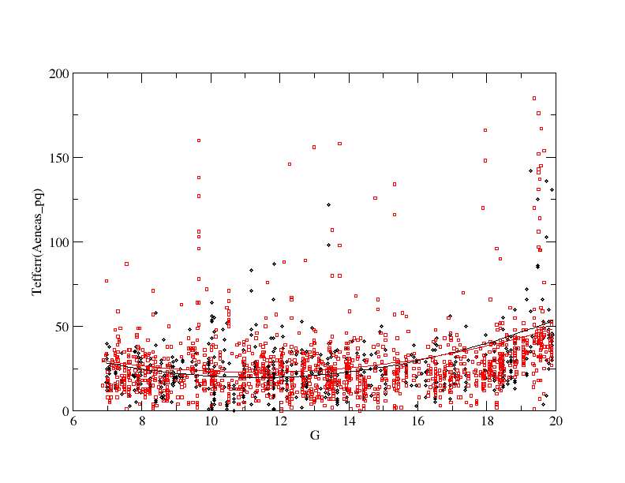
GOG: AP error model
Aeneas-pq precision on Teff as a function of G magnitude (units: Kelvin)
Liu et al. 2012: “These are statistical precisions, as they do not take into account the specific input data, they should be used with caution, ... they appear to be underestimated ... under investigation”

Slide 57
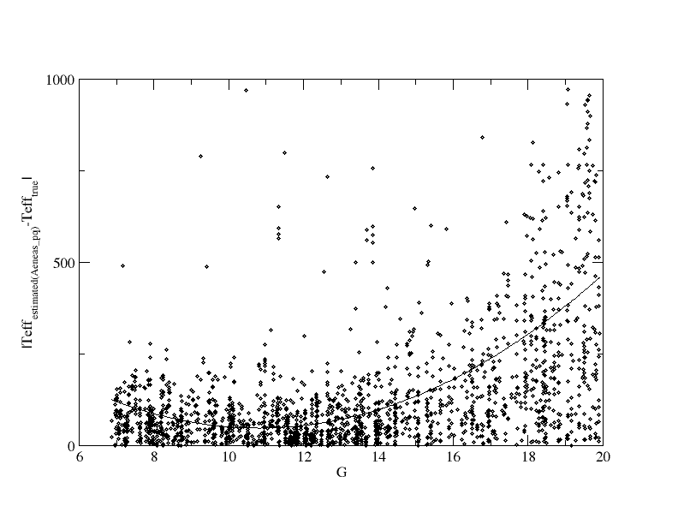
Fortran code : AP error model
Residuals for Teff computed as |estimated values from Aeneaspq – true| (units: Kelvin)
In the fortran code, the standard deviation in Teff for a star with G magnitude is computed by fitting a second order polynomial to this data (default option). The error in Teff is the assigned assuming a gaussian distribution

Slide 58
Teff
Aeneas-pq precision
|estimated values from Aeneaspq – true|
Caution: different vertical scale!
Liu et al. (2012), Antiche et al. (2012, in preparation)

Slide 59
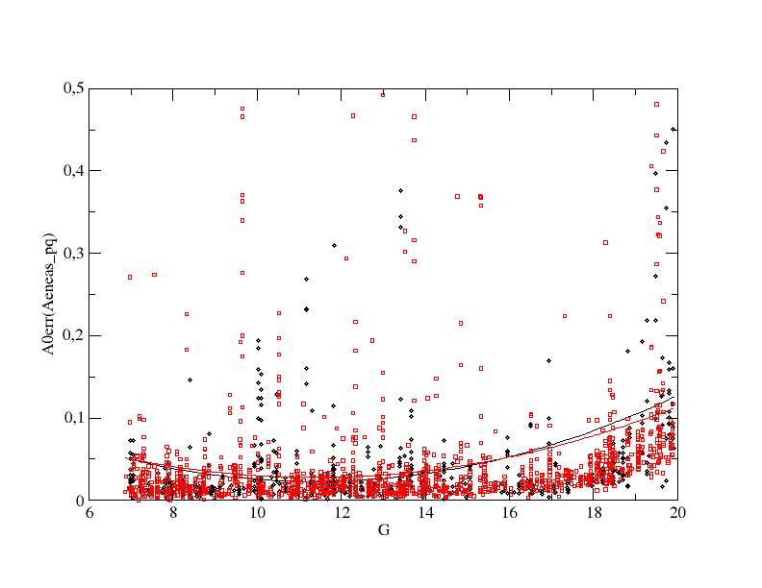
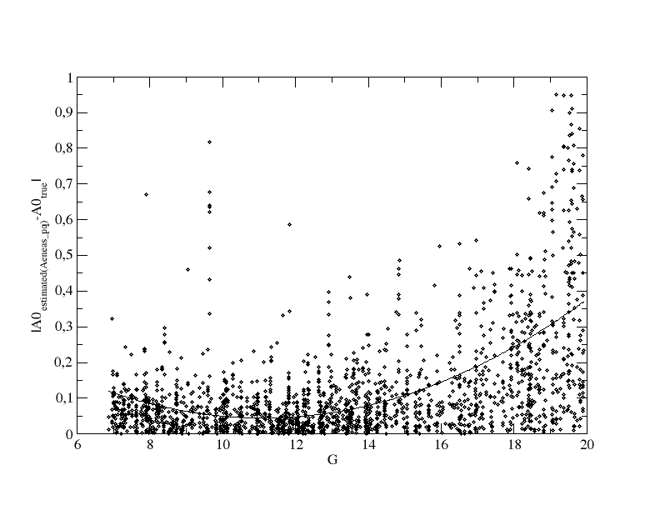
Ao (absorption)
Aeneas-pq precision
|estimated values from Aeneaspq – true|
Caution: different vertical scale!
Liu et al. (2012), Antiche et al. (2012, in preparation), see Bailer-Jones (2011) for the definition of Ao

Slide 60
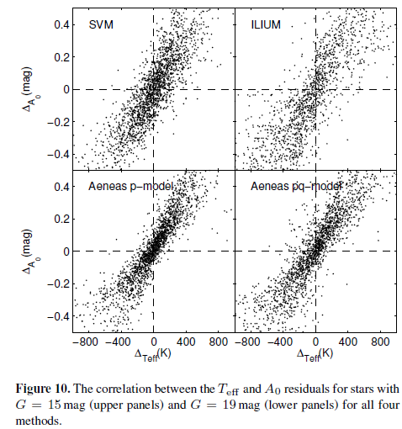
A critical degeneracy between Teff and Ao (extinction) is present
(Liu et al., 2012)

Slide 61
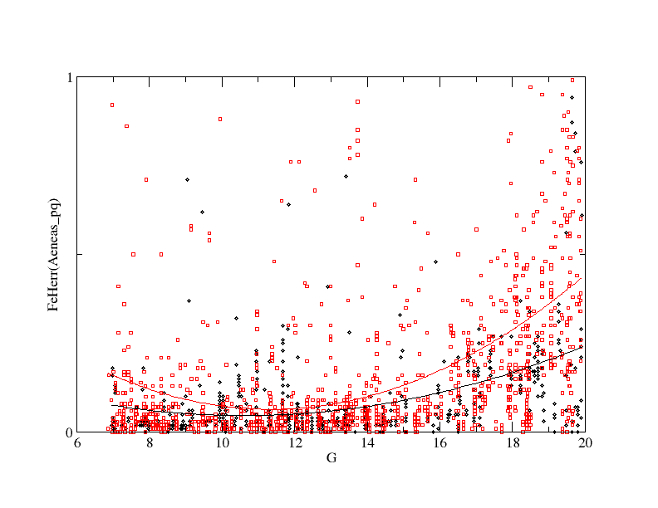
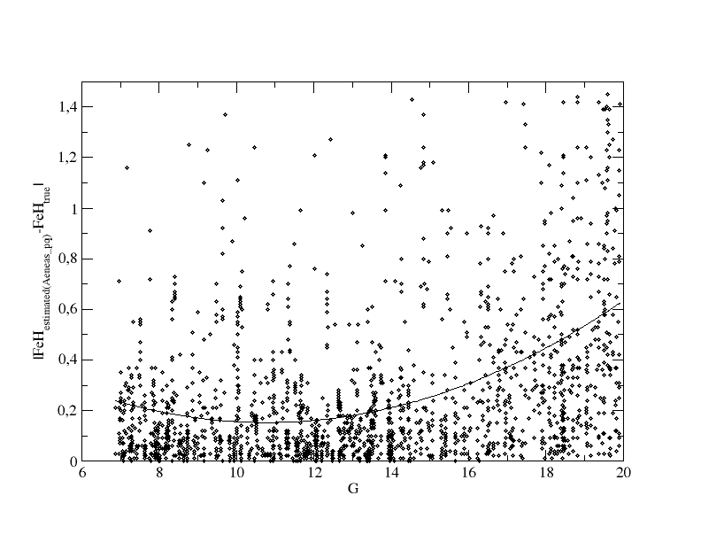
[Fe/H]
Aeneas-pq precision
|estimated values from Aeneaspq – true|
Caution: different vertical scale!
Liu et al. (2012), Antiche et al. (2012, in preparation)

Slide 62
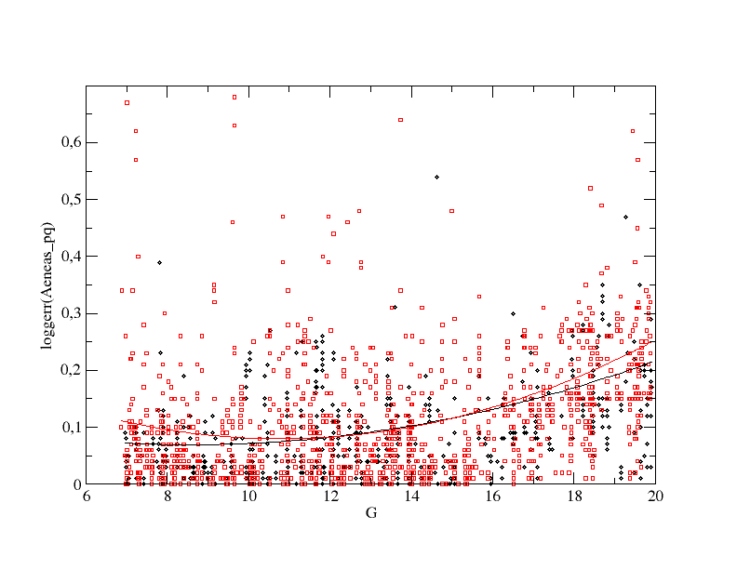
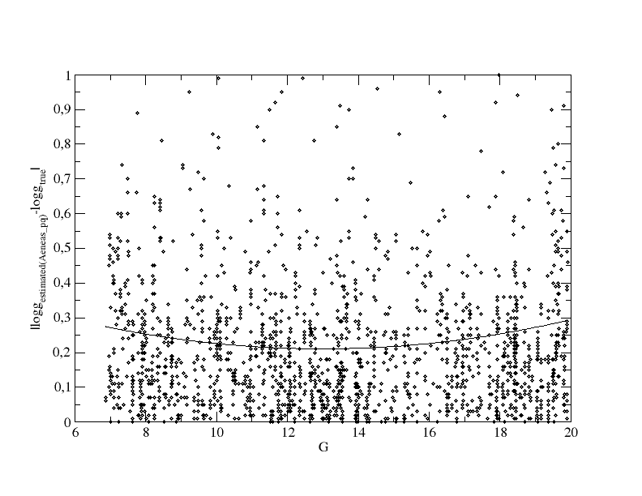
Log g
Aeneas-pq precision
|estimated values from Aeneaspq – true|
Caution: different vertical scale!
Liu et al. (2012), Antiche et al. (2012, in preparation)

Slide 63
References:
Antiche, E., Luri, X., et al., 2012 (in preparation)
Bailer-Jones, 2010, MNRAS, 403, 96
Bailer-Jones, C., 2011, 411, 435
Bastian, U., 2004, Gaia Livelink,
http://www.rssd.esa.int/SYS/docs/ll_transfers/project=PUBDB&id=2939027.pdf
Carrasco, J.M., Jordi, C., Figueras, F., et al., 2006, GAIA-C5-TN-UB-JMC-001-2
De Bruijne, J., Perryman, M., Lindegren, L., et al., 2005, JdB-022-2005
Jordi et al., 2010, Astron. Astrophys 523, 48
Liu, C., Baier-Jones, C.A.L., Sordo, R., et al., 2012, MNRAS (accepted) arXiv:1207.6005
Robin, A., Luri, X., Reylé, C., 2012, Astron. Astrophys. 543, 100
Sartoretti, P., Isasi, Y., 2011, GAIA-C2-TN-OPM-PS-011-1
Sartoretti, P., Katz, D. , Gomboc, A., 2007, GAIA-C6-TN-OPM-PS-006-I
Isasi, Y., Borrachero, R., Martinez, O., et al., 2010, GAIA-C2-UG-UB-YI-003-10

